Slide 1

Is it a square?
1)
2)
3)
4)

Slide 2
Is it a square?
1)
2)
3)
4)

Slide 3

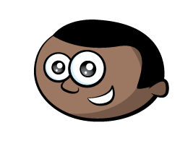
Rectangles
What properties does a rectangle have to have?
How many sides? How many vertices?

Slide 4
Rectangles

Slide 5
Triangles
What properties does a triangle have to have?
How many sides? How many vertices?

Slide 6
Pentagons
What properties does a pentagon have to have?
How many sides? How many vertices?

Slide 7
Do you think it was a triangle, a square, a rectangle or a pentagon?
Hmm, triangle, square, rectangle, pentagon.

Slide 8
Do you think it was a triangle, a square, a rectangle or a pentagon?
Hmm, triangle, square, rectangle, pentagon.

