Slide 1

How many does each tally represent?
a) b)
Draw tallies to show
a) 7 b) 11
3) Complete the tally chart.
Button Colour | Tally | Total
pink
blue
green

Slide 2
How many does each tally represent?
a) b)
Draw tallies to show
a) 7 b) 11
3) Complete the tally chart.
9
22
Button Colour | Tally | Total
pink
blue
green
3
6
4

Slide 3
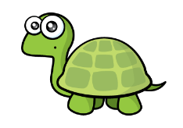

Key $=$ 1 shape
Shape
Square
Triangle
Decagon
Trapezium

Slide 4


Day | Minutes spent reading
Monday | 3
Tuesday | 10
Wednesday | 8
Key $=$ 1 minute reading
Day
Monday
Tuesday
Wednesday
Have a think
Do you think this pictogram is correct?

Slide 5
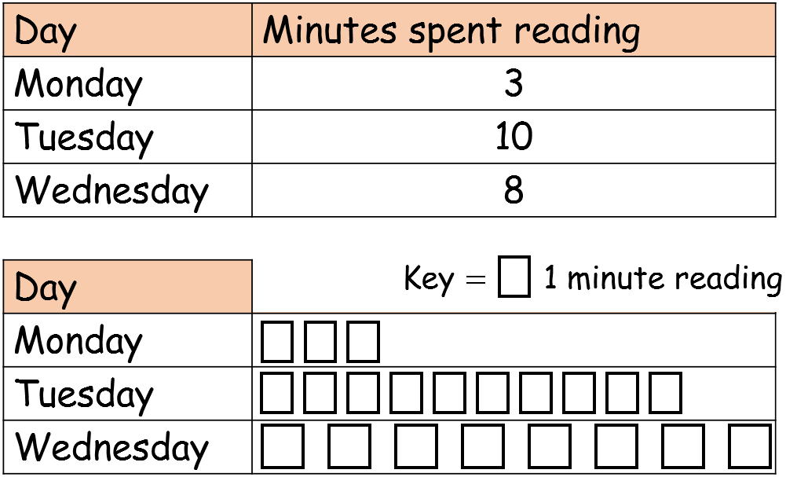
Key $=$ 1 minute reading
Day
Monday
Tuesday
Wednesday
Each symbol needs to be the same size so we can compare the information easily.

Slide 6





Key $=$ 1 relative called
Relatives
Grandmas
Uncles
Cousins
And twice as many uncles as grandmas!
We’ve called 5 grandmas!
We’ve been video calling our relatives
But one less cousin than uncles
How could we show the number of family members called in a pictogram?

