Slide 1


Week 1
Annie
Eva
Ron
Mo
Week 2
Annie
Eva
Ron
Mo
Key $=$ 1 piece of fruit
Who ate the most pieces of fruit in week 1?
Who ate the least fruit overall?
What was the difference in amount of fruit between week 1 and week 2 for Ron?
Did Ron have the biggest difference?

Slide 2
Week 1
Annie
Eva
Ron
Mo
Week 2
Annie
Eva
Ron
Mo
Key $=$ 1 piece of fruit
Who ate the most pieces of fruit in week 1?
Who ate the least fruit overall?
What was the difference in amount of fruit between week 1 and week 2 for Ron?
Did Ron have the biggest difference?
Mo
Ron
0
No, Annie had a difference of 5

Slide 3
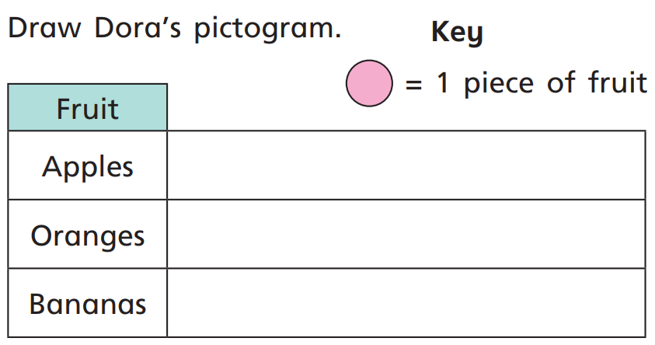


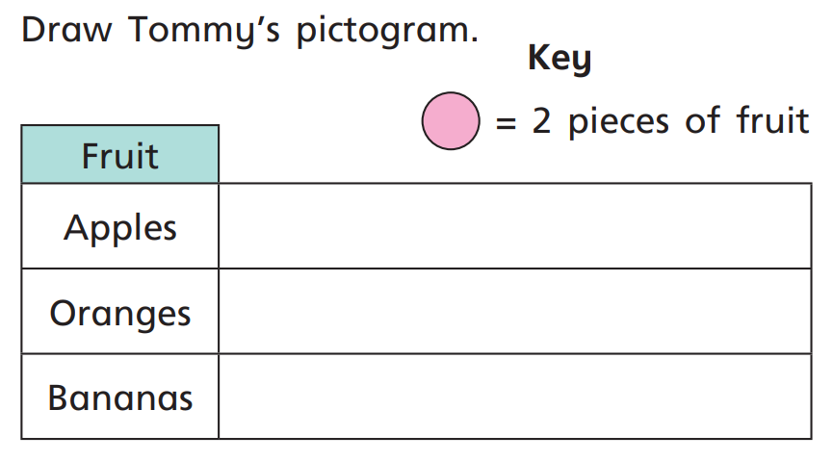

Tell your partner how many pieces of fruit.

Slide 4






?
10
Key $=$ __ relatives called
Relatives
Grandmas
Uncles
Cousins
And twice as many uncles as grandmas!
We’ve called 20 grandmas!
The whole class have been video calling our relatives
But five fewer cousins than uncles

Slide 5



10
Key $=$ __ relatives called
Relatives
Grandmas
Uncles
Cousins
Have a think
10
5
Key $=$__ relatives called
Relatives
Grandmas
Uncles
Cousins
How would you show the same information when each symbol represents 5 relatives?
Notes:
What do you notice about the two pictographs?

Slide 6


Day | Minutes spent reading
Monday | 20
Tuesday | 25
Wednesday | 10
Thursday | 15
Friday | 30
Saturday | 55
Sunday | 45
10
Have a
think
Key = ________ minutes
5
Key = ________ minutes
What could the key be? What will you have to consider?

Slide 7

Key $=$ 10 minutes
Monday
Tuesday
Wednesday
Thursday
Friday
Saturday
Sunday
Have a think
On which day did Alex read the most and by how much?
Saturday, by 10 minutes

