Slide 1
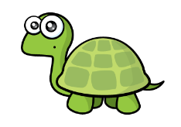
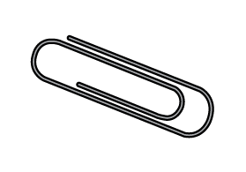
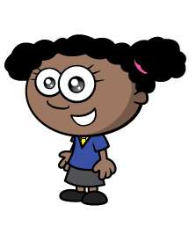
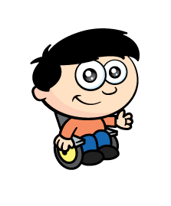
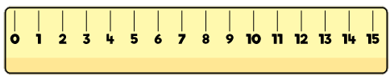
What can we use to measure?

Slide 2
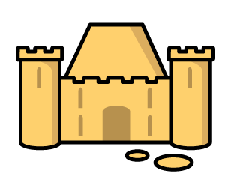
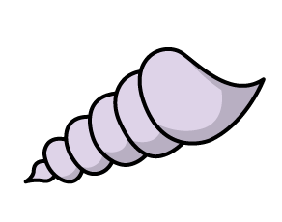
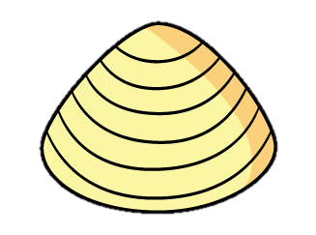
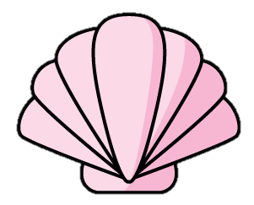
Why use a ruler?
?
?
?
The sandcastle is 4 shells long.
No confusion!

Slide 3


Why use a ruler?
Have a think
To measure and compare
different objects.

Slide 4
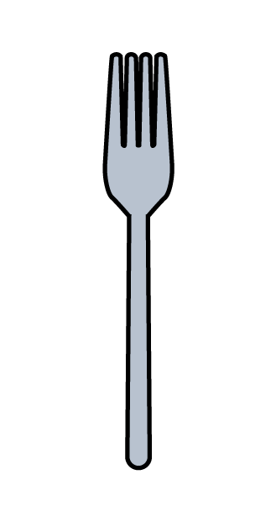
Why use a ruler?
Have a think
There are no spaces.

Slide 5
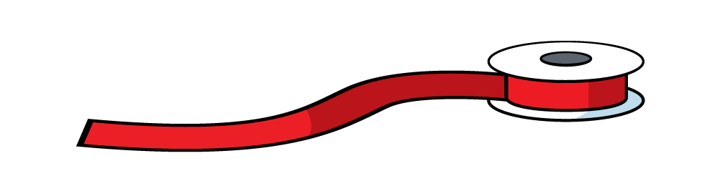
Why use a ruler?
Have a think
People talk about length using rulers.

Slide 6
Can you find a ruler?
What is the same? What is different?

Slide 7
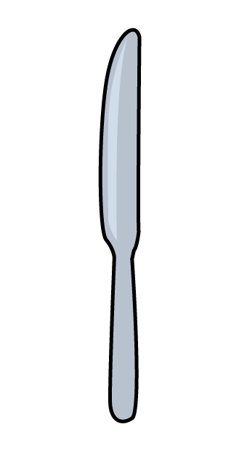
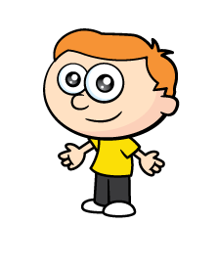
Be careful!
Have a think
Mind the gap!

Slide 8
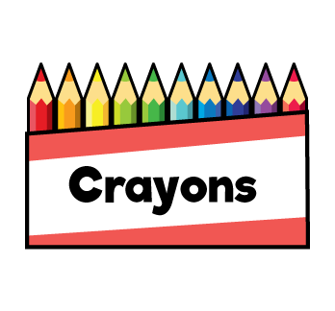
Where can you start?
Have a think
5
Any number!

Slide 9
Can you measure your crayons?

Slide 10
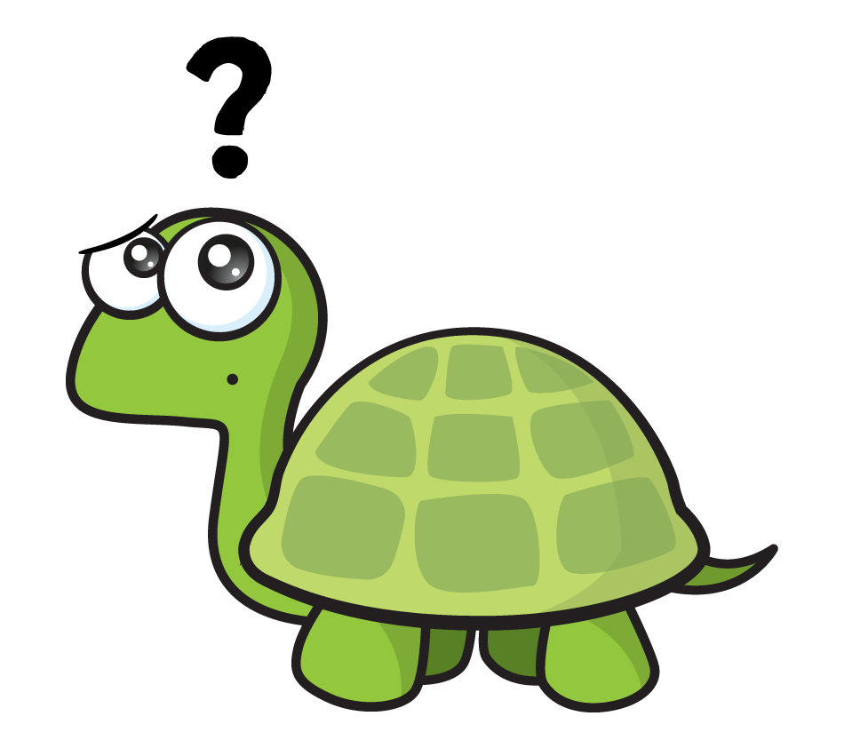
What if it isn’t perfect?
Have a think
Closest to…
Almost…

Slide 11
Can you measure your pencil?
Can you start from different spots?

