Slide 1
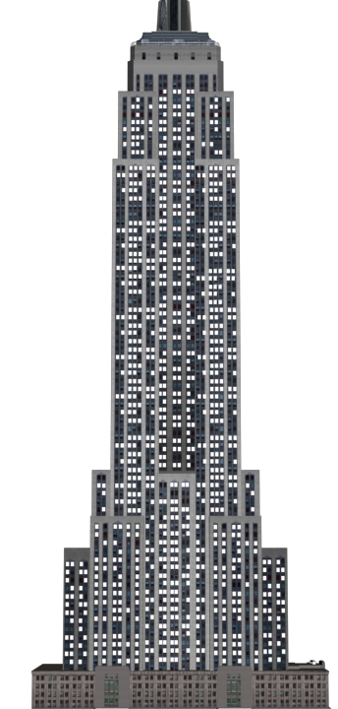

Horizontal or Vertical?
1) Is this building stretching up horizontally or vertically?
2) Is the line of the horizon
horizontal or vertical?
3) Do elevators travel
horizontally or vertically?

Slide 2
Horizontal or Vertical?
1) Is this building stretching up horizontally or vertically?
2) Is the line of the horizon
horizontal or vertical?
3) Do elevators travel
horizontally or vertically?
Vertically
Horizontal
Vertically

Slide 3
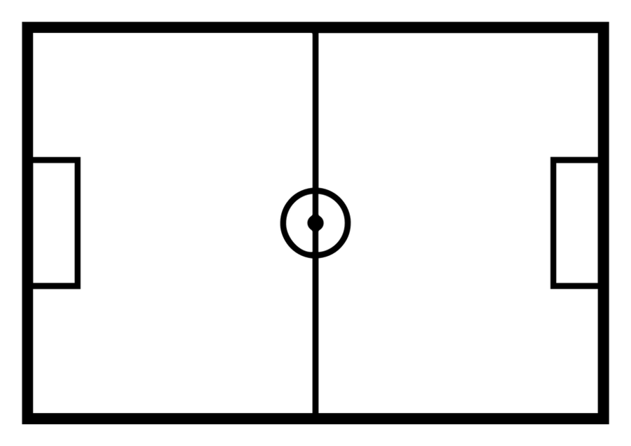
What is a vertical line of symmetry?
What do you notice about both sides of the shape either side of the symmetry line?

Slide 4
What do you notice about both sides of the shape either side of the symmetry line? Is this symmetrical?

Slide 5
What do you notice about both sides of the shape either side of the symmetry line? Is this symmetrical?

Slide 6

Have a think
Which of these shapes are symmetrical? How do you know?

Slide 7


Hey, one of us has made a mistake
Have a think
What do you think of this statement? Do you agree? Explain how you know.

