Slide 1

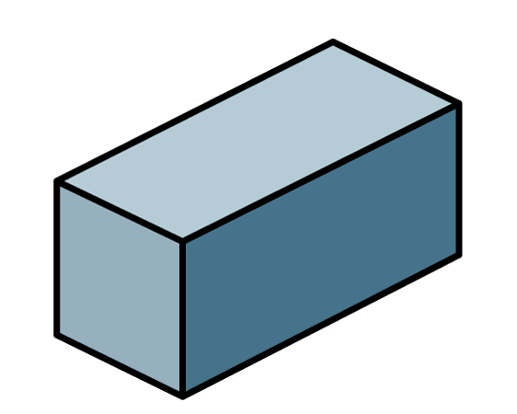
1) Which is a 2-D shape?
2) Which is a 3-D shape?
3) Which word would come next?
Up, down, up, down, up, down, up, down, ____

Slide 2
1) Which is a 2-D shape?
2) Which is a 3-D shape?
3) Which word would come next?
Up, down, up, down, up, down, up, down, ____
up

Slide 3



What are patterns?
What do you notice?
Is this a pattern?
Where have you seen patterns?
Describe the patterns to your partner.
Notes:
Patterns can be repeating objects
Say the shapes outloud

Slide 4

What objects are repeating?
What comes next?
?
I know what comes next if I say the pattern.

Slide 5




Have a
think
Which parts of the pattern repeat? What would come next?

Slide 6
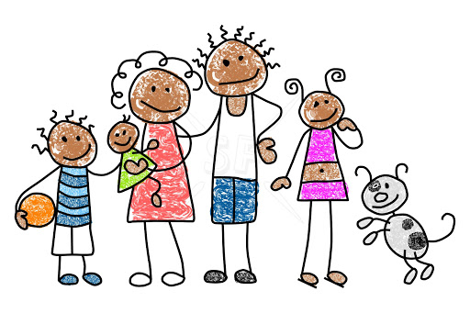
Have a think
Which parts of the pattern repeat? What would come next?
Notes:
Can be backwards and forwards

Slide 7

Will you draw me a pattern that goes: rectangle, square, triangle, then repeats please
What will the 11th shape in the pattern be?
A square
Have a think

Slide 8
Which objects are repeating?
What has been knocked out of place?
?
?
Have a think

Slide 9
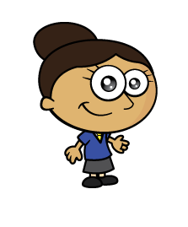
Have a think
Which parts of the pattern repeat? What would come next?

Slide 10
Which parts of the pattern repeat? What would come next?

Slide 11
Have a think
Which parts of the pattern repeat? What would come next?

