Slide 1
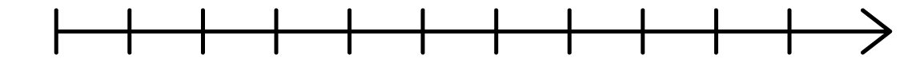
What does the number line with orange blocks show?
What is the same about the two number lines?
What is different about the two number lines?
0
1
2
0
3
1
4
2
5
3
6
4
7
5
8
6
9
7
10
8
9
10
0
1
2
3
4
5
6
7
8
9
10

Slide 2
What does the number line with orange blocks show?
What is the same about the two number lines?
What is different about the two number lines?
4
Both ascend in 1s
Both show 4
The colour of the cubes
One is vertical and one is horizontal
0
1
2
0
3
1
4
2
5
3
6
4
7
5
8
6
9
7
10
8
9
10
0
1
2
3
4
5
6
7
8
9
10

Slide 3







Key $=$ 1 cube
Colour | Cubes
Green
Yellow
Red
Let’s make real towers using cubes

Slide 4
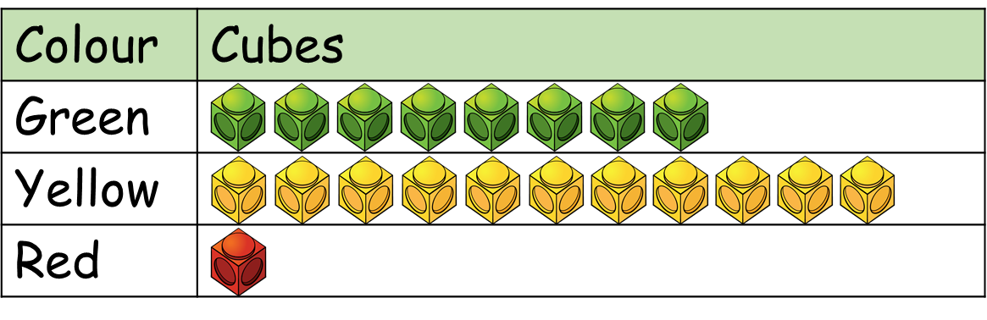
Key $=$ 1 cube
We can take the symbols off the pictogram (making sure they represent 1) and place them in a block.

Slide 5
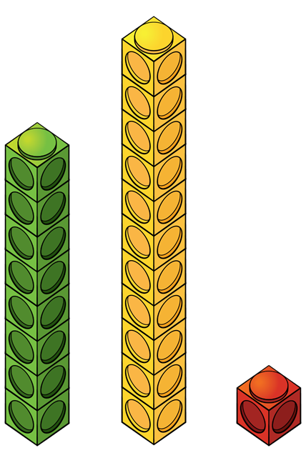
11
10
9
8
7
6
5
4
3
2
1
Green
Red
Yellow
We can place these blocks into a graph. A graph has two axis. The ‘x’ axis which shows us the different colours, and the ‘y’ axis which shows us how many.
Notes:
Instead of a key we have a scale

Slide 6










Slide 7


Rosie and Teddy
Colour | Balloons
Red
Green
Key $=$ 10 balloons
Interpret the data first. How many of each balloon?
20
15
10
5
0
Red
Green
As the numbers are quite large, we can record the total amount of each colour using a scale of 5.

Slide 8

Rosie and Teddy
Colour | Balloons
Red
Green
Key $=$ 10 balloons
Have a think
20
15
10
5
0
Red
Green

