Slide 1
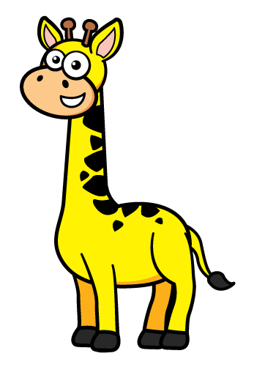
These words help us compare heights:
short
tall
height
same
shorter
tallest
shortest
taller

Slide 2
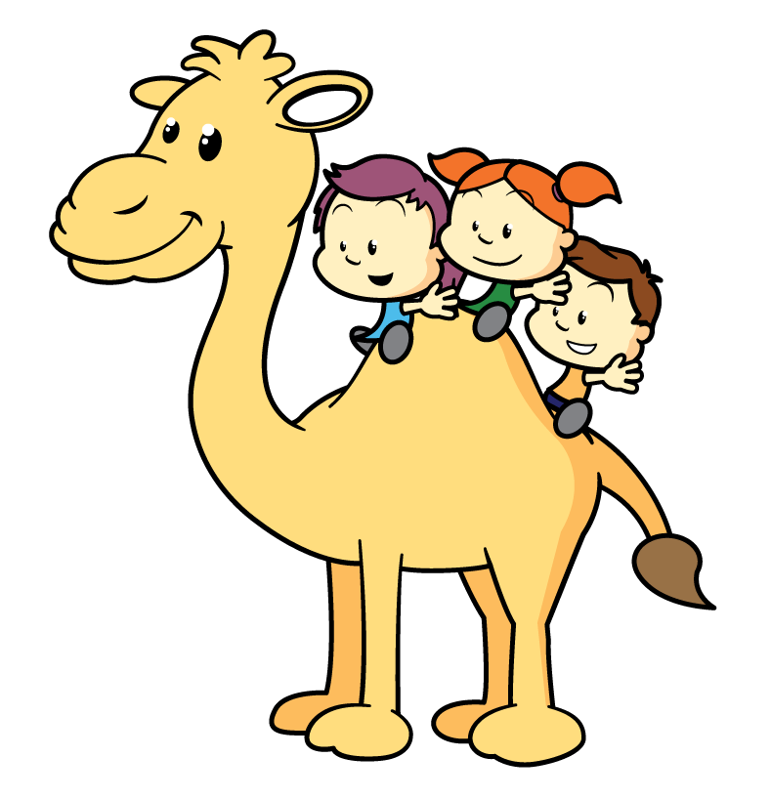
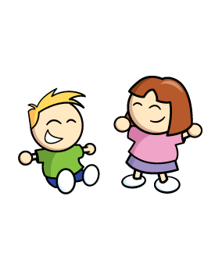
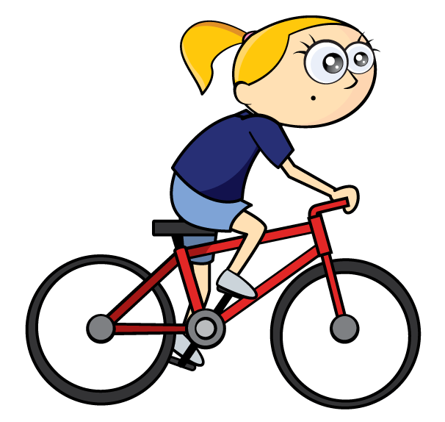
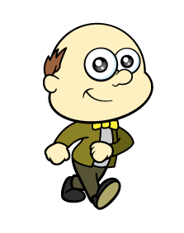
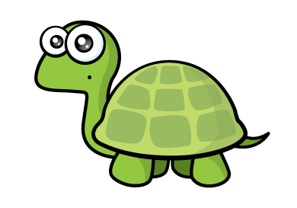
Who is tallest?
Do you think Tiny is correct?
I can see who is tallest!
Remember to stand up straight.

Slide 3


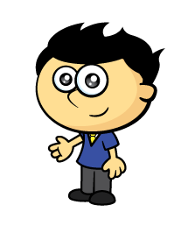
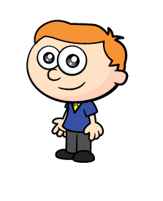

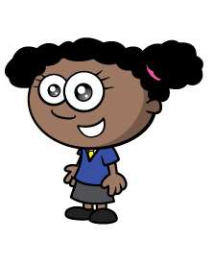
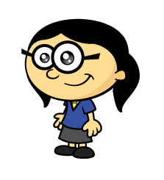
Who is the tallest?
Have a think
How can we compare?
Remember to stand up side by side.

Slide 4
Who is the shortest?
Have a think
How can we compare?
Remember to stand up side by side.

Slide 5
Have a think
How tall are you?
Can you find someone taller?
Can you find someone shorter?

Slide 6
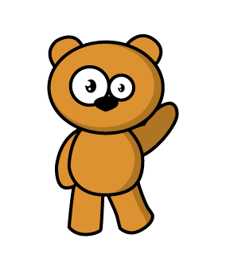
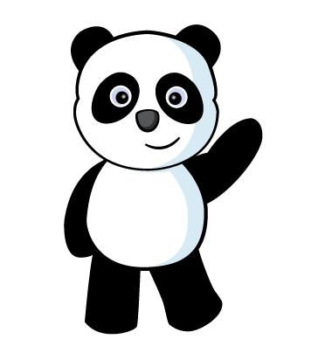

Have a think
Let’s compare!
I can see they are the SAME height.
Panda is shorter than
the brown bear.

Slide 7
Can you find 3 things shorter than you?

Slide 8
Can you find 3 things taller than you?

Slide 9
Can you find 3 things the same height as you?

