Slide 1


1) Which symbol means ‘is equal to’?
2) Which symbol means ‘is greater than’?
3) Which symbol means ‘is less than’?
4) What is the correct symbol?
>
<
=
>
<
=
>
<
=

Slide 2
1) Which symbol means ‘is equal to’?
2) Which symbol means ‘is greater than’?
3) Which symbol means ‘is less than’?
4) What is the correct symbol?
>
<
=
>
<
=
>
<
=
>

Slide 3



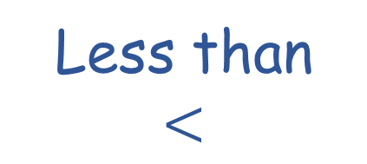
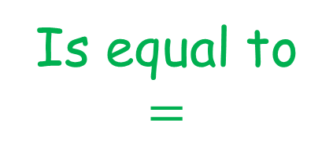
What do we say when we compare objects?
Fewer
Is equal to
$$=$$
More
Less than
$$<$$
Greater than
$$>$$

Slide 4

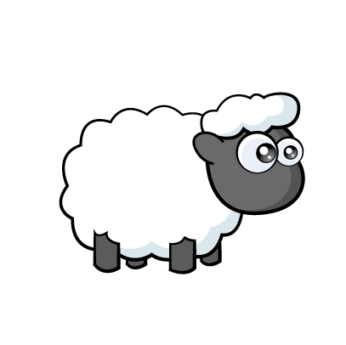
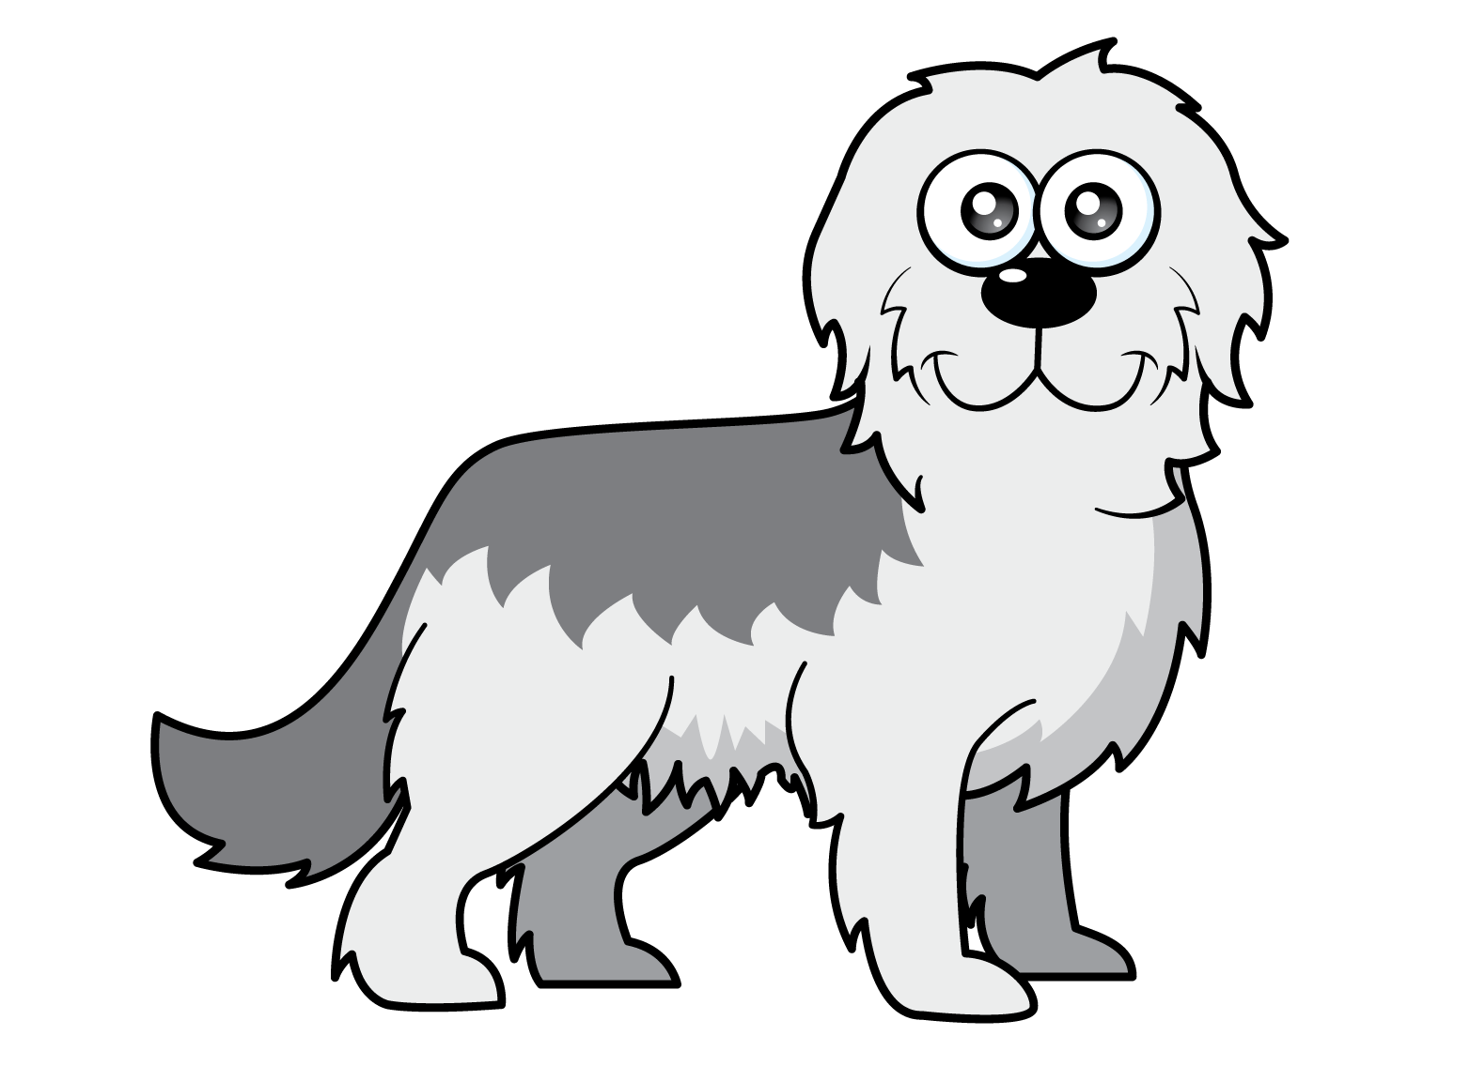
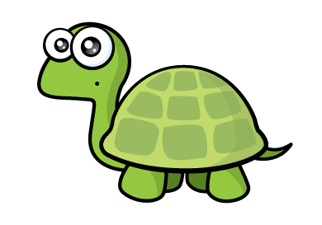
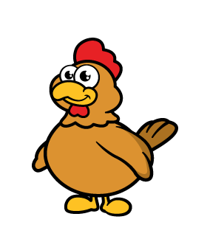
Let’s compare animals!
10
9
16
13
The number of is greater than
the number of
v

Slide 5
Let’s compare animals!
10
9
16
13
The number of is less than
the number of

Slide 6
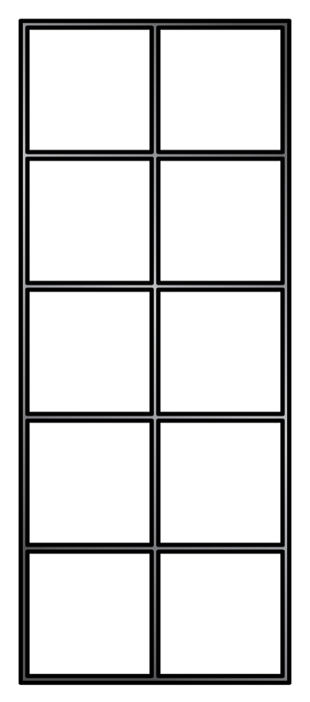



How can we compare objects?
There are 18 donuts
Have a think
There are 19 biscuits
There are fewer than
There are more than

Slide 7
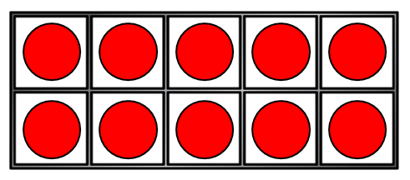
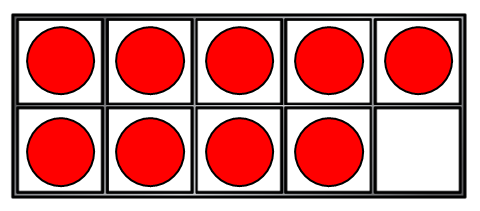
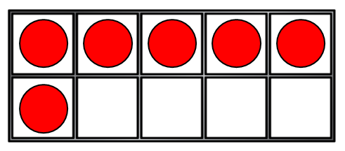
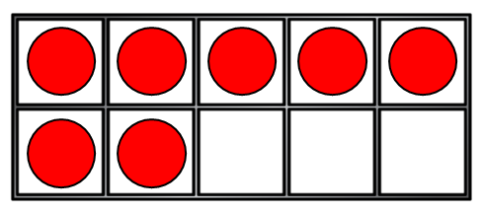
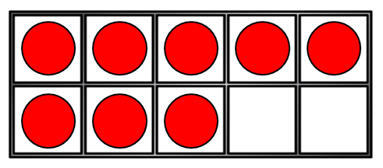
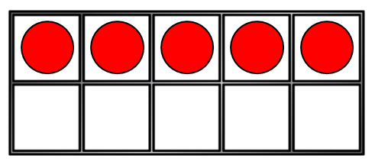
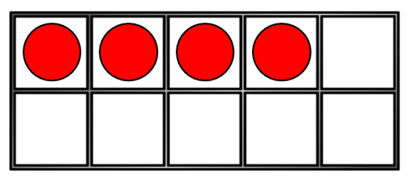
Let’s compare!
Have a think
16
=
16
13
<
14

Slide 8
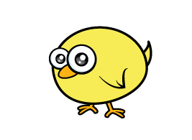
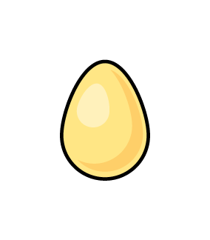
Have a think
There are 30 chicks.
There are 28 eggs.
There are more chicks than eggs.
How many eggs could there be?
26, 27, 28, 29

