Slide 1




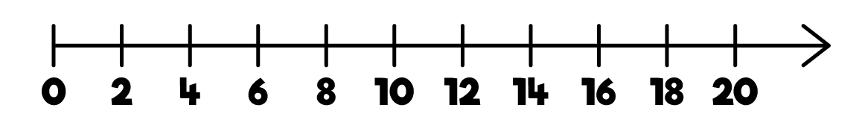
1) How many socks?
2) How many?
3) What is missing? 12, 10, 8, ___
4) What is missing?

Slide 2
1) How many socks?
2) How many?
3) What is missing? 12, 10, 8, ___
4) What is missing?
8
14
6

Slide 3
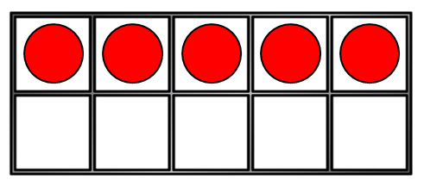
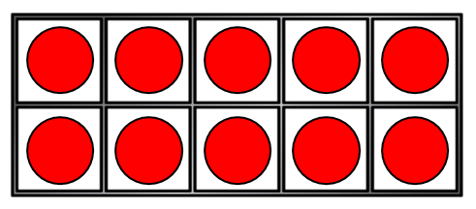
How many counters?
5
10
15
20
25

Slide 4
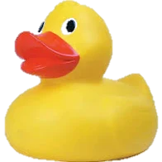
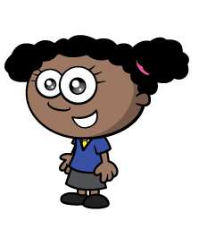
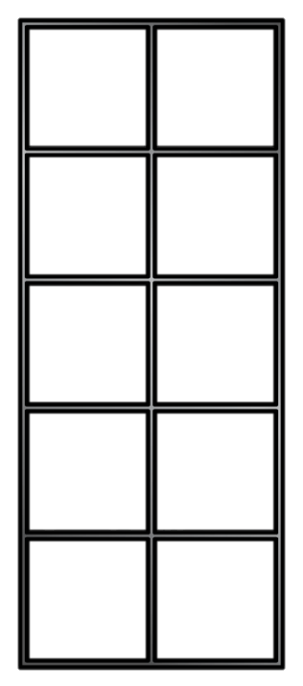
I am going to count by 5s!
5, 10, 15, 20, 25
There are 25 ducks.
How many ducks?

Slide 5


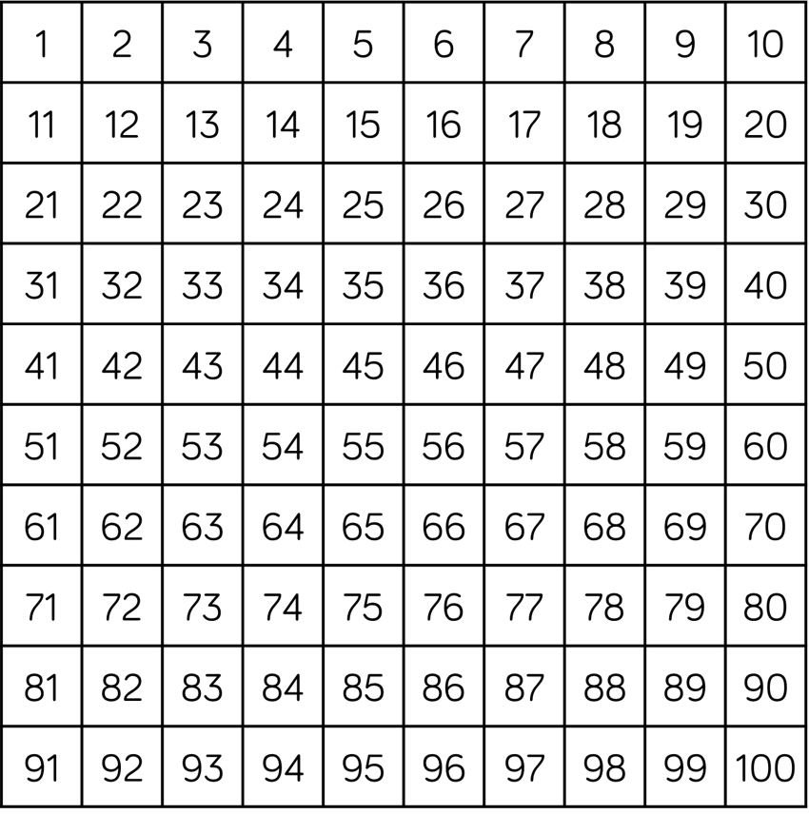
Have a think
There are 5 pears in each bag.
There are 9 bags.
There are 45 pears.

Slide 6

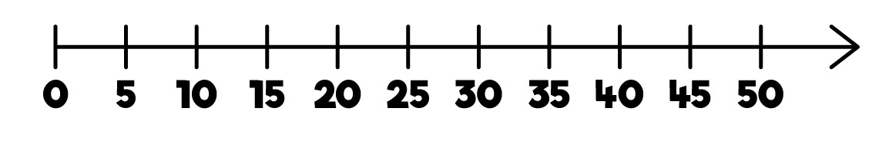
Can you count on in 5s,
starting at 20?

Slide 7


How many pencils?
30
How many chocolates?
20
Have a think

Slide 8
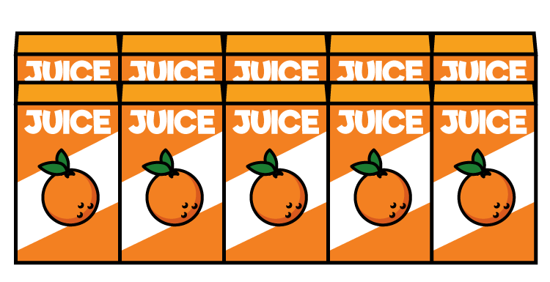
How many juice boxes did the children drink?

Slide 9
What numbers are missing?
25
15 | 20 | ? | 30 | 35 | 40 | 45 | ?
50

Slide 10


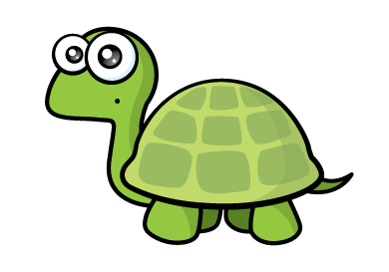
What numbers did they both count?
I counted by 2s
to 50!
I counted by 5s
to 50!
You both counted
10, 20, 30, 40, 50!

