Slide 1
Which one of these is the odd one out? There is no one correct answer, so make sure you explain your thinking clearly.
Notes:
3 side
2 long sides the same length and 2 shorter sides the same length
Without a right angle
All sides the same

Slide 2
Which one of these is the odd one out?
Notes:
3 side
2 long sides the same length and 2 shorter sides the same length
Without a right angle
All sides the same

Slide 3

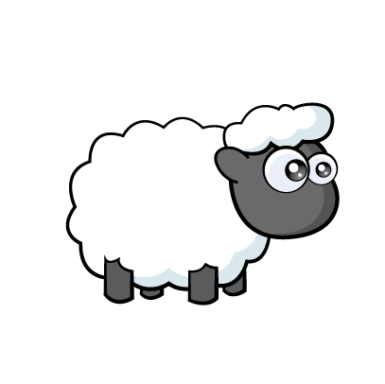
Annie has some sheep.
I can keep them in with two straight lines!
Do you think Annie is correct? Explain your thinking.

Slide 4
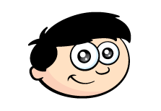

Annie is drawing 2D shapes.
Can I draw a 2D shape with two straight lines?
Have a think
Do you think Annie is correct? Explain your thinking.

Slide 5
Who is correct?
This shape has 3 vertices
No, this shape has 3 sides
Have a think

Slide 6
Who is correct?
This shape has 3 vertices
No, this shape has 3 sides

Slide 7
Are all shapes with
3 sides triangles?
Yes, they are all triangles
Have a think

Slide 8
Number of sides
Have a think
Notes:
She thinks that’s a lot

Slide 9
Number of sides
6 sides
6 sides
12 sides
Notes:
She thinks that’s a lot

Slide 10

Have a think
Pentagon
Rectangle
Square
Triangle
Hexagon
1
1
1
3
5
Which shapes did Tommy use?

