Slide 1
Which tally chart is correct?
Why are the others incorrect?
Children | Amount of smiles
Bella | 6
Isla | 4
Theo | 10
Bella
Isla
Theo
Bella
Isla
Theo
Bella
Isla
Theo
Bella
Isla
Theo

Slide 2
Which tally chart is correct?
Why are the others incorrect?
Children | Amount of smiles
Bella | 6
Isla | 4
Theo | 10
Bella
Isla
Theo
Bella
Isla
Theo
Bella
Isla
Theo
Bella
Isla
Theo

Slide 3
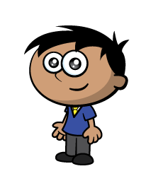
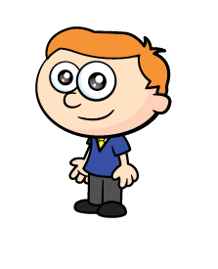

Ron and Amir have been tallying animals they saw on their walk.
Can you help to complete the tally chart?
Animals | Tally | Total
Birds
Alpacas
Dogs
Horses
10
2
6
4
Have a think

Slide 4
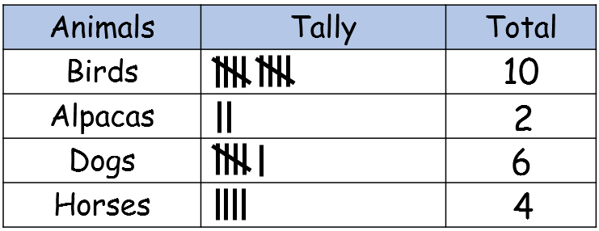
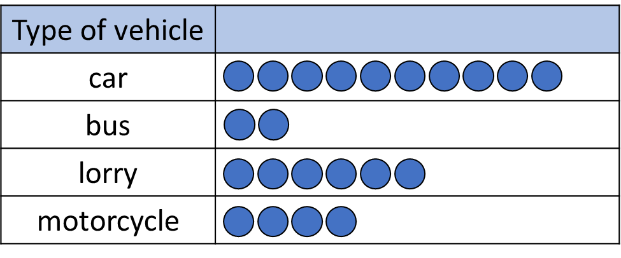
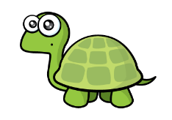
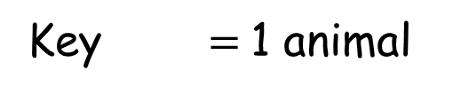
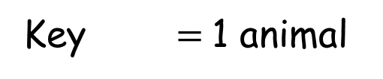
They use their tally to draw pictograms.
Key $=$1 animal
Animals
Birds
Alpacas
Dogs
Horses
Key $=$1 animal
Amir hasn’t drawn circles.
Animals
Birds
Alpacas
Dogs
Horses

Slide 5
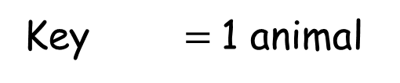
Either go on a walk or use my virtual walk, or both!
Key $=$1 animal
Animals
Birds
Frogs
Octopuses

Slide 6

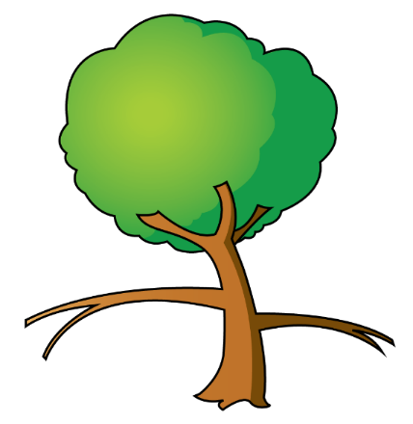


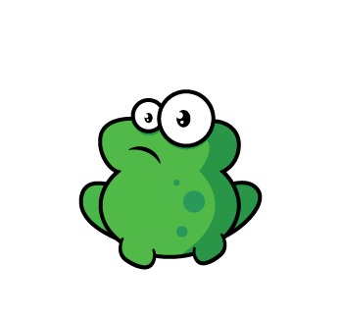
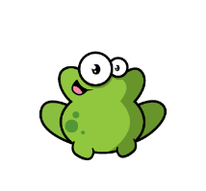
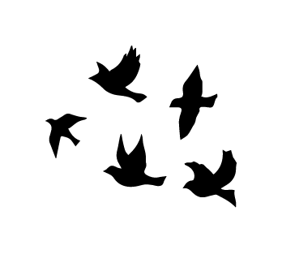
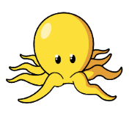

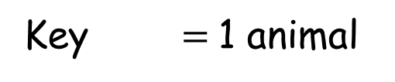
Animals
Birds
Frogs
Octopuses
Key $=$1 animal

Slide 8
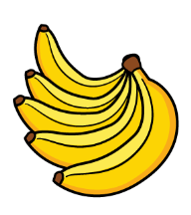
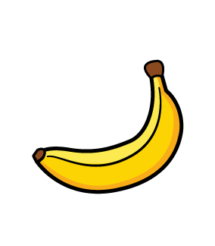
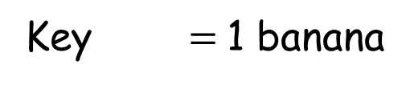
How many bananas?
Key $=$1 banana
Children
Alex
Rosie
Mo
Amir

Slide 9
How many bananas does each child have?
Have a think
Who has the most bananas?
Who has the least bananas?
How many bananas were there altogether?
Key $=$1 banana
Children
Alex
Rosie
Mo
Amir

Slide 10
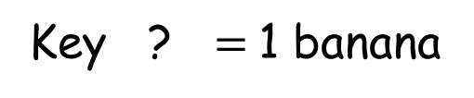
How many bananas does each child have?
Who has the most bananas?
Who has the least bananas?
How many bananas were there altogether?
Have a think
Key ? $=$1 banana
Children
Charlotte
Poppy
Noah
Oliver

