Slide 1


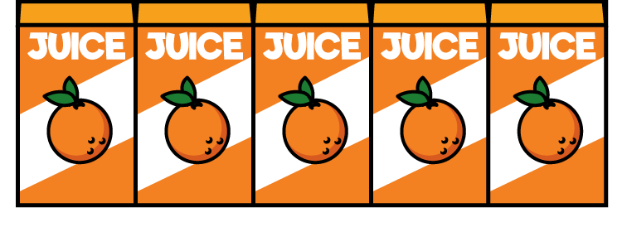
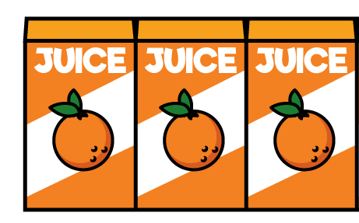
How many is represented here?
1)
2)
3)

Slide 2
How many is represented here?
1)
2)
3)
10
25
13

Slide 3



Teddy is drawing a tally chart while his mum unpacks the shopping.
How many bananas Mum?
5 altogether Teddy dear

Slide 4



Each object is marked with a line.
What happens when we get 5 objects?
Why do you think we group objects in 5’s?

Slide 5




Draw a tally for these amounts of fruit
Have a think

Slide 6
Draw a tally for these amounts of fruit

Slide 7
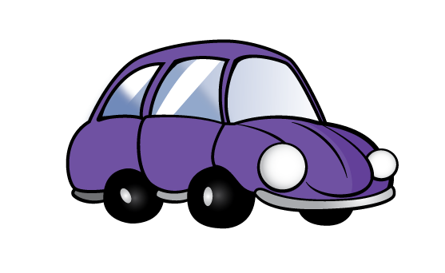


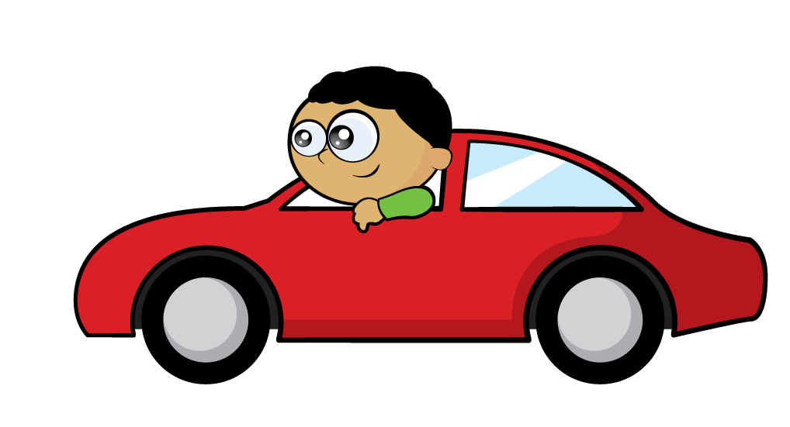
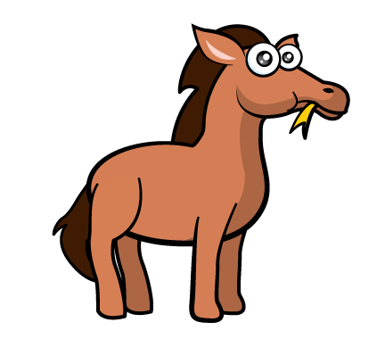
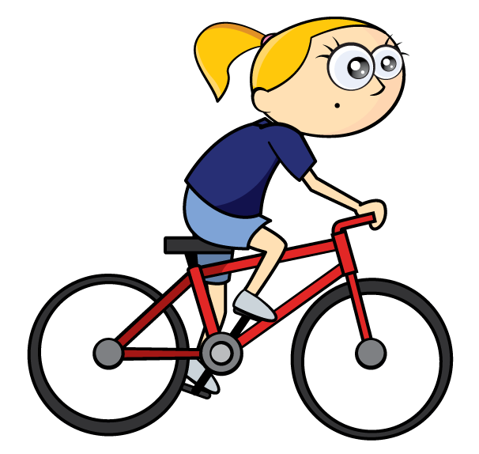

Tally
Cars
Bikes

Slide 8


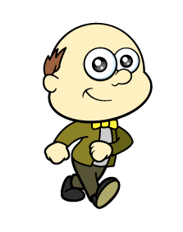

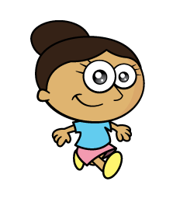



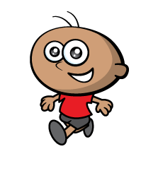



Tally
Adults
Children
Have a
think

Slide 9
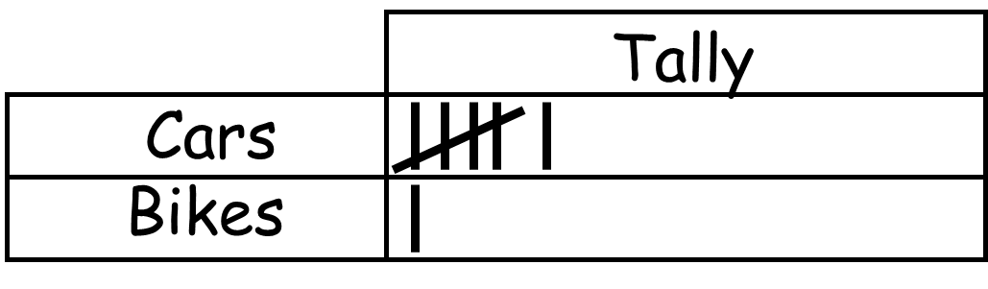
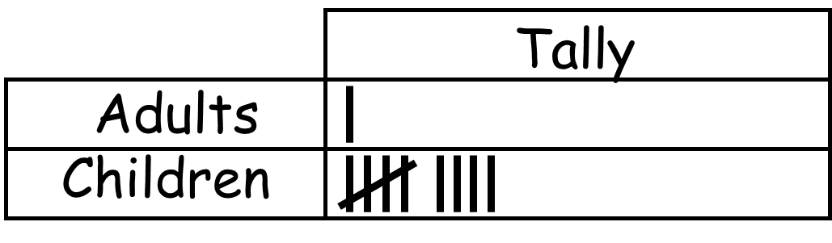
Make a tally and record what you see out of your window or the people you see at school

Slide 10


Sport Tally Total
Running 6
Football 3
Tennis 11
Can you tally the correct number for each sport?

Slide 11






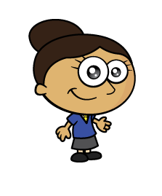


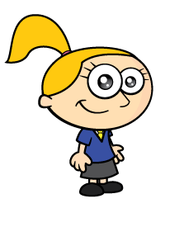


Make a tally of children’s favourite fruit
Fruit Tally Total

Slide 12
Make a tally of children’s favourite fruit
Fruit Tally Total
Oranges
Pears
Grapes
5
10
13

