Slide 1
1) What comes next? 27, 28, 29, ___
2) What comes next? 43, 42, 41, ___
3) 43 is one more or less than 44
4) 31 is one more or less than thirty

Slide 2
30
1) What comes next? 27, 28, 29, ___
2) What comes next? 43, 42, 41, ___
3) 43 is one more or less than 44
4) 31 is one more or less than thirty
40

Slide 3
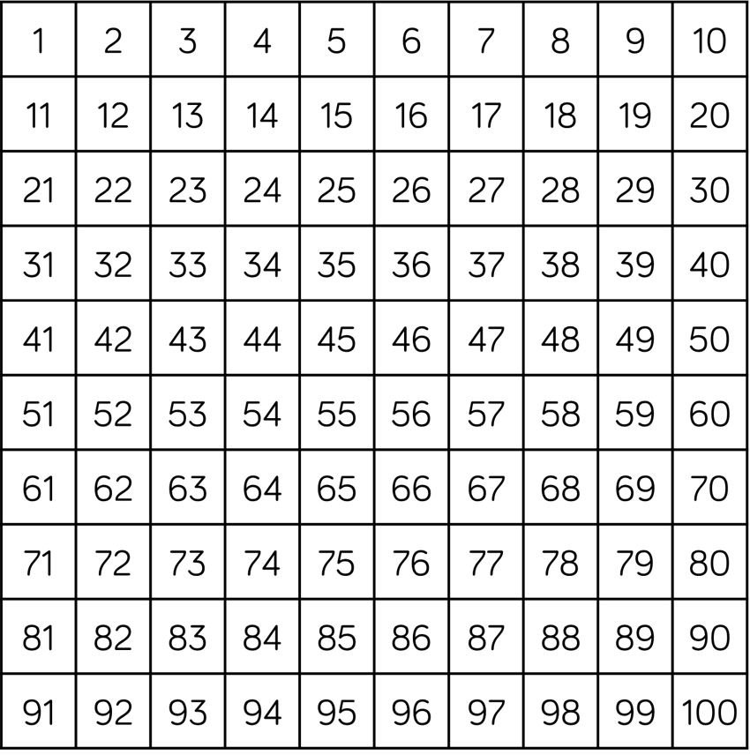

Can you find ….
Have a think
47
One more than 46?
20
One less than 21?
33
One less than 34?
41
One more than 40?

Slide 4
Have a think
24
25 is one more than
10
11 is one more than
49
48 is one less than
20
19 is one less than

Slide 5
One ten is equal to 10 ones.
=

Slide 6
What is one more?
One more than 19 is 20

Slide 7
What is one more?
One more than 19 is 20

Slide 8
What is one more?
One more than 19 is 20
One more than 29 is 30

Slide 9
What is one more?
One more than 19 is 20
One more than 29 is 30
One more than 39 is 40

Slide 10
What is one more?
One more than 19 is 20
One more than 29 is 30
One more than 39 is 40
One more than 49 is 50

Slide 11
What is one less?
One less than 50 is 49

Slide 12
What is one less?
One less than 50 is 49
One less than 40 is 39

Slide 13
What is one less?
One less than 50 is 49
One less than 40 is 39
One less than 30 is 29

Slide 14
What is one less?
One less than 50 is 49
One less than 40 is 39
One less than 30 is 29
One less than 20 is 19

Slide 15
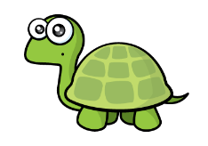

Only the ones change!
One less than 34 is 33
Actually, not always.
One less than 40 is 39

