Slide 1
1) What comes next? 13, 14, 15, ___
2) What comes next? 13, 12, 11, ___
3) Nineteen is one more or less than twenty
4) Twelve is one more or less than thirteen

Slide 2
16
1) What comes next? 13, 14, 15, ___
2) What comes next? 13, 12, 11, ___
3) Nineteen is one more or less than twenty
4) Twelve is one more or less than thirteen
10

Slide 3




Finding one more is like
adding one!
I will give you one more straw!
I have 3 tens
and 2 ones
One more than 32 is 33

Slide 4
Finding one less is like
subtracting one!
I will take away one straw!
I have 3 tens
and 2 ones
One less than 32 is 31

Slide 5



What is one more?
One more than 15 is 16
15 is made up of ____ ten and ____ ones.
One more than 15 is _____.

Slide 6
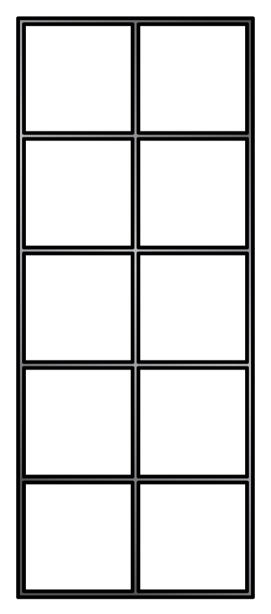

What is one more?
One more than 29 is 30
29 is made up of ____ tens and ____ ones.
One more than 29 is _____.

Slide 7

What is one less?
One less than 28 is 27
28 is made up of ____ tens and ____ ones.
One less than 28 is _____.

Slide 8
What is one less?
One less than 40 is 39
40 is made up of ____ tens and ____ ones.
One less than 40 is _____.

Slide 9

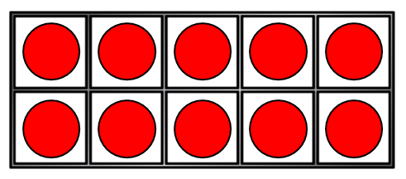
Have a think
Let’s build 23
and find one more
One more than 23 is 24
23 is made up of ____ tens and ____ ones.
One more than 23 is _____.

Slide 10
Have a think
Let’s build 48
and find one less
One less than 48 is 47
48 is made up of ____ tens and ____ ones.
One less than 48 is _____.

