Slide 1


1) How many?
2) What comes next? 36, 37, 38, 39 ___
3) Which is equal to 5 tens?
fifty or fifteen
4) What comes next? 32, 31, 30, ___

Slide 2
1) How many?
2) What comes next? 36, 37, 38, 39 ___
3) Which is equal to 5 tens?
fifty or fifteen
4) What comes next? 32, 31, 30, ___
34
40
29

Slide 3
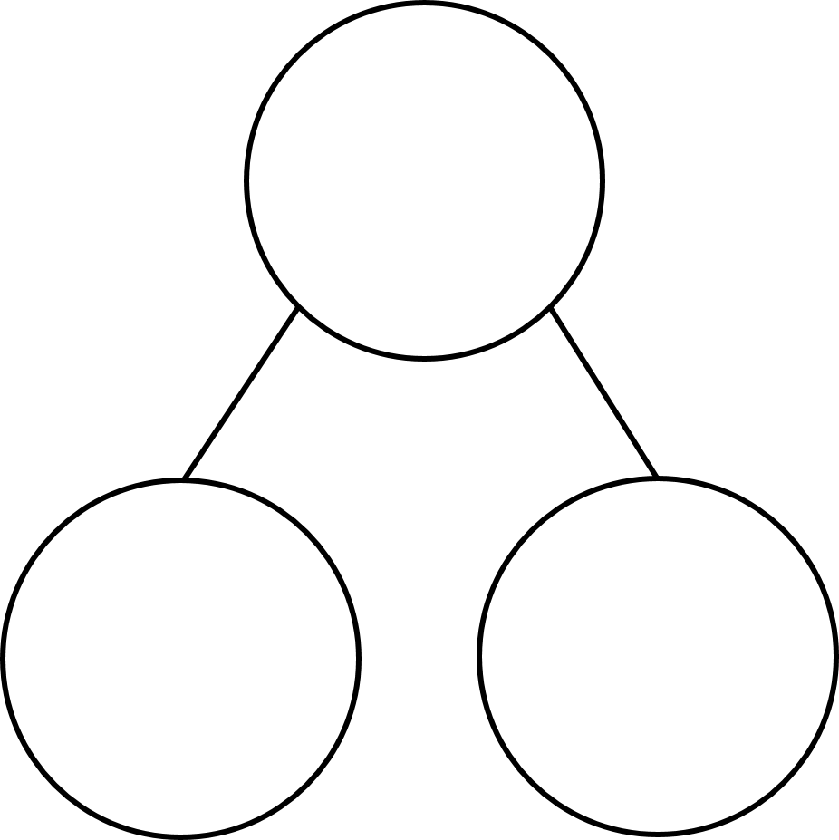
Part whole model
16
1 ten and 6 ones =
16
A part of ___ and a part of _____ makes a whole of _____

Slide 4

Part whole model
Have a think
38
3 tens and 8 ones =
38
A part of ___ and a part of _____ makes a whole of _____

Slide 5
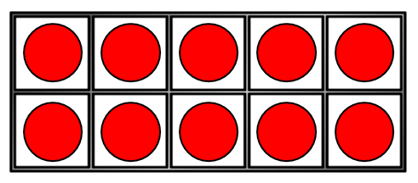
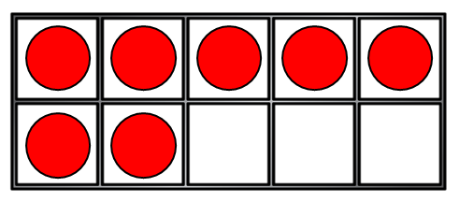
Part whole model
27
2 tens and 7 ones =
27
A part of ___ and a part of _____ makes a whole of _____

Slide 6


Part whole model
Have a think
41
4 tens and 1 one =
41
A part of ___ and a part of _____ makes a whole of _____

Slide 7
Representing numbers to 50
13
thirty
31

Slide 8
What is missing?
Have a think
35
23
50

