Slide 1



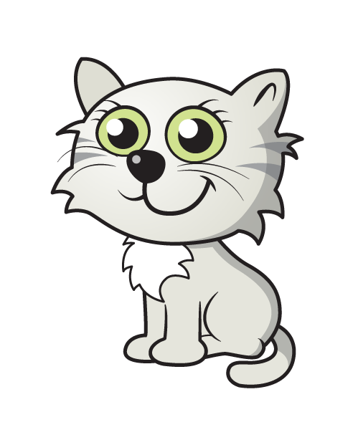

Have a think
How many?

Slide 2




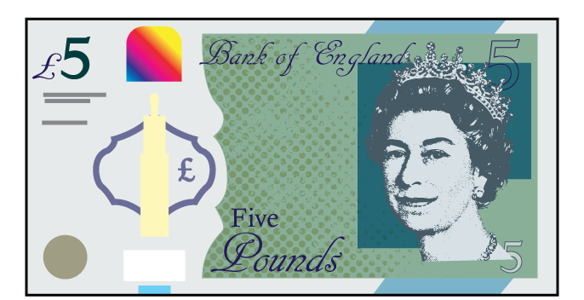

Have a think
Why count in 5s?
Can you think of objects which come in 5’s?

Slide 3

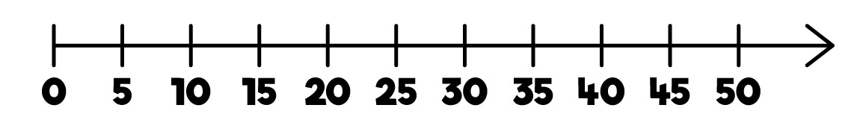
Have a think
Can you count in 5s with your
fingers and thumbs?
Use the number line to count in steps of 5.

Slide 4
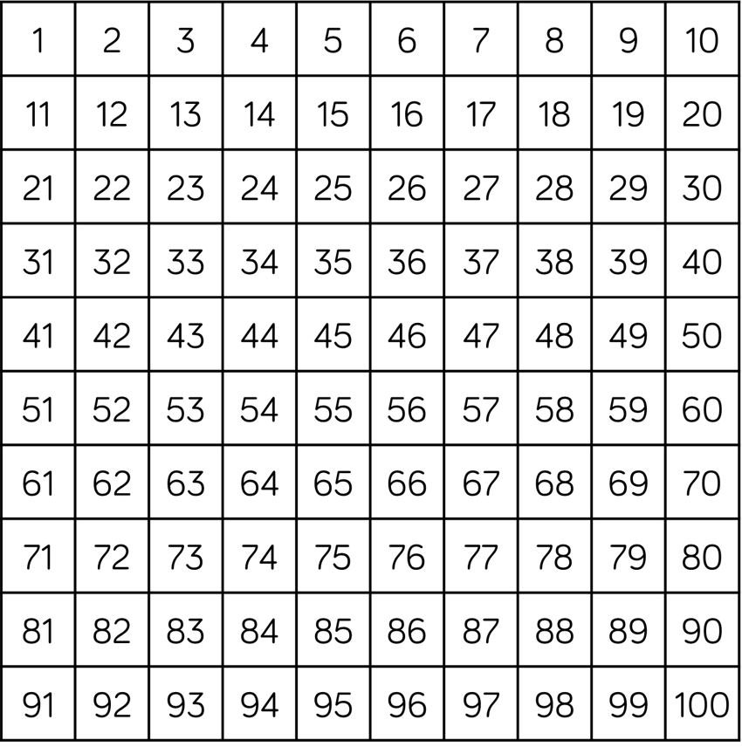
Have a think
Try counting backwards in 5s!
Which numbers will you say? Count along as they become highlighted on the number square.

Slide 5
Have a think
What patterns can you see?
What do you notice about the positions of the digits? What about the columns? rows?

