Slide 1


Slide 3


Which representations show 100?
Have a think
20 | 20 | 20 | 20 | 20

Slide 5


How many different ways can you represent 100?
Use your representations to divide 100 into 2 equal groups
Now divide 100 by 4
What do you notice?
Have a think
100 $÷$ 2 $=$ 50
100 $÷$ 4 $=$ 25

Slide 6


Now use your representations to divide 100 into 5 equal groups
And then 10 equal groups
What do you notice this time?
Have a think
100 $÷$ 5 $=$ 20
100 $÷$ 10 $=$ 10

Slide 7



The children are investigating different ways to divide 100 by 2, 4, 5 and 10
I will use a
place value grid.
I will use 100
squares.
I will use the partitioning method.

Slide 8

The children are investigating 100 divided by 2, 5, 4 and 10
Tens | Ones
I will use a
place value grid.
100 $÷$ 2 $=$ 50
Have a think
Use Amir’s method to divide 100 by 4, 5 and 10
Will any of the divisions need an exchange?

Slide 9

Use Jack’s method to divide 100 by 2, 4 and 10
How will you partition the 100 each time?
Is there more than one way?
100
100 $÷$ 5 $=$ 20
50
50
Have a think
÷ 5
÷ 5
10
10
I will use the partitioning method.
10 + 10 =
20

Slide 10
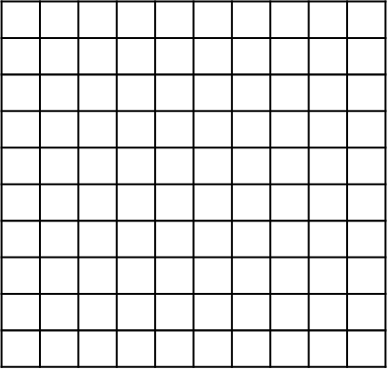


I will use a 100
square.
Have a think
100 $÷$ 2 $=$ 50
Use Annie’s method to divide 100 by 4, 5 and 10
Is there more than one way to cut the 100 square into equal parts each time?

Slide 11
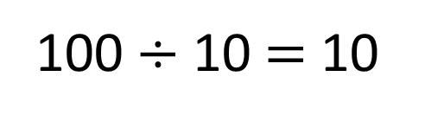
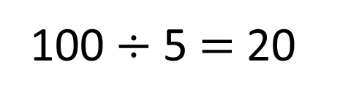
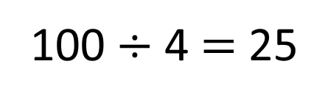
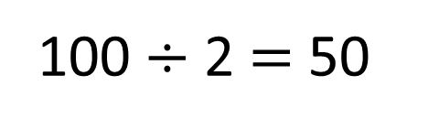
Do you notice any patterns?
100 $÷$ 2 $=$ 50
100 $÷$ 5 $=$ 20
double
half
double
half
100 $÷$ 4 $=$ 25
100 $÷$ 10 $=$ 10
50 | 50
20 | 20 | 20 | 20 | 20
25 | 25 | 25 | 25
10 | 10 | 10 | 10 | 10 | 10 | 10 | 10 | 10 | 10

Slide 12



Have a think
$\text{100} ÷$ $=$ $×$
$\text{100} ÷$ $=$
$\text{100} ÷$ $= +$
$\text{100} ÷$ $= + +$
What is the value of each shape?

Slide 13
$\text{100} ÷$ $=$ $×$
2
5
10
$\text{100} ÷$ $=$
10
10
$\text{100} ÷$ $= +$
5
10
10
4
$\text{100} ÷$ $= + +$
10
10
5
$=$ 2 $=$ 10 $=$ 5 $=$4

Slide 14
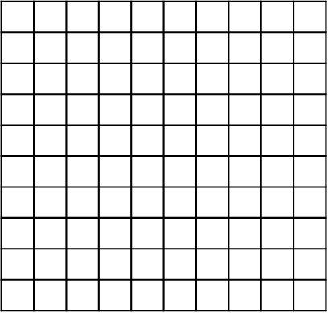
Here are some 100 squares for you to cut into equal parts.

