Slide 1


Slide 3
Circle the multiples of 10
120 13 30 80 23 204
2) Here are 20 cubes.
a) How many groups of 4 are there?
b) How many groups of 3 are there?
How many cubes will be remaining?

Slide 4
Circle the multiples of 10
120 13 30 80 23 204
2) Here are 20 cubes.
a) How many groups of 4 are there?
b) How many groups of 3 are there?
How many cubes will be remaining?
5
6
2

Slide 6

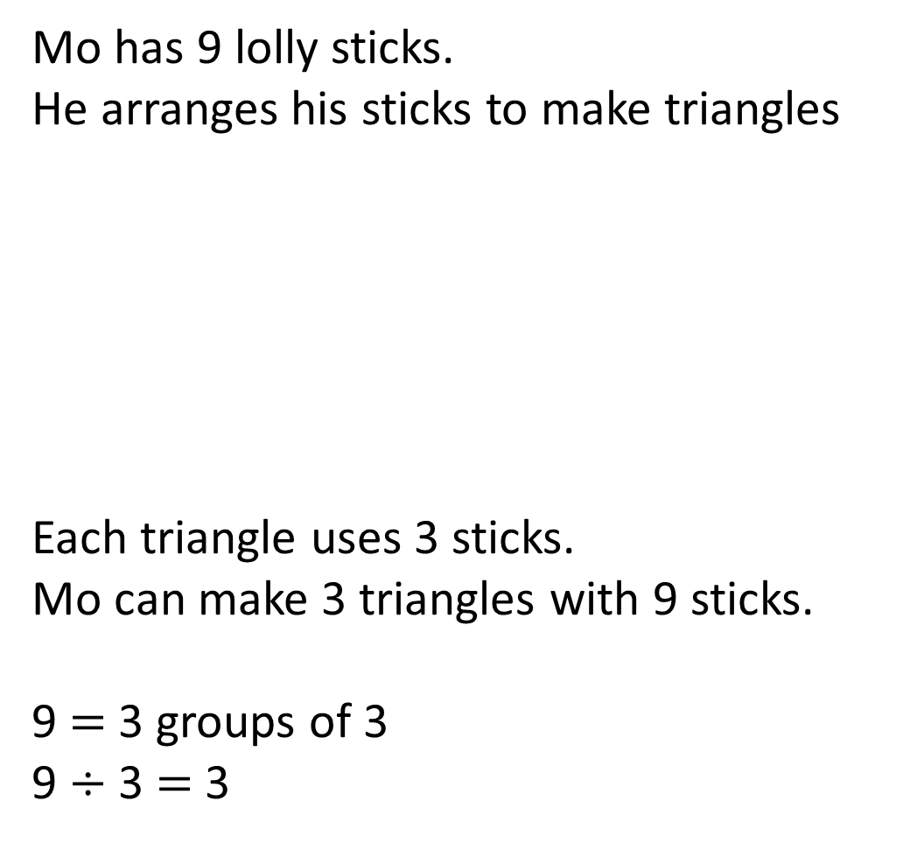
Mo has 9 lolly sticks.
He arranges his sticks to make triangles
Each triangle uses 3 sticks.
Mo can make 3 triangles with 9 sticks.
9 $=$ 3 groups of 3
9 $÷$ 3 $=$ 3

Slide 7
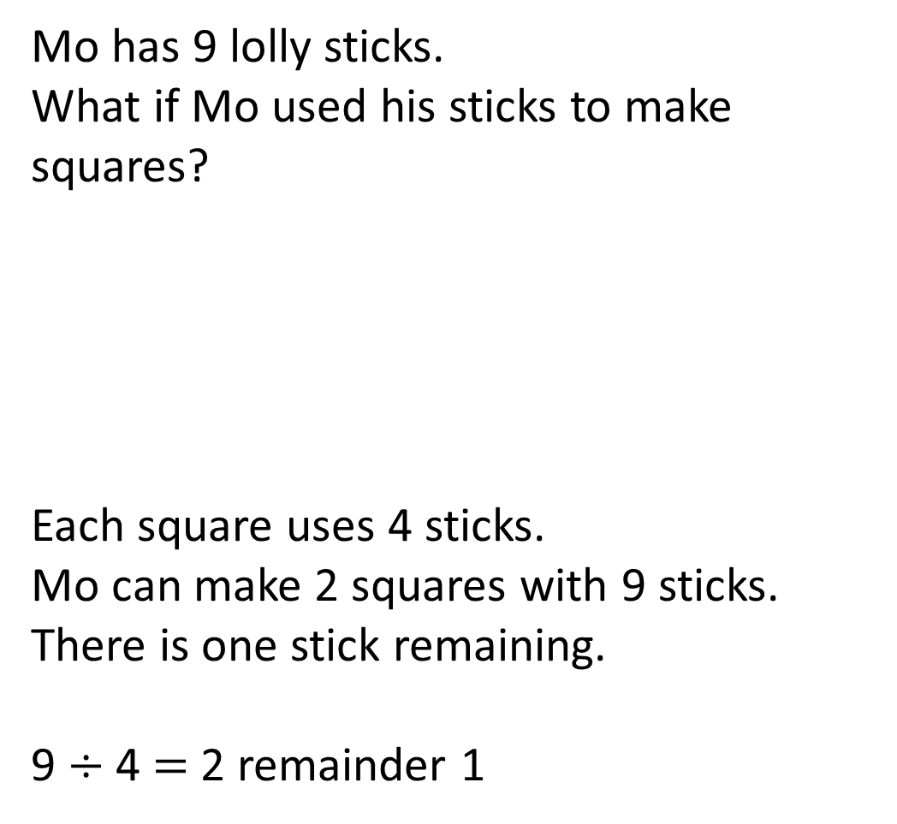
Mo has 9 lolly sticks.
What if Mo used his sticks to make squares?
Each square uses 4 sticks.
Mo can make 2 squares with 9 sticks.
There is one stick remaining.
9 $÷$ 4 $=$ 2 remainder 1

Slide 8

What if Mo has 19 lolly sticks.
How many squares and triangles could he make? How many sticks will be remaining each time?
Have a think
6 triangles and 1 stick remaining. 19 $÷$ 3 $=$ 6 r 1
4 squares and 2 sticks remaining. 19 $÷$ 4 $=$ 4 r 3

Slide 9
Have a go at questions
1 - 3 on the worksheet

Slide 10

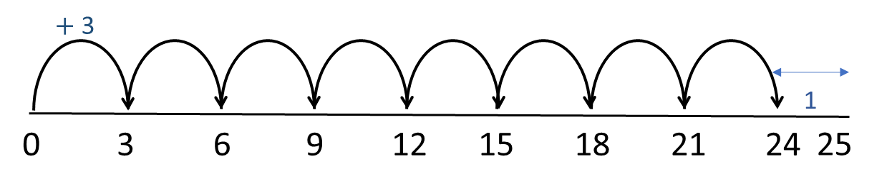

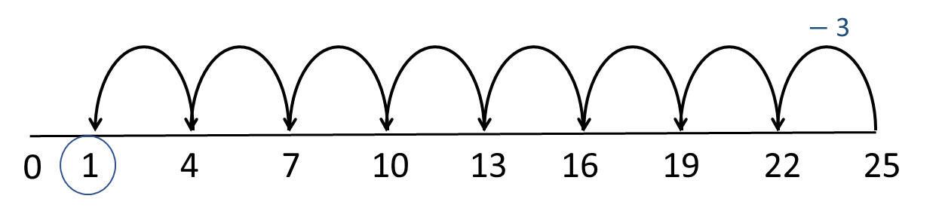


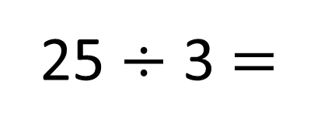
25 $÷$ 3 $=$
8 r 1
Have a think
$+$ 3
1
0
3
6
9
12
15
18
21
24
25
What’s the same? What’s different?
$−$ 3
0
1
4
7
10
13
16
19
22
25

Slide 11


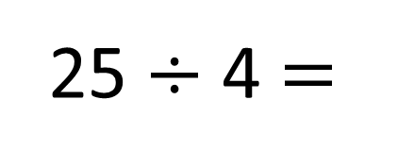
25 $÷$ 4 $=$
6 r 1
Have a think
$+$ 4
1
0
4
8
12
16
20
24
25
$−$ 4
0
1
5
9
13
17
21
25

Slide 12
Have a go at questions
4 and 5 on the worksheet

Slide 13
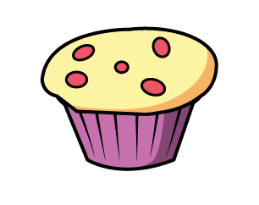





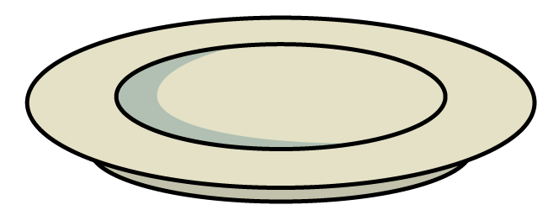

Here are 13 cakes.
They are shared equally between 4 plates.
There will be 3 cakes on each plate.
13 $÷$ 4 $=$ 3 r 1

Slide 14
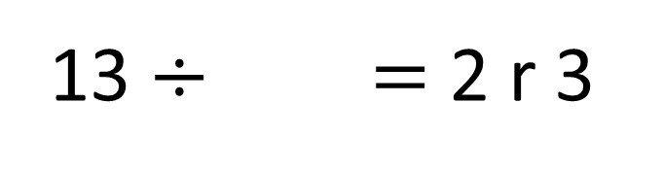
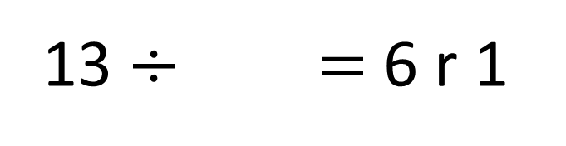
13 $÷$ $=$6 r 1
2
13 $÷$ $=$ 2 r 3
5
Have a think

Slide 15

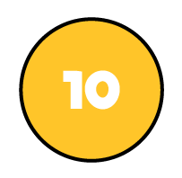
73 ÷ 3 =
24
remainder 1
Tens | Ones

Slide 16
Have a go at the rest of the questions on the worksheet

