Slide 1


Slide 3
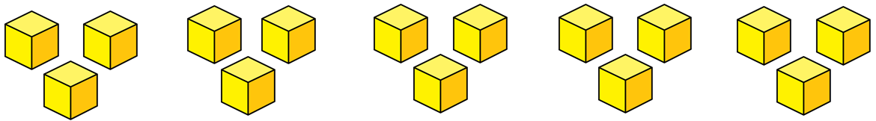
Circle the multiples of 5
12 35 40 57 95 70
2) Here are 15 cubes.
How many groups of 3 are there?
Here is an array.
How many groups of 4 are there?

Slide 4
Circle the multiples of 5
12 35 40 57 95 70
2) Here are 15 cubes.
How many groups of 3 are there?
Here is an array.
How many groups of 4 are there?
5
3

Slide 6






Alex has 11 flowers.
There are 5 pots of 2 and 1 flower remaining.
11 $÷$ 2 $=$ 5 remainder 1
If she plants 2 flowers in each pot.
How many pots can she fill?

Slide 7


What if Alex grouped her flowers into pots of 3?
There are 3 pots of 3 and 2 flowers remaining.
11 $÷$ 3 $=$ 3 remainder 2
How many pots can she fill?
How many flowers will be remaining?
Have a think

Slide 8

What if Alex grouped her flowers into pots of 4?
There are 2 pots of 4 and 3 flowers remaining.
11 $÷$ 4 $=$ 2 r 3
How many pots can she fill?
How many flowers will be remaining?
Have a think

Slide 9

Dora has 13 counters.
She arranges her counters into equal groups
and has some counters remaining.
How could Dora have arranged her counters?
Have a think

Slide 10
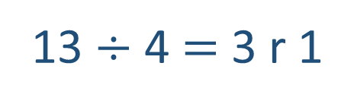
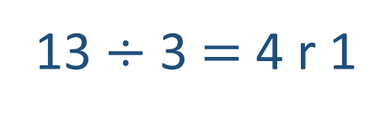
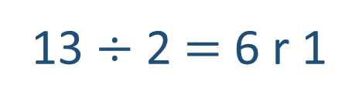
6 groups of 2 and 1 remaining
13 $÷$ 2 $=$ 6 r 1
4 groups of 3 and 1 remaining
13 $÷$ 3 $=$ 4 r 1
3 groups of 4 and 1 remaining
13 $÷$ 4 $=$ 3 r 1

Slide 11
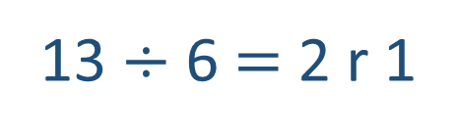
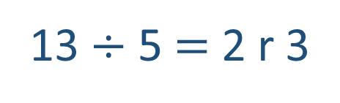
2 groups of 5 and 3 remaining
13 $÷$ 5 $=$ 2 r 3
2 groups of 6 and 1 remaining
13 $÷$ 6 $=$ 2 r 1

Slide 12
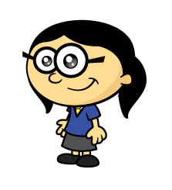
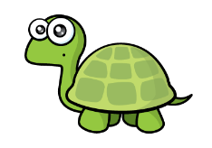
Have a think
19 divided by 5 is equal to 3 r 4
20 divided by 5 is equal to 3 r 5

Slide 13

Use counters to complete the following divisions.
What do you notice?
21 $÷$ 4 $=$
22 $÷$ 4 $=$
23 $÷$ 4 $=$
24 $÷$ 4 $=$
5 r 1
5 r 2
5 r 3
6
Have a think

Slide 14
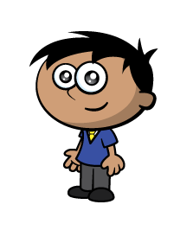
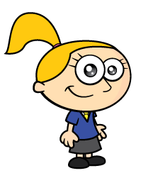
The children have some counters
How many counters do they have?
There are fewer than 30 counters.
If I arrange the counters into groups of 5 there is 1 counter left over.
If I arrange the counters into groups of 8 there are 2 counters left over.
Have a think

Slide 15
How many counters do they have?
6
11
16
21
26
There are fewer than 30 counters.
If I arrange the counters into groups of 5 there is 1 counter left over.
10
18
26
If I arrange the counters into groups of 8 there are 2 counters left over.
Can you create your own puzzle like this?
They have 26 counters.

