Slide 1


Slide 3

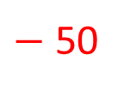
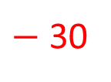
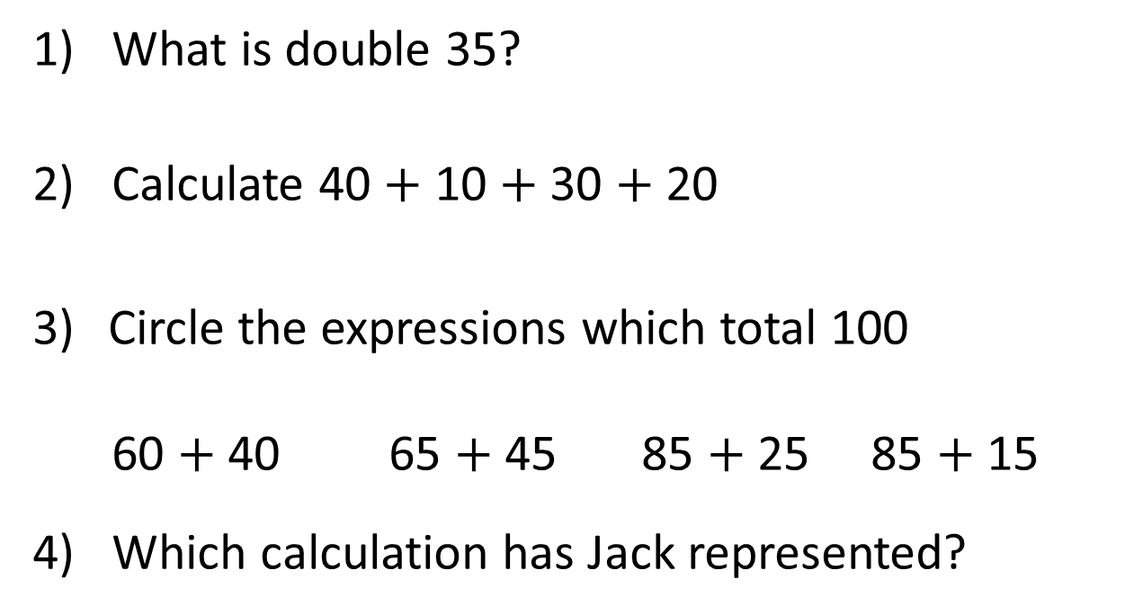
1) What is double 35?
2) Calculate 40 $+$ 10 $+$ 30 $+$ 20
Circle the expressions which total 100
60 $+$ 40 65 $+$ 45 85 $+$ 25 85 $+$ 15
4) Which calculation has Jack represented?
$−$ 50
$−$ 30
50
100
130

Slide 4
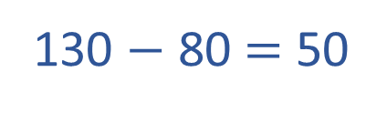
1) What is double 35?
2) Calculate 40 $+$ 10 $+$ 30 $+$ 20
Circle the expressions which total 100
60 $+$ 40 65 $+$ 45 85 $+$ 25 85 $+$ 15
4) Which calculation has Jack represented?
70
100
$−$ 50
$−$ 30
130 $−$ 80 $=$ 50
50
100
130

Slide 6

Table to show the number of visitors to the library
Day of the week | Mon | Tues | Wed | Thur | Fri | Sat | Sun
Number of visitors | 52 | 45 | 60 |  | 38 |  | 70
Use the clues below to complete the table
Twice as many people visited the library on Thursday than on Tuesday.
There were 120 visitors in total at the weekend.
Have a think

Slide 7
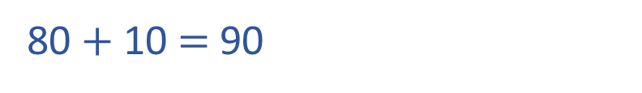
Table to show the number of visitors to the library
Day of the week | Mon | Tues | Wed | Thur | Fri | Sat | Sun
Number of visitors | 52 | 45 | 60 |  | 38 |  | 70
90
Twice as many people visited the
library on Thursday than on Tuesday.
45
40
5
double
double
80 $+$ 10 $=$ 90
80
10
90 people visited on Thursday.

Slide 8
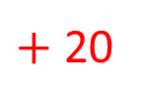
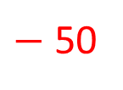
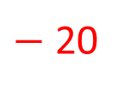
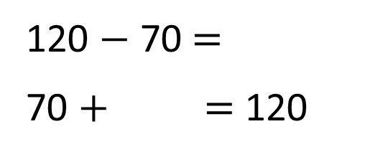
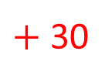
Table to show the number of visitors to the library
Day of the week | Mon | Tues | Wed | Thur | Fri | Sat | Sun
Number of visitors | 52 | 45 | 60 |  | 38 |  | 70
90
50
There were 120 visitors in total at the weekend.
50
Weekend 120
Sat ? | Sun 70
120 $−$ 70 $=$
70 $+$ $=$ 120
50
$−$ 50
$−$ 20
$+$ 30
$+$ 20
50
100
120
70
100
120

Slide 9
Table to show the number of visitors to the theatre
Day | Adults | Children
Thurs | 110 | 40
Fri | 95 | 60
Sat | 115 | 85
Sun | 75 | 50
1. How many people attended the theatre on Friday?
2. The theatre holds 200 people.
Which day was sold out?
3. How many children attended overall?
Have a think

Slide 10
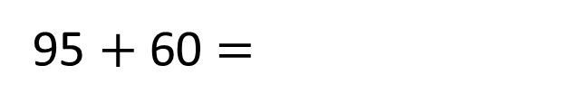
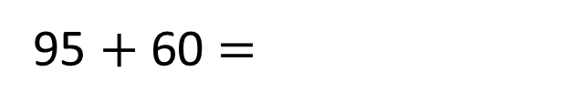
Table to show the number of visitors to the theatre
Day | Adults | Children
Thurs | 110 | 40
Fri | 95 | 60
Sat | 115 | 85
Sun | 75 | 50
1. How many people attended the theatre on Friday?
95 $+$ 60 $=$
155
155
95 $+$ 60 $=$
5
55
55
40

Slide 11
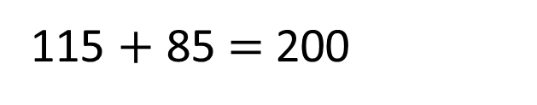
Table to show the number of visitors to the theatre
Day | Adults | Children
Thurs | 110 | 40
Fri | 95 | 60
Sat | 115 | 85
Sun | 75 | 50
2. The theatre holds 200 people.
Which day was sold out?
115 $+$ 85 $=$200
Saturday was sold out.

Slide 12
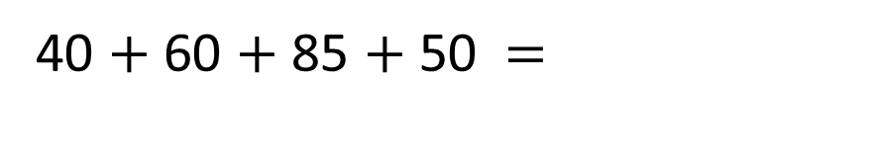
Table to show the number of visitors to the theatre
Day | Adults | Children
Thurs | 110 | 40
Fri | 95 | 60
Sat | 115 | 85
Sun | 75 | 50
3. How many children attended overall?
40 $+$ 60 $+$ 85 $+$ 50 $=$
235
35
50

Slide 13
Have a go at questions
1 and 2 on the work sheet

Slide 14
Table to show number of visitors to a swimming pool
Day | 10am-12pm | 12pm-2pm | 6pm-8pm
Mon | 20 | 45 | 15
Tues | 30 | 40 | 20
Wed | 35 | 50 | 30
Thurs | 15 | 35 | 20
Fri | 30 | 40 | 35
1. Which was the pools busiest day?
2. How many people visited the pool in the evening?
Have a think

Slide 15
Table to show number of visitors to a swimming pool
Day | 10am-12pm | 12pm-2pm | 6pm-8pm | Total
Mon | 20 | 45 | 15
Tues | 30 | 40 | 20
Wed | 35 | 50 | 30
Thurs | 15 | 35 | 20
Fri | 30 | 40 | 35
80
90
115
70
105
Which was the pools busiest day?
Wednesday was the busiest day.

Slide 16
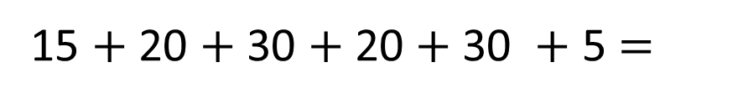
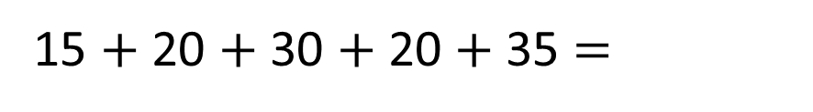
Table to show number of visitors to a swimming pool
Day | 10am-12pm | 12pm-2pm | 6pm-8pm
Mon | 20 | 45 | 15
Tues | 30 | 40 | 20
Wed | 35 | 50 | 30
Thurs | 15 | 35 | 20
Fri | 30 | 40 | 35
2. How many people visited the pool in the evening?
15 $+$ 20 $+$ 30 $+$ 20 $+$35 $=$
120
15 $+$ 20 $+$ 30 $+$ 20 $+$30 $+$ 5 $=$

Slide 17
Have a go at the rest of the questions on the worksheet

