Slide 1


Slide 3
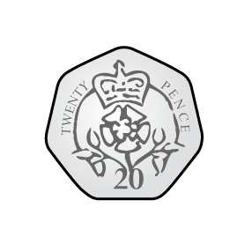
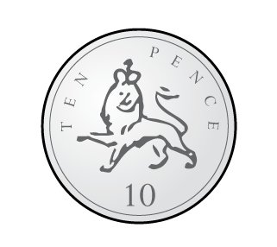

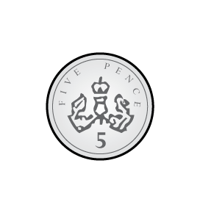
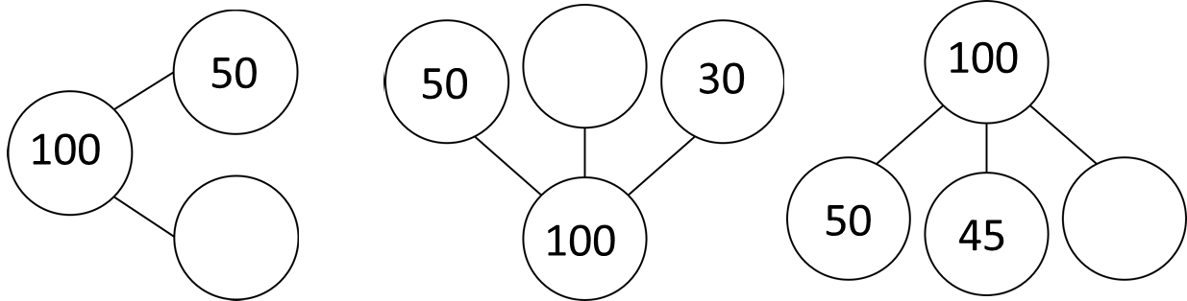
1) How much does Ron have?
Which sets of coins total 50p?
a) b)
c) d)
3) Complete the part-whole models.

Slide 4
1) How much does Ron have?
Which sets of coins total 50p?
a) b)
c) d)
3) Complete the part-whole models.
100p or £1
20
50
5

Slide 6
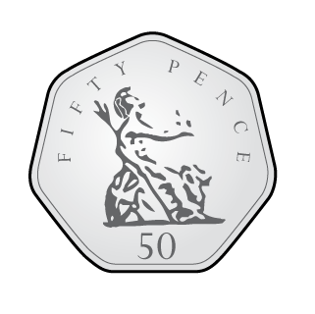
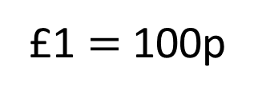
£1 $=$ 100p
Circle £1 in each set.
a)
b)
c)
d)

Slide 7


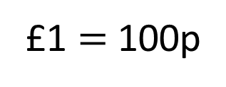
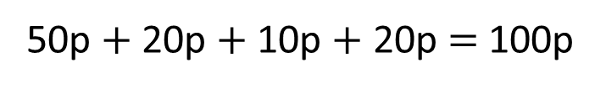
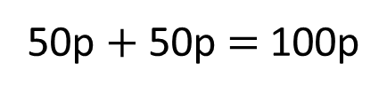
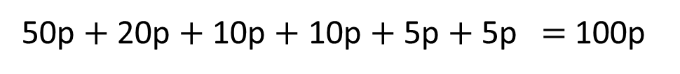
Tiny is exploring different ways to make £1
£1 $=$ 100p
I think I have lost a coin from each set.
50p $+$ 50p $=$ 100p
50p $+$ 20p $+$ 10p $+$ 20p $=$ 100p
80p
50p $+$ 20p $+$ 10p $+$ 10p $+$ 5p $+$ 5p $=$ 100p
Have a think
95p

Slide 8

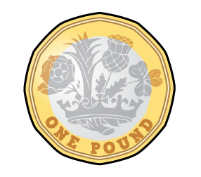
I wonder if I can make £1 using exactly
1 coin, 2 coins, 3 coins and 4 coins
1 coin
2 coins
3 coins
4 coins
Have a think
What about 5 coins, 6 coins and so on?

Slide 9
Have a go at questions 1 and 2 on the worksheet

Slide 10

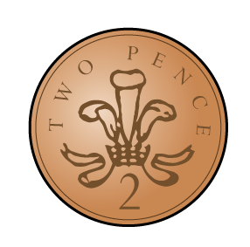
How much does Rosie have?
£1
82p
I can see two 50 pence coins. They make £1
Rosie has £1 and 82p
Rosie has 182p

Slide 11
How much does Rosie have?
£1
£1
12p
Rosie has £2 and 12p
Rosie has 212p
Have a think

Slide 12
How much does Rosie have?
£1
£1
£1
7p
Rosie has £3 and 7p
Rosie has 307p
Have a think

Slide 13
£1 and 50p
105p
£5 and 50p
501p
£1 and 5p
150p
£5 and 1p
550p

Slide 14
Have a go at the rest of the questions on the worksheet

