Slide 1


Slide 3
Favourite pizza topping
How many people prefer pepperoni pizza? ____
2) How many more people chose cheese than tuna? ____
3) How many people took part in the survey? ____
30
25
20
15
10
5
0
cheese
tuna
ham
pepperoni

Slide 4
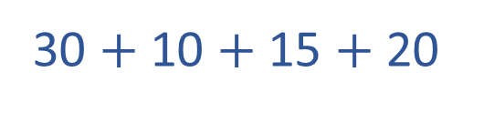
Favourite pizza topping
How many people prefer pepperoni pizza? ____
2) How many more people chose cheese than tuna? ____
3) How many people took part in the survey? ____
30
25
20
15
10
5
0
cheese
tuna
ham
pepperoni
20
20
30 $+$ 10 $+$ 15 $+$ 20
75

Slide 6
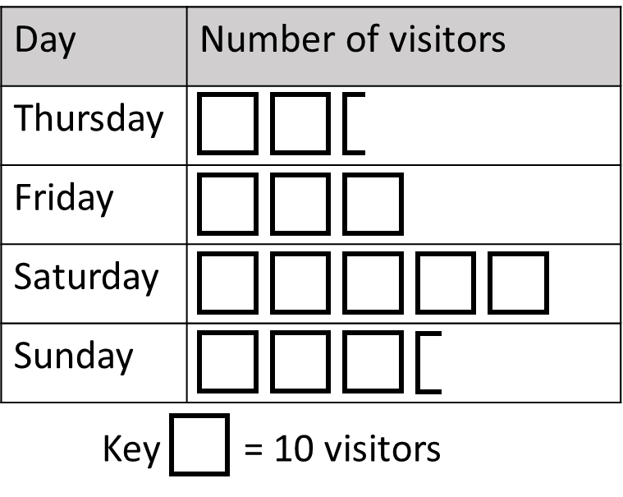

Here is a pictogram to show the number of people visiting an art gallery.
What can you find out?
Have a think

Slide 7
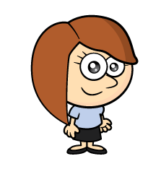


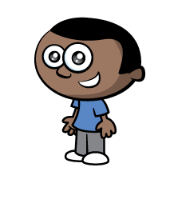
30 people visited on Friday.
Saturday was the busiest day.
There were 85 visitors at the weekend.
There were 140 visitors in total.

Slide 8
Have a think
Art gallery visitors
60
12
50
10
8
40
6
30
4
20
2
10
0
Thurs
Fri
Sat
Sun

Slide 9
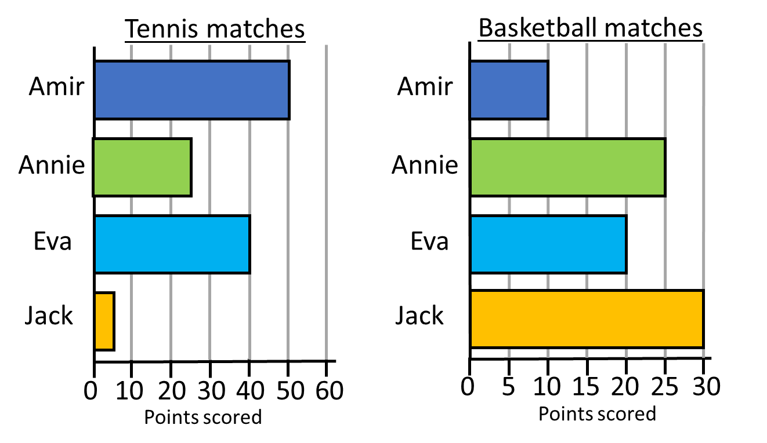

I scored the same number of points in tennis and basketball because my bars are the same size.
Have a think
No Eva scored 40 points in tennis and 20 in basketball.

Slide 10
Who scored the same number of points in both games?
How many more points did Amir score in tennis than basketball?
Annie scored 25 points in both games.
40 more points

Slide 11
Have a go at all of the questions on the worksheet

