Slide 1


Slide 3
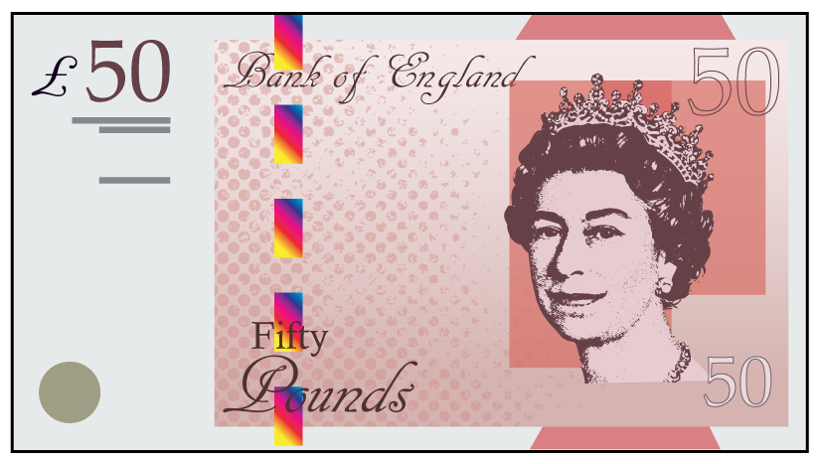
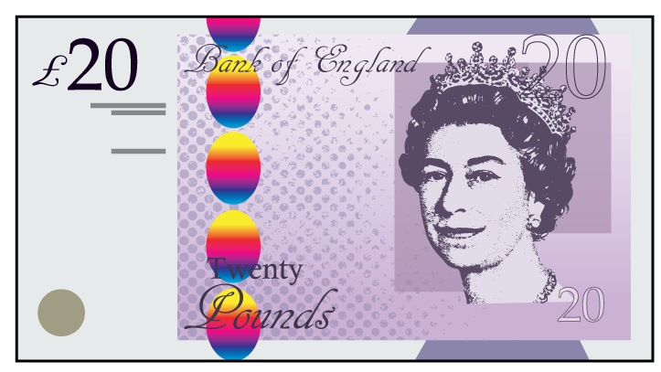
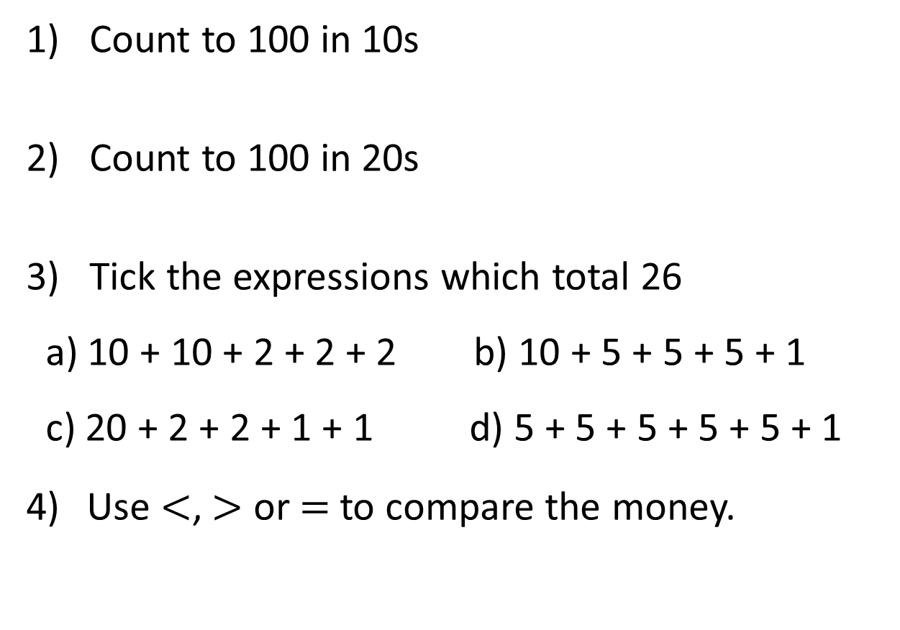
1) Count to 100 in 10s
2) Count to 100 in 20s
3) Tick the expressions which total 26
a) 10 + 10 + 2 + 2 + 2 b) 10 + 5 + 5 + 5 + 1
c) 20 + 2 + 2 + 1 + 1 d) 5 + 5 + 5 + 5 + 5 + 1
Use $<$, $>$ or $=$ to compare the money.

Slide 4


1) Count to 100 in 10s
2) Count to 100 in 20s
3) Tick the expressions which total 26
a) 10 + 10 + 2 + 2 + 2 b) 10 + 5 + 5 + 5 + 1
c) 20 + 2 + 2 + 1 + 1 d) 5 + 5 + 5 + 5 + 5 + 1
Use $<$, $>$ or $=$ to compare the money.
10, 20, 30, 40, 50, 60, 70, 80, 90, 100
20, 40, 60, 80, 100
$$>$$

Slide 6
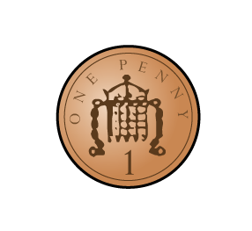

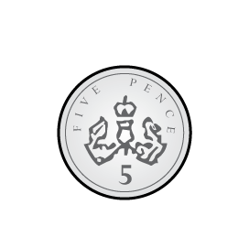
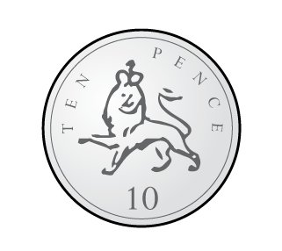
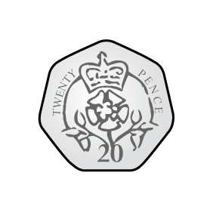
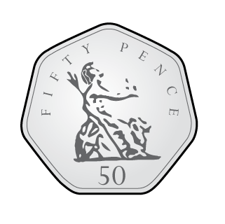
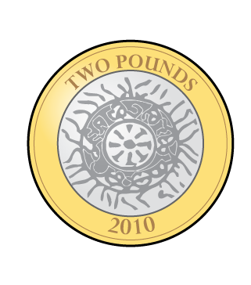
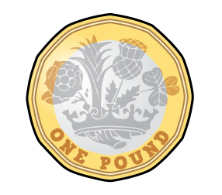
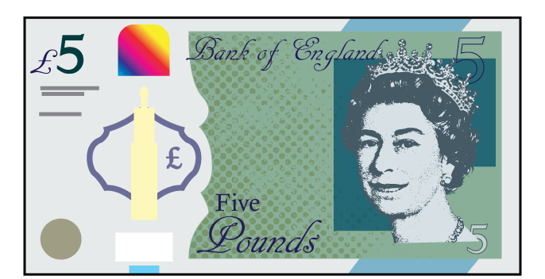
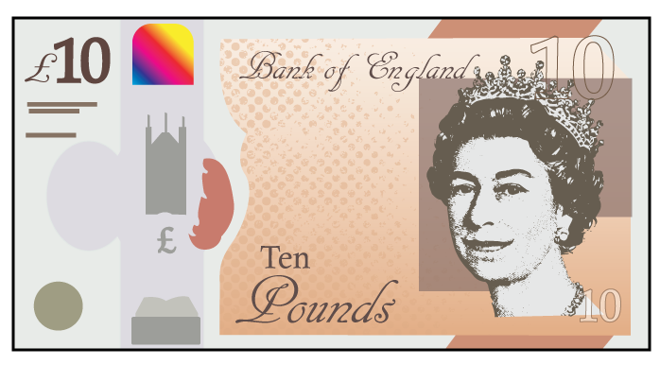
1p
2p
5p
10p
20p
50p
£1
£2
£5
£10
£20
£50

Slide 7
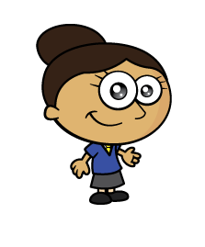
Dora is using pound coins to represent the value of different notes.
Which note has she represented?

Slide 8
Which notes has she represented?

Slide 9
Which note has she represented?

Slide 10

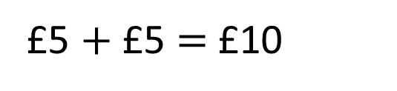
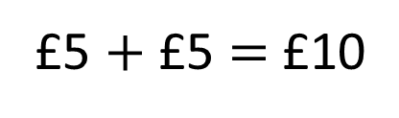
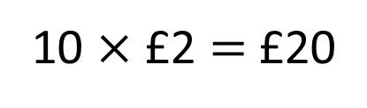
Which sets total £10?
a)
b)
c)
Have a think
10 $×$ £2 $=$ £20
£5 $+$ £5 $=$ £10
£5 $+$ £5 $=$ £10

Slide 11

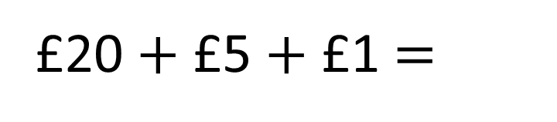
How much money is there?
£20 $+$ £5 $+$ £1 $=$
£26
It’s easier to add them if I place the greatest value notes first.

Slide 12
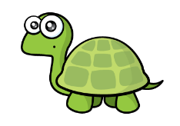
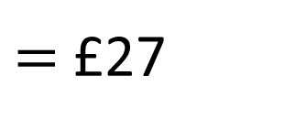
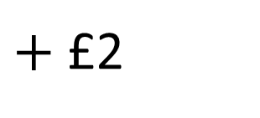
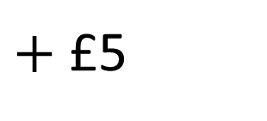
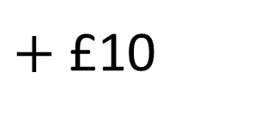
How much money is there?
$=$ £27
£10
$+$ £10
$+$ £5
$+$ £2
If you have pictures of notes and coins, you can cross them out as you count them.

Slide 13
Have a go at questions
1 – 4 on the worksheet

Slide 14

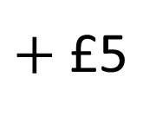

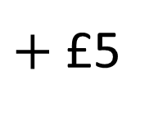
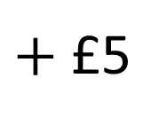
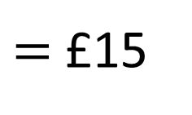
I have more money.
No you don’t, I have more money.
£10
$+$ £5
$=$ £15
£5
$+$ £5
$+$ £5
$=$ £15
Who is correct?
Have a think

Slide 15


Ron is thinking of an amount.
What amount could Ron be thinking of?
My amount can be made using 3 different notes.
£20 + £10 + £5 = £35
£50 + £10 + £5 = £65
£50 + £20 + £5 = £75
£50 + £20 + £10 = £80
Have a think

Slide 16

Annie is making amounts using pounds.
She uses one note and one coin.
How many different possible amounts are there?
Have a think

Slide 17
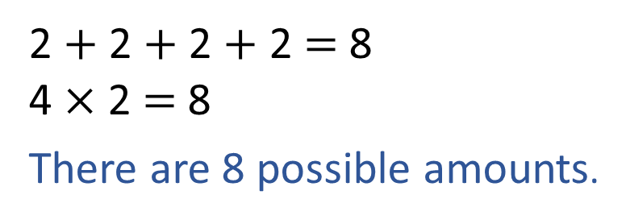
Annie is making amounts using pounds.
She uses one note and one coin.
How many different possible amounts are there?
£5
£1
£5
£2
£10
£1
£10
£2
£20
£1
£20
£2
2 $+$ 2 $+$ 2 $+$ 2 $=$ 8
4 $×$ 2 $=$ 8
There are 8 possible amounts.
£50
£1
£50
£2

Slide 18
Have a go at the rest of the questions on the worksheet

