Slide 1


Slide 3
How many does each tally represent?
a) b)
Draw tallies to show
a) 8 b) 16
If represents 10, what is represented by…
a) b)
c) d)

Slide 4
How many does each tally represent?
a) b)
Draw tallies to show
a) 8 b) 16
If represents 10, what is represented by…
a) b)
c) d)
7
17
20
40
5
25

Slide 6


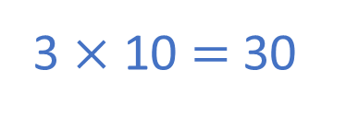

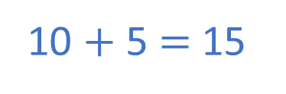
Day | Dogs seen
Monday
Tuesday
Wednesday
Thursday
Friday
Key $=$ 10 dogs
3 × 10 $=$ 30
10 $+$ 5 $=$ 15
How many dogs were seen on Wednesday?
_____ dogs
3
30
How many dogs were seen on Thursday?
_____ dogs
10 $\frac{\text{1}}{\text{2}}$
15

Slide 7


Day | Dogs seen
Monday
Tuesday
Wednesday
Thursday
Friday
Key $=$ 10 dogs
How many more dogs were seen on Wednesday
than Tuesday?
I know an easier way to compare.
I will subtract to find the difference.

Slide 8


How many more dogs were seen on Wednesday
Than Tuesday?
Tuesday
Wednesday
Key $=$ 10 dogs
30 dogs were seen on Wednesday.
10 dogs were seen on Tuesday.
30 $−$ 10 $=$ 20
20 more dogs were seen on Wednesday than Tuesday.
I can use the pictogram to compare.
I can see there are 20 more dogs on Wednesday.

Slide 9







Player | Goals scored
Alex
Jack
Mo
Rosie
Whitney
Key $=$ 2 goals
I scored 6. That’s the most goals!
Jack scored 1 goal.
What do you notice?
19 goals were scored altogether.
Mo scored 2 more goals than Whitney.
Have a think

Slide 10

Game 1
Key $=$ 5 points
Game 2
Player | Points scored
Ron
Amir
Player | Points scored
Ron
Amir
30 points
How many points did Ron score overall?
Who scored the most points overall?
In which game were most points scored?
Amir
Game 1
Have a think

Slide 11
Have a go at the questions on the worksheet

