Slide 1

Maths

Slide 2
Friday

Slide 3
Starter-
Sing the shape song with your child and discuss the features of the shapes-
Ask the children questions e.g.
How many sides does a triangle have?
What is the difference between a square and a rectangle? How many sides does a circle have?
https://www.youtube.com/watch?v=UDQDyx59QY4

Slide 4
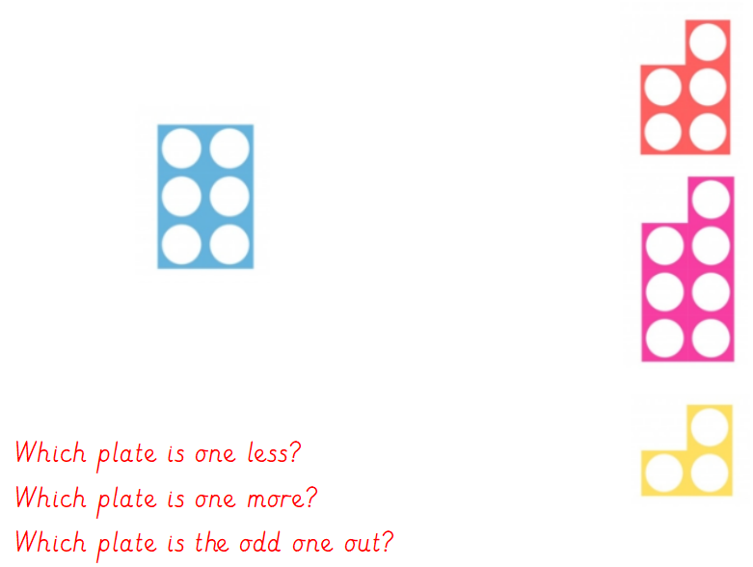

Slide 5
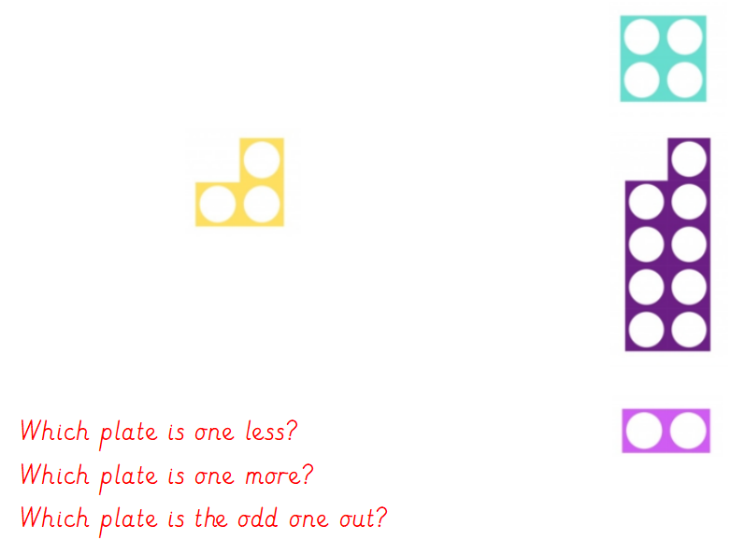

Slide 6
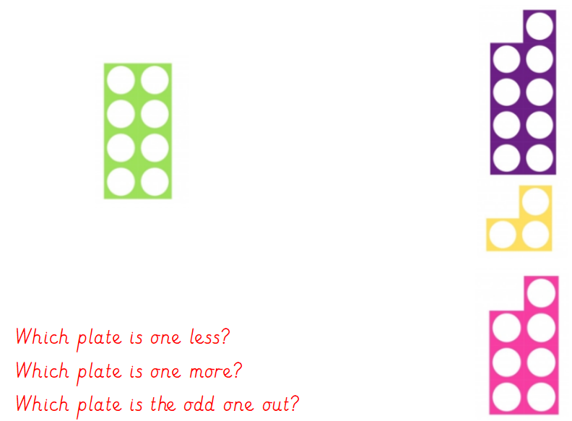

Slide 7
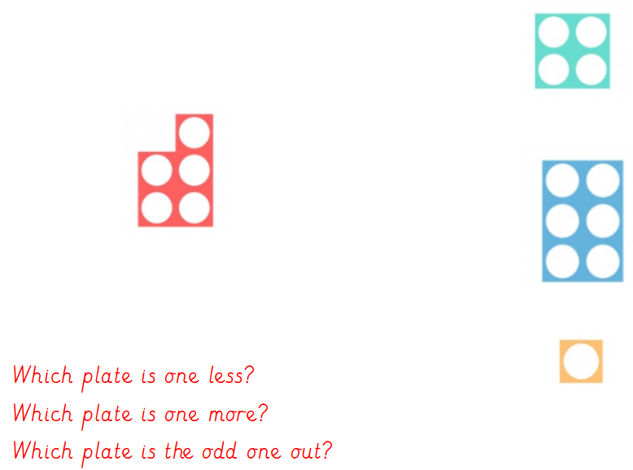

Slide 8
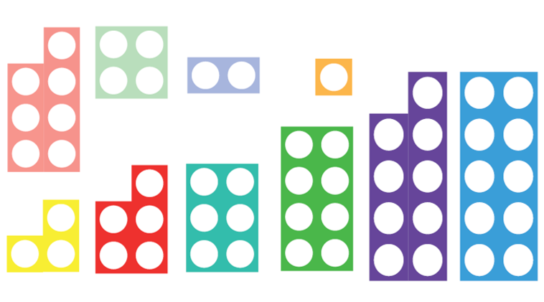
Cut me out and use me like you would in the classroom.
Don’t put me in the bin as I may be useful at a later date.
Look at the Numicon can you name the different plates?
Can you find the numicon plate that is one more than 3?
Each person pick up a plate. Who has the biggest number? Which plate is ones less the plate you are holding?
Continue activity with different Numbers, plates and questions.

