Slide 1

Maths

Slide 2
Thursday

Slide 3

Starter-
Lets listen to our 10 times tables song
Can you continue your ten times tables?
Which number comes next?
10
20
30
Notes:
This is the first time the children have engaged with their times tables so please do not worry they will not know them yet. This is an introduction.

Slide 4
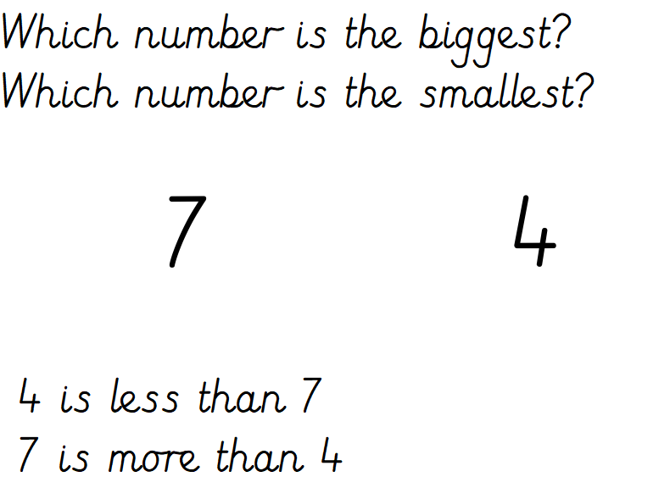

Slide 5
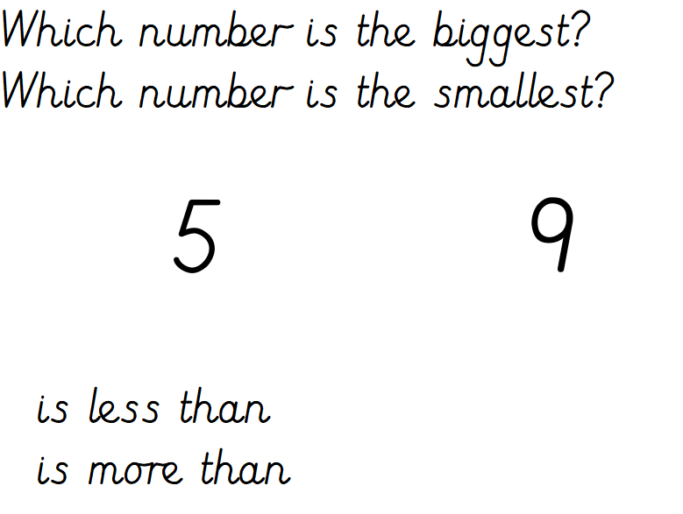
What number is one more / one less than the given numbers?

Slide 6

What number is one more / one less than the given numbers?

Slide 7
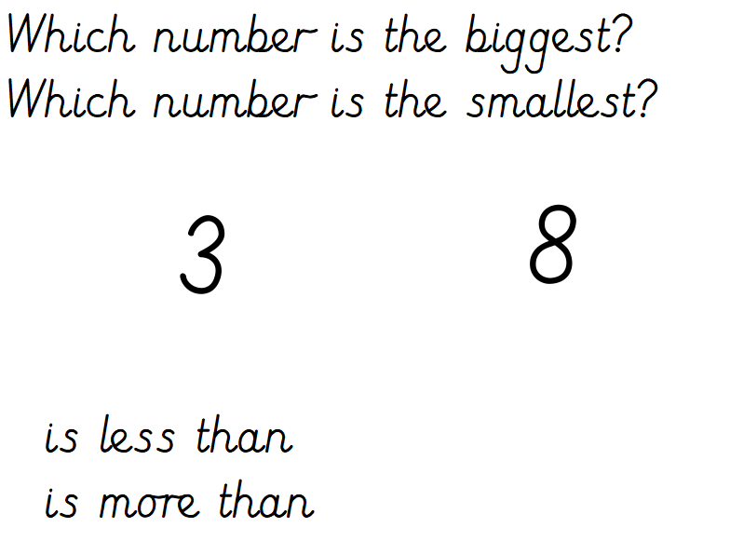
What number is one more / one less than the given numbers?

Slide 8
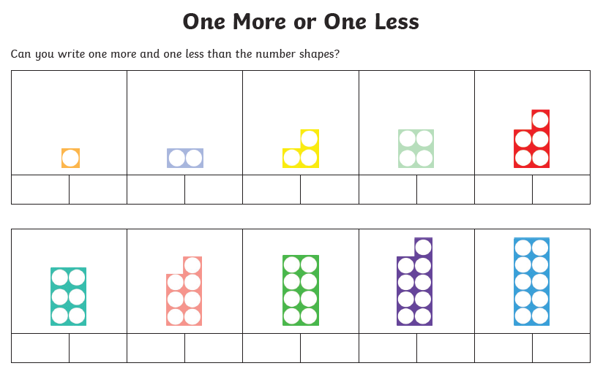
The children work with Numicon daily and can should be able to name each plate independently
0
3
6
11
The aim of the activity is for the children to write the number that is one less / one more than the given numicon plate.
Please see examples given.

