Slide 1
Maths
WB 11.1.21

Slide 2
Tuesday

Slide 3

Starter
Lets listen to our 2 times tables song
https://www.youtube.com/watch?v=3yf3xgE8wMc
2
Can you continue your two times tables?
Which number comes next?
4
6
Notes:
This is the first time the children have engaged with their times tables so please do not worry they will not know them yet. This is an introduction.
Play the song listen, play again and repeat until children are confident and comfortable with the concept. U se a piece of paper to count in 2’s complete activity. 2,4,6,8,10,12,14,16,18,20,22,24 do not go any further.

Slide 4
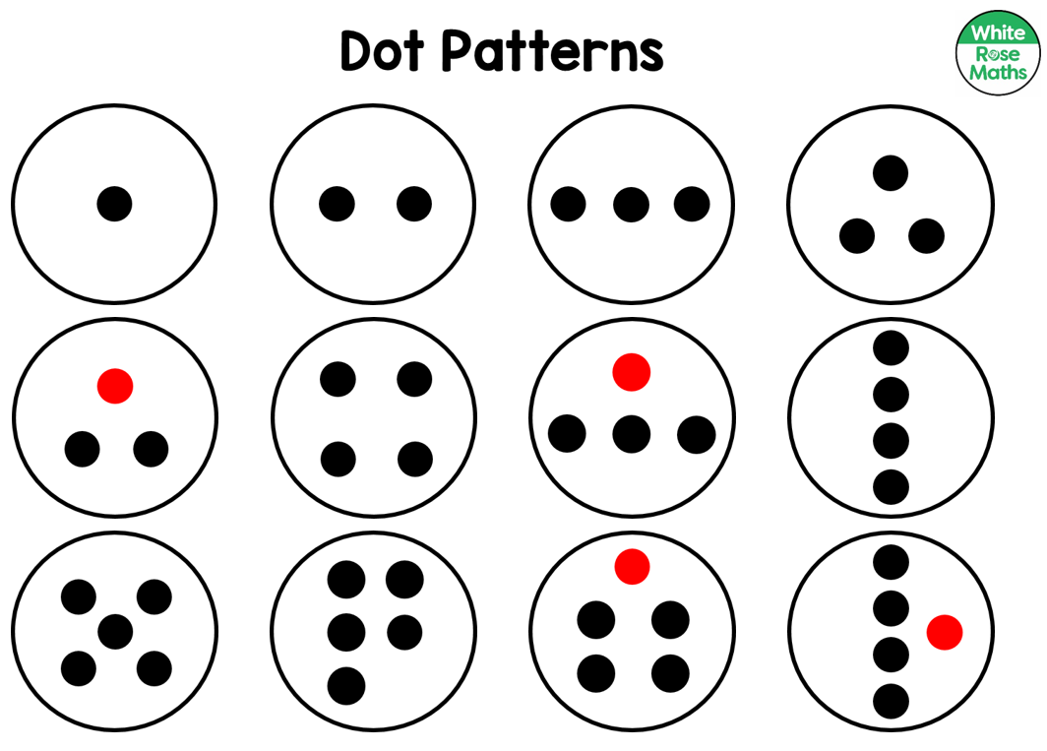
Can you find a plate with 4 dots?
With more/fewer than 3 dots?
Can you cut out the plates and put them in order?
Can you find a plate with 4 black dots and 1 red dot?
One of the plates is missing.
Can you work out which one?
Can you think of your own questions.
Notes:
First cut out the plates. Place the plates in front of your child in a random order -
Work through the questions on the screen, once completed you can change the numbers to vary the answers. E.g. can you find a plate with 5 dots? Etc.
Once the activity is drawing to a close allow children to order the plates from the smallest to the largest number and discuss how the dots have been represented differently e.g. 4 in a straight line, 4 in a box discuss how even though they are represented different they still make the same amount (please use the vocabulary ‘represented’ with your child as this is the terminology we use in school).

