Slide 1

Maths

Slide 2
Wednesday

Slide 3

Starter-
Lets listen to our 5 times tables song
https://www.youtube.com/watch?v=2KyDZ7f1RfE
Can you continue your five times tables?
Which number comes next?
5
10
15
Notes:
This is the first time the children have engaged with their times tables so please do not worry they will not know them yet. This is an introduction.

Slide 4
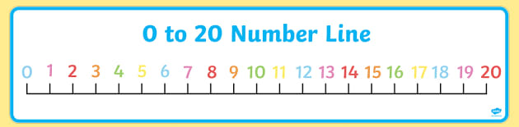
This activity is getting you prepared for your Main Activity.
I’m thinking of a number
1 less | Magic Number | 1 more
 | 7
Which number is one more and one less – use the number line to help you

Slide 5
This activity is getting you prepared for your Main Activity.
I’m thinking of a number
1 less | Magic Number | 1 more
 | 3
Which number is one more and one less – use the number line to help you

Slide 6
This activity is getting you prepared for your Main Activity.
I’m thinking of a number
1 less | Magic Number | 1 more
 | 10
Which number is one more and one less – use the number line to help you

Slide 7
This activity is getting you prepared for your Main Activity.
I’m thinking of a number
1 less | Magic Number | 1 more
 | 5
Which number is one more and one less – use the number line to help you

