Slide 1
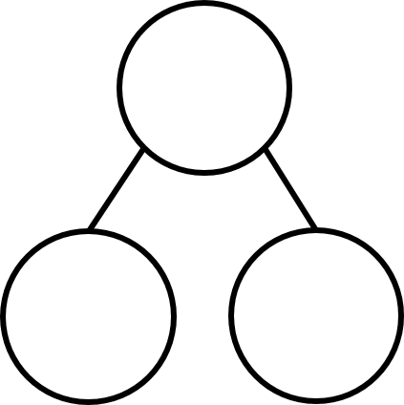



Double is
2
4

Slide 2



6
Double is
3
$+ =$
6
3
3
6
3
3

Slide 3
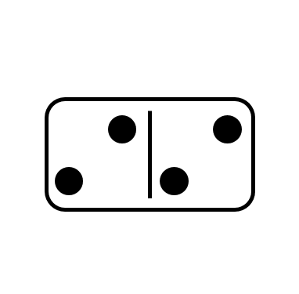
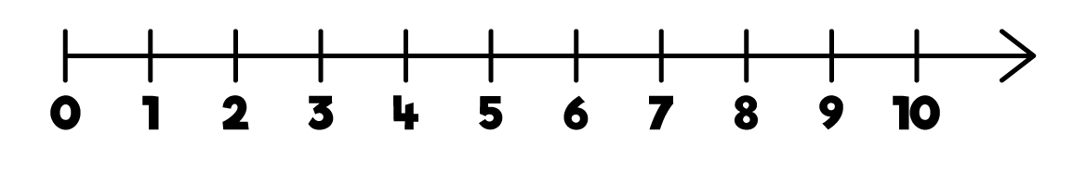

Double is
2
4
$+ =$
2
2
4

Slide 4


Double is
4
8
$+ =$
4
4
8

Slide 5



Have a think
Double is
5
10
$+ =$
10
5
5

Slide 6





Double is
11
22
$+ =$
11
11
22
$$+$$
$$=$$
20
2
22
$+ =$

