Slide 1


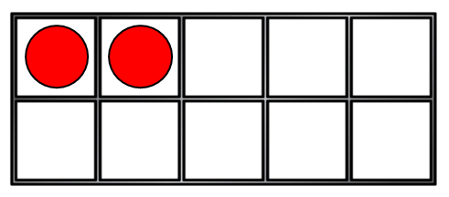
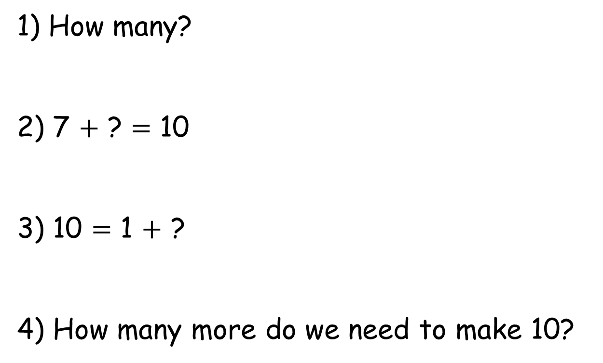
1) How many?
2) 7 $+$ ? $=$ 10
3) 10 $=$ 1 $+$ ?
4) How many more do we need to make 10?

Slide 2
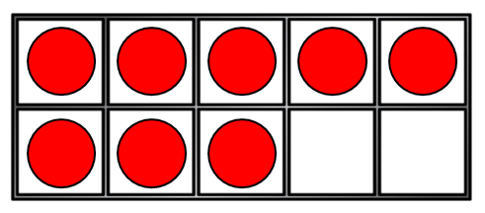
1) How many?
2) 7 $+$ ? $=$ 10
3) 10 $=$ 1 $+$ ?
4) How many more do we need to make 10?
10
3
9
8

Slide 3


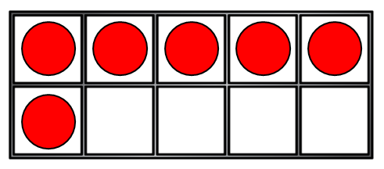
Making 10
Amir and Eva are practising their number bonds to 10
You need … more!
6
I have…
4

Slide 4
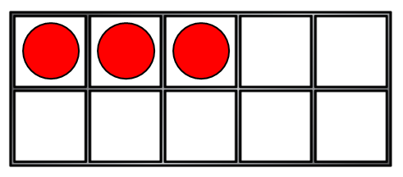
Making 10
Amir and Eva are practising their number bonds to 10
You need … more!
3
I have…
7

Slide 5

Have a think
Making 10
Amir and Eva are practising their number bonds to 10
You need … more!
8
I have…
2

Slide 6
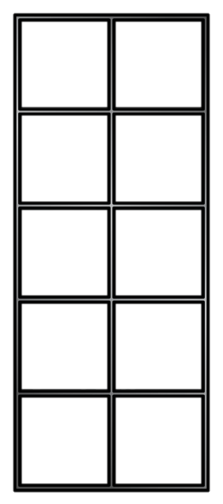
Have a think
Can you practise your number bonds to 10?
You need … more!
I have…
Work with a partner using the sentence stems state how many you have. Can your partner tell you how many more you need?

Slide 7
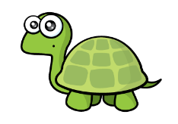
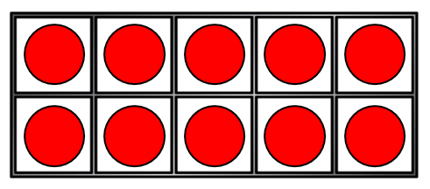
Add on from 10
I like adding on to the number 10
+
18
10 add 8 is equal to

Slide 8
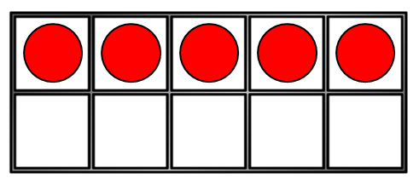
Add on from 10
I like adding on to the number 10
+
15
10 add 5 is equal to
Why might Tiny like adding on to the number 10?

Slide 9

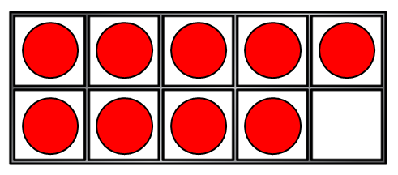
Making 10
I only like adding on to the number 10
You can make 10 with other numbers!
+
15
10 + 5 =
+
9 + 6 is equal to 10 + 5

Slide 10
Making 10
Can you help me make the number 10 ?
+
18
10 + 8 =
+
9 + 9 is equal to 10 + 8

Slide 11
Making 10
This makes it easier to add!
+
2
9 + 3 is equal to 10 +

