Slide 1
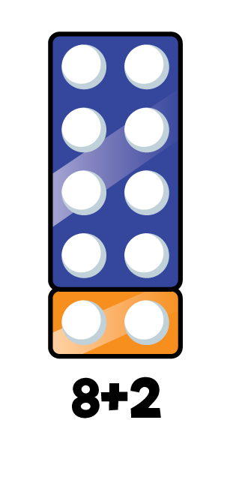
1) How many?
2) These are number bonds for
3) If then
4) What number is this? thirteen
5 + 2 = ?
3 + 4 = ?
5 + 2 = 7
15 + 2 = ?

Slide 2
1) How many?
2) These are number bonds for
3) If then
4) What number is this? thirteen
8 + 2 = 10
7
5 + 2 = ?
3 + 4 = ?
5 + 2 = 7
15 + 2 = ?
17
13

Slide 3
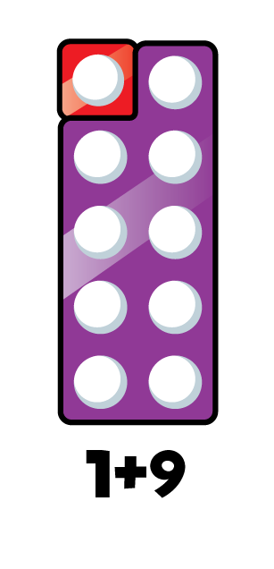
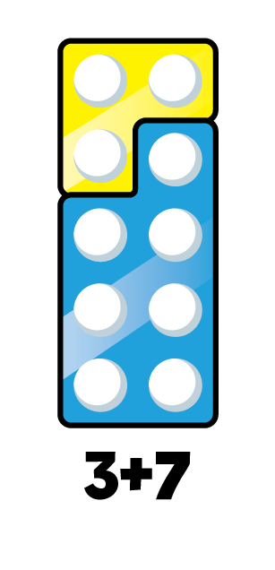
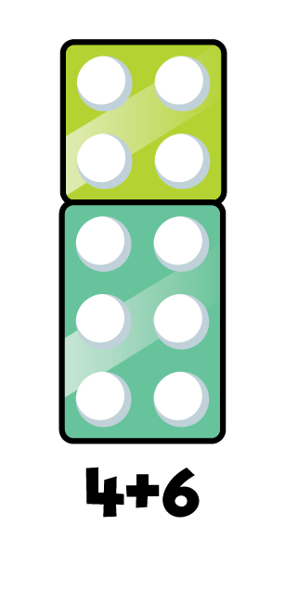
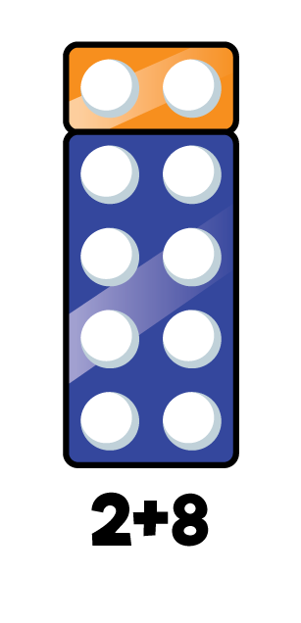
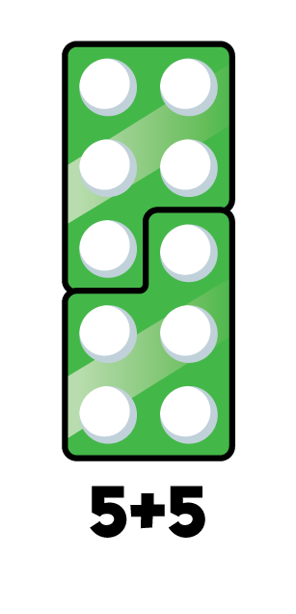
Number bonds to 10
1 + 9 = 10
2 + 8 = 10
3 + 7 = 10
4 + 6 = 10
5 + 5 = 10

Slide 4
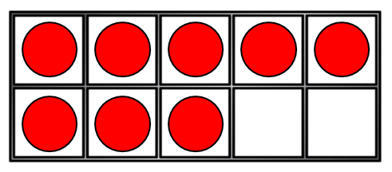
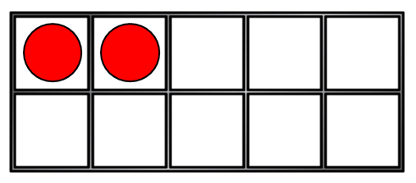
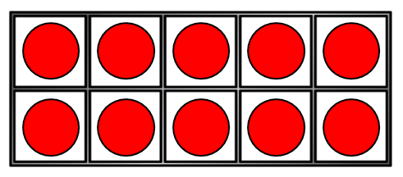
If
8 + 2 = 10
Then
18 + 2 = 20
8 + 12 = 20

Slide 5

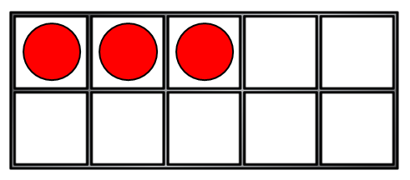
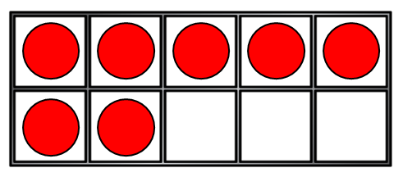
If
Have a think
3 + 7 = 10
Then
13 + 7 = 20
3 + 17 = 20

Slide 6
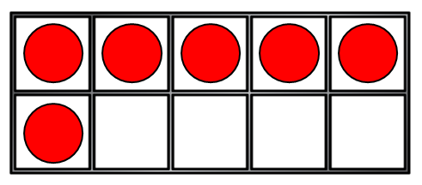
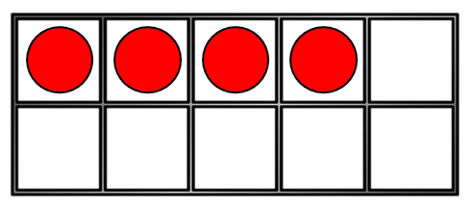
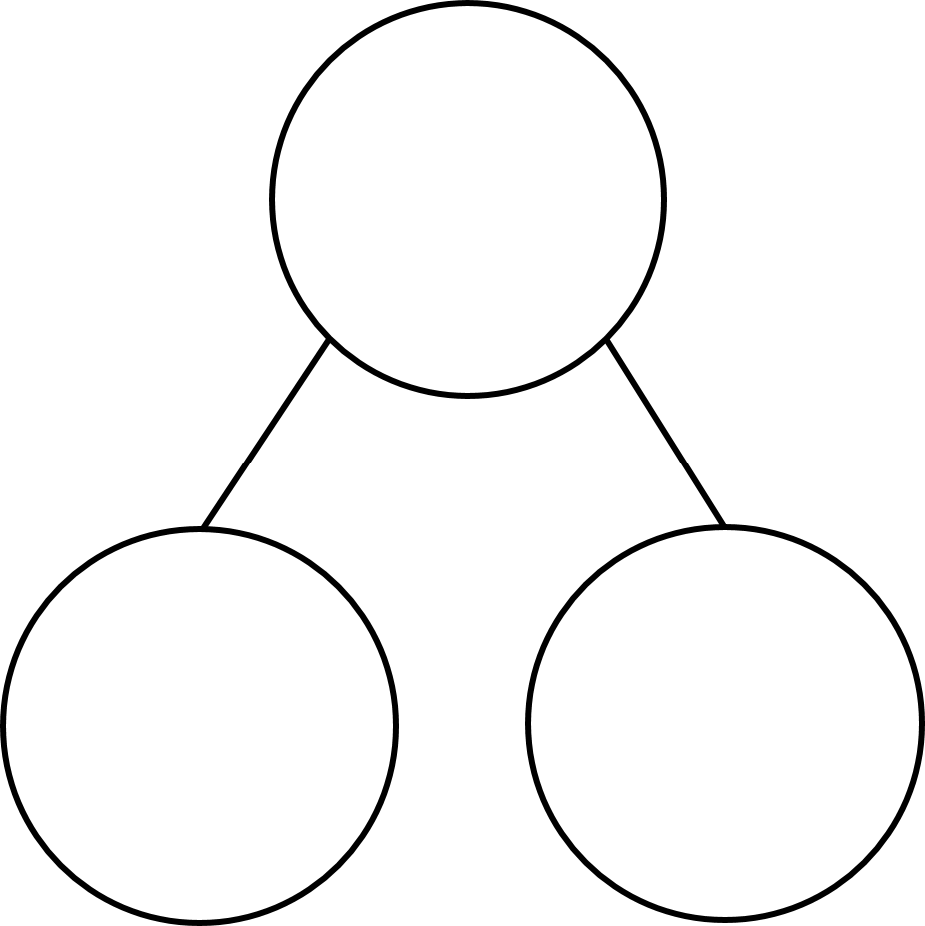
6 + 4 = 10
10
10
6
4
6
4

Slide 7
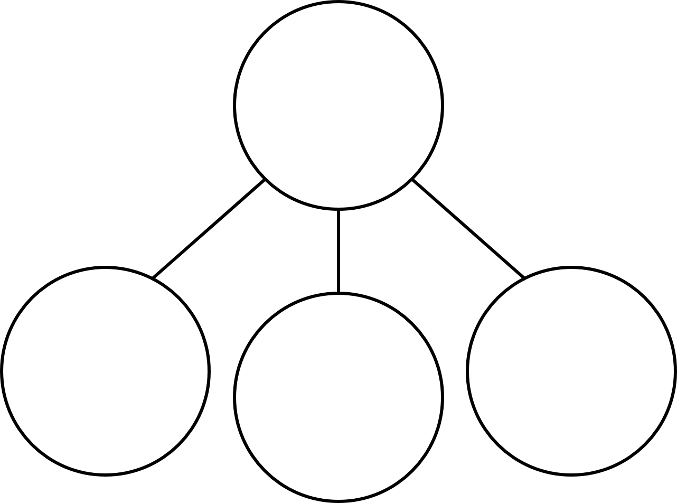
6 + 4 = 10
Have a think
16 + 4 = 20
20
20
10
6
4
20
10
6
4
16
4

Slide 8
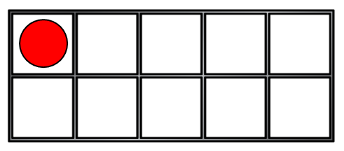
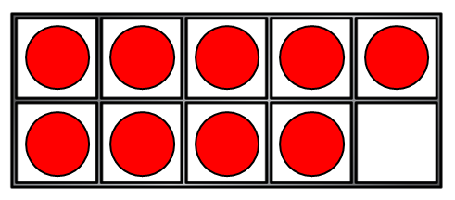
1 + 9 = 10
Have a think
11 + 9 = 20
20
20
10
1
9
10
9
20
1
11
9

Slide 9

I am going to practise my number bonds to 20 by using my number bonds to 10!
1 + 9 = 10
2 + 8 = 10
3 + 7 = 10
4 + 6 = 10
5 + 5 = 10
Which number bonds to 20 would I be able to write using these bonds to 10?

