Slide 1
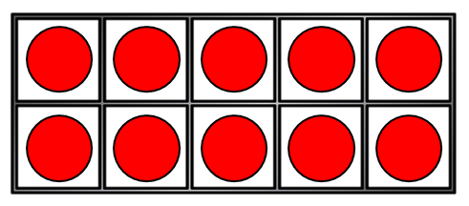
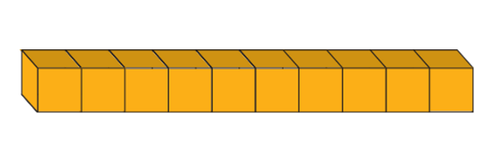
1) How many counters?
2) How many ones?
3) Complete the number track.
10 | 20 | 30 |  |  | 60 |  | 80

Slide 2
1) How many counters?
2) How many ones?
3) Complete the number track.
20
10
10 | 20 | 30 |  |  | 60 |  | 80
40
90
50
70
100

Slide 3



The function machine is multiplying the number going in by 10.
Look at the ones going in and what comes out.
What do you notice?

Slide 4
The function machine is multiplying the number going in by 10.
Look at the ones going in and what comes out.
What do you notice?

Slide 5
The function machine is multiplying the number going in by 10.
Look at the ones going in and what comes out.
What do you notice?

Slide 6





Have a think
Complete the multiplication fact to match the bar model.
30
10 | 10 | 10
3
$$×$$
10
$$=$$
30
or
10
$$×$$
3
$$=$$
30

Slide 7
Have a think
Complete the multiplication fact to match the bar model.
90
10 | 10 | 10 | 10 | 10 | 10 | 10 | 10 | 10
9
$$×$$
10
$$=$$
90
or
10
$$×$$
9
$$=$$
90

Slide 8

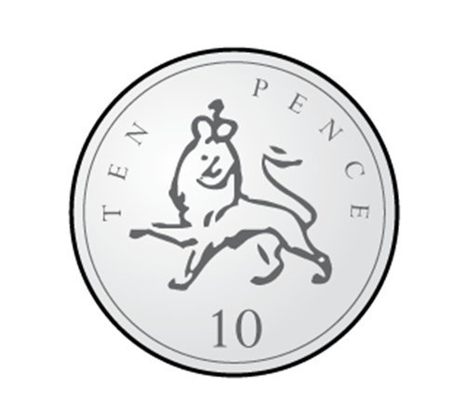




Dexter has got some 10 pence coins.
Have a think
How many coins has he got?
7
How much is each coin worth?
10 pence
How much money does he have in total?
70 pence
7
$$×$$
10
$$=$$
70
or
10
$$×$$
7
$$=$$
70

Slide 9

40
30
20
10
0

Slide 10
90
80
70
60
50

Slide 11
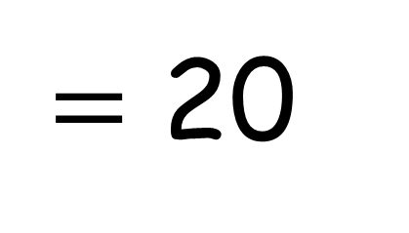
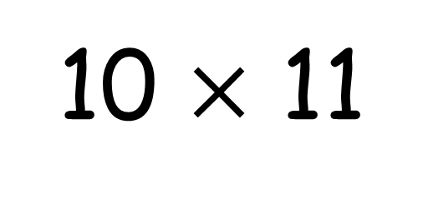
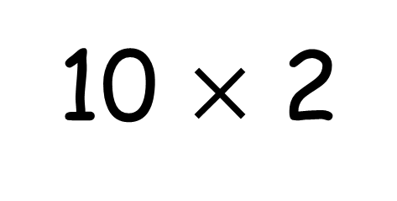
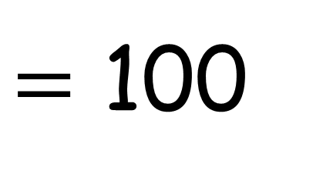
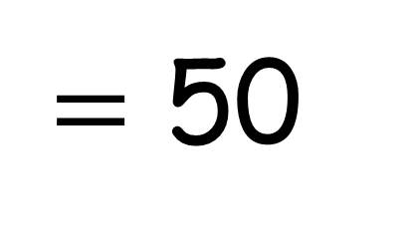
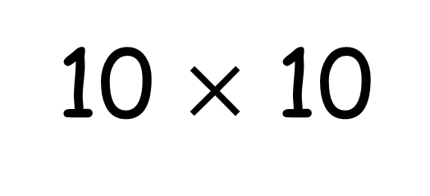
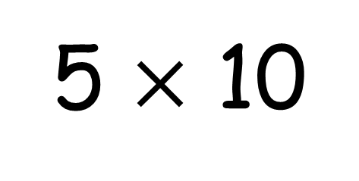
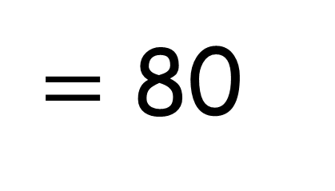
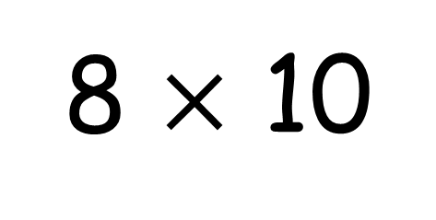
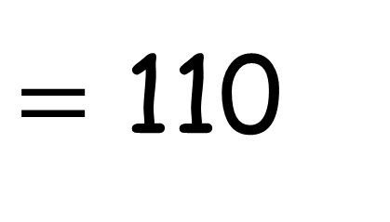
5 $×$ 10
10 $×$ 2
8 $×$ 10
10 $×$ 10
10 $×$ 11
$=$ 50
$=$ 20
$=$ 80
$=$ 100
$=$ 110

