Slide 1



1) What is one less than 6?
2) What is take away
3) If 9 $−$ 5 = 4, then 9 $−$ 4 =
4) What is this called?
1)
2)
3)
4)
1 | 2 | 3 | 4 | 5 | 6 | 7 | 8 | 9 | 10

Slide 2
1) What is one less than 6?
2) What is take away
3) If 9 $−$ 5 = 4, then 9 $−$ 4 =
4) What is this called?
1)
2)
3)
4)
5
3
5
Number track
1 | 2 | 3 | 4 | 5 | 6 | 7 | 8 | 9 | 10

Slide 3

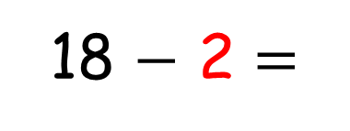
Subtraction
Counting back
I can use a
number track
to count back.
16
18 $−$ 2 =
11 | 12 | 13 | 14 | 15 | 16 | 17 | 18 | 19 | 20

Slide 4



Remember to count 4 jumps.
4
3
2
1
11 | 12 | 13 | 14 | 15 | 16 | 17 | 18 | 19 | 20
I can count back 4!
16, 15, 14, 13
16
$$−$$
4
$$=$$
13
12

Slide 5
Try it again, Tiny.
4
3
2
1
11 | 12 | 13 | 14 | 15 | 16 | 17 | 18 | 19 | 20
16,
15,
14,
13
OK! I will.
17
$$−$$
4
$$=$$
13

Slide 6







Have a think
Counting back
using a number line
6
7
8
9
10
11
12
13
14
15
16
17
18
19
20
19
$$−$$
2
$$=$$
17
17
$$−$$
3
$$=$$
14
14
$$−$$
1
$$=$$
13

Slide 7


Have a think
Counting back
using a number line
4
3
2
1
6
7
8
9
10
11
12
13
14
15
16
17
18
19
20
15
$$−$$
4
$$=$$
11

