Slide 1

MY HOBBY: CRICKET
MR PARRY

Slide 2
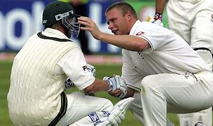
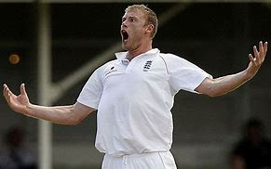
How did I get involved in cricket?
Watching The 2005 Ashes inspired me to start playing cricket. It was so captivating watching some of my early heroes competing at such a high level.
Andrew Flintoff was my idol as a child (and still is to some extent). The way he displays passion and commitment, combined with fair play and humour, was incredibly inspiring.

Slide 3
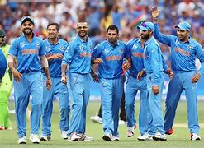
Why do I enjoy my hobby?
I think that cricket is a great way to socialise with friends, whilst still keeping fit and taking part in competitive sport.
It can give you a great ‘buzz’ when you are doing well, like scoring a hundred, hence helping to improve your mood and mental health.

Slide 4
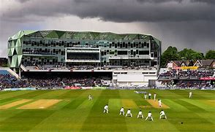
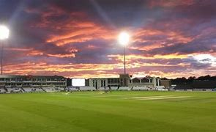
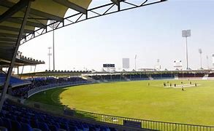
Where has my hobby taken me?
I have travelled to several amazing places, both domestic and overseas, to play cricket – this has been a real privilege.
I have played at Headingley (Leeds), Emirates Riverside (Durham) and Sharjah International Cricket Stadium (Dubai).

Slide 5


One final note…
Cricket is massively enjoyable and important to me for several reasons. Perhaps the most important reason is that it has shown me that you can achieve your dreams if you are willing to work hard enough.

