Slide 1



P.E from Home KS1

Slide 2
Introduction
Physical activity can be lots of things. It can mean all bodily movements that use energy. It includes all types of physical exercise, sports and dance activities. But it also includes indoor and outdoor play, work-related activity, outdoor and adventurous activities, active travel (walking, cycling, scooting) and even something as simple as using the stairs in your home.
For everyone, not just children, who are stuck at home this lockdown it’s important to maintain a physical exercise routine and where possible try and stay as active as you can be. It may even be a great time to increase how active you are if you have more available time. Staying active is extremely important, we should aim to do physical activity everyday for 60 minutes if you are aged between 5-18.
The following PowerPoint is our third instalment for P.E. at home and has some new ways in which your child can stay active this week as well as those challenges for across this half term. Hopefully you are making a start at those longer activities for this half term. Maybe some of you have already climbed many mountains or even got Bingo? Remember if you have let us know on class dojo.
Thanks Elliott

Slide 3


Warm-up: Cosmic Yoga
It’s always important to stretch and warm up before doing any sport to get us ready for our activities.
This weeks cosmic yoga warm-up is a special yoga adventure inspired by the Sonic the Hedgehog movie. Step into Sonic’s sneakers and find out how it feels to be the coolest hedgehog in the universe.
https://www.youtube.com/watch?v=QM8NjfCfOg0&list=PL8snGkhBF7nhEquR7wXbzIXjFrlXsze_H&index=16

Slide 4
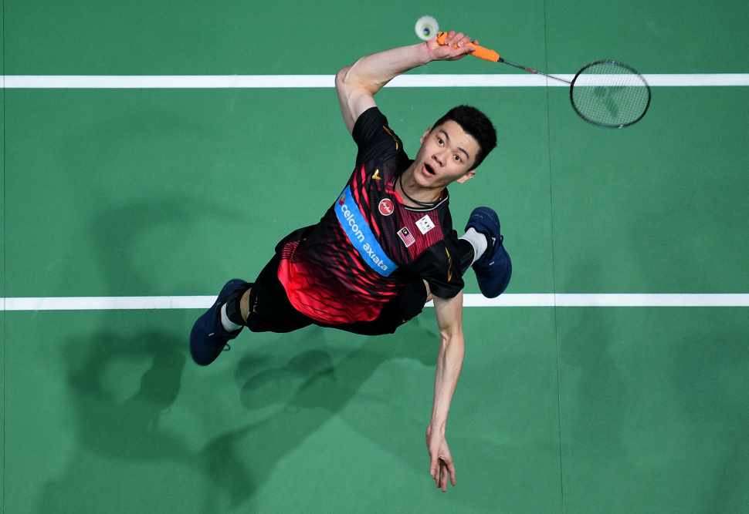
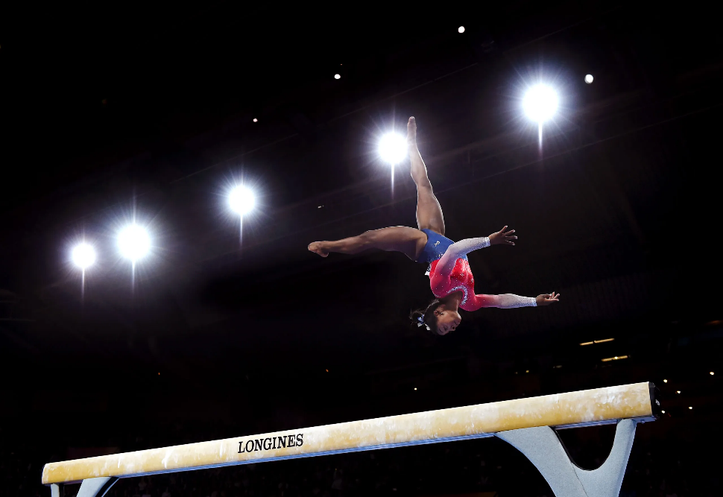
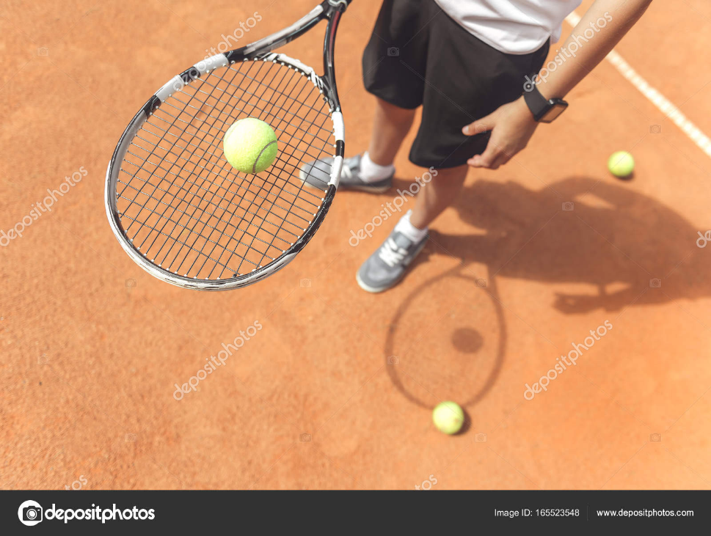
This Weeks Activities
This week one of our focuses is going to be on strength and balance through gymnastics. We will also focus on hand-eye coordination and reactions. Core strength and good balance are essential in any young child’s life and are required in the basic movements and activities they will do daily. Hand-eye coordination and reactions are just as important in daily life but apply to this half-terms sporting focus of Hockey, but are even more essential in our upcoming next half-term sports of Badminton and Tennis.

Slide 5
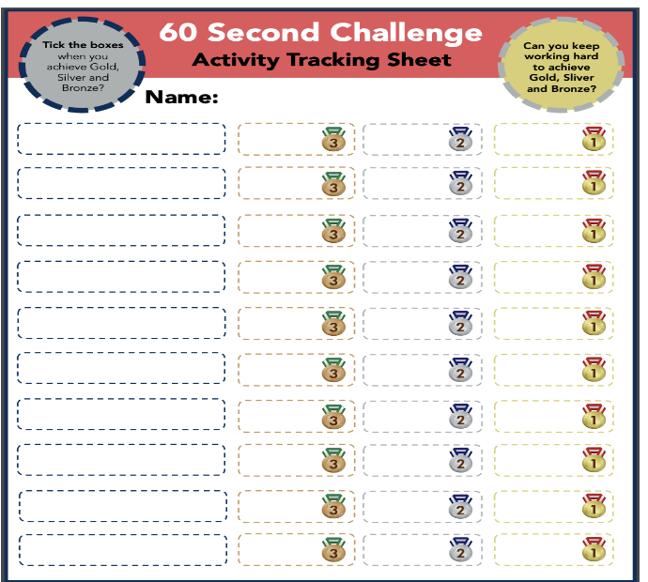
Activity 1: Rock & Roll Gymnastics
Our next activity will work on some gymnastic moves to help increase strength and balance. The video link below shows you how to play and what we are going to practice.
https://www.youtube.com/watch?v=DcGFteFryoA
Courtesy of Yorkshire Sport Foundation
Do the following to earn those medals;
Gold: Rock back and forward to stand on one leg 5 times in a row.
Silver: Rock back and forward to stand on two legs 10 times in a row.
Bronze: Rock back and forward to sit up 10 times in a row.
Submit your high score for keep ups and rallies to class dojo!

Slide 6
Activity 2: Balloon Blasting
Our next activity will test our hand-eye coordination through striking the balloon to keep it up and return it to a partner. The video link below shows you how to play and what we are going to practice.
https://www.youtube.com/watch?v=08AIvWfmJlo
Courtesy of Yorkshire Sport Foundation
For our medal challenge can you try and keep the balloon up for a rally for as long as possible as many times as you can in 60 seconds. The second challenge is can you try and keep two balloons up on your own by hitting them upwards. Use both hands and count every time you hit the balloons try get as high a score as you can.
Gold: Get a rally of 60 seconds and keep two balloons up on your own for 30 hits.
Silver: Get a rally of 40 seconds and keep two balloons up on your own for 20 hits.
Bronze: Get a rally of 20 seconds and keep two balloons up on your own for 10 hits.
If you are finding keeping two balloons up on your own difficult try with one then build up to two!
Submit your high score for keep ups and rallies to class dojo!

Slide 7
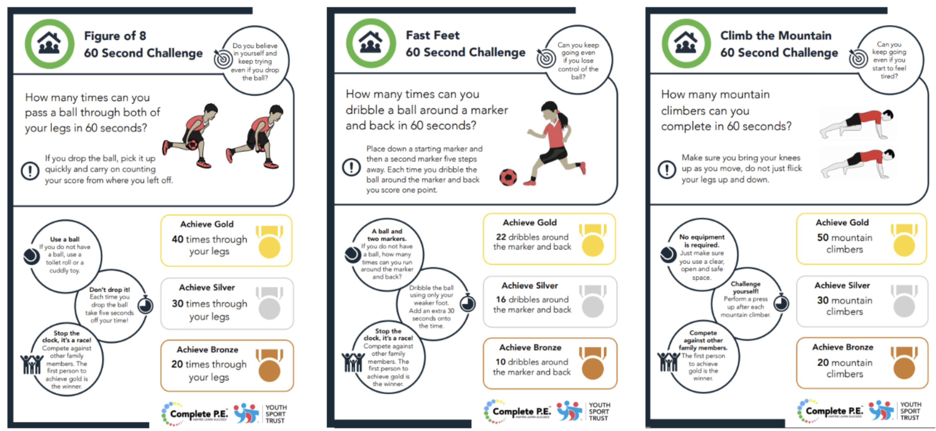
Activity 3: 60 second skill challenge *bonus*
Here are a few more 60 second challenges you can do to earn even more medals. Remember don’t worry if you don’t get Gold straightaway keep practicing to work your way up from Bronze, to Silver, to Gold. Remember to record your scores on the score sheet from the previous slide.

Slide 8
Activity 4: Workout Challenge
The below are a few links to videos from the wonderful YouTube channel of Joe Wicks who has been keeping the entire nation moving across all three of these lockdowns. They are some short exercise blasts that can be done in one go as a longer exercise workout or as a daily top up.
Active 8 Minute Workout 1 | The Body Coach
https://www.youtube.com/watch?v=uqLNxJe4L2I&list=PLyCLoPd4VxBvPHOpzoEk5onAEbq40g2-k&index=6
5 Minute Move | Short energising workout for kids and schools
https://www.youtube.com/watch?v=5MBEyQIlrfo&list=PLyCLoPd4VxBvPHOpzoEk5onAEbq40g2-k&index=8
5 Minute Move | Kids Workout 4 | The Body Coach TV
https://www.youtube.com/watch?v=fAUckPMJKSY&list=PLyCLoPd4VxBvPHOpzoEk5onAEbq40g2-k&index=9

Slide 9
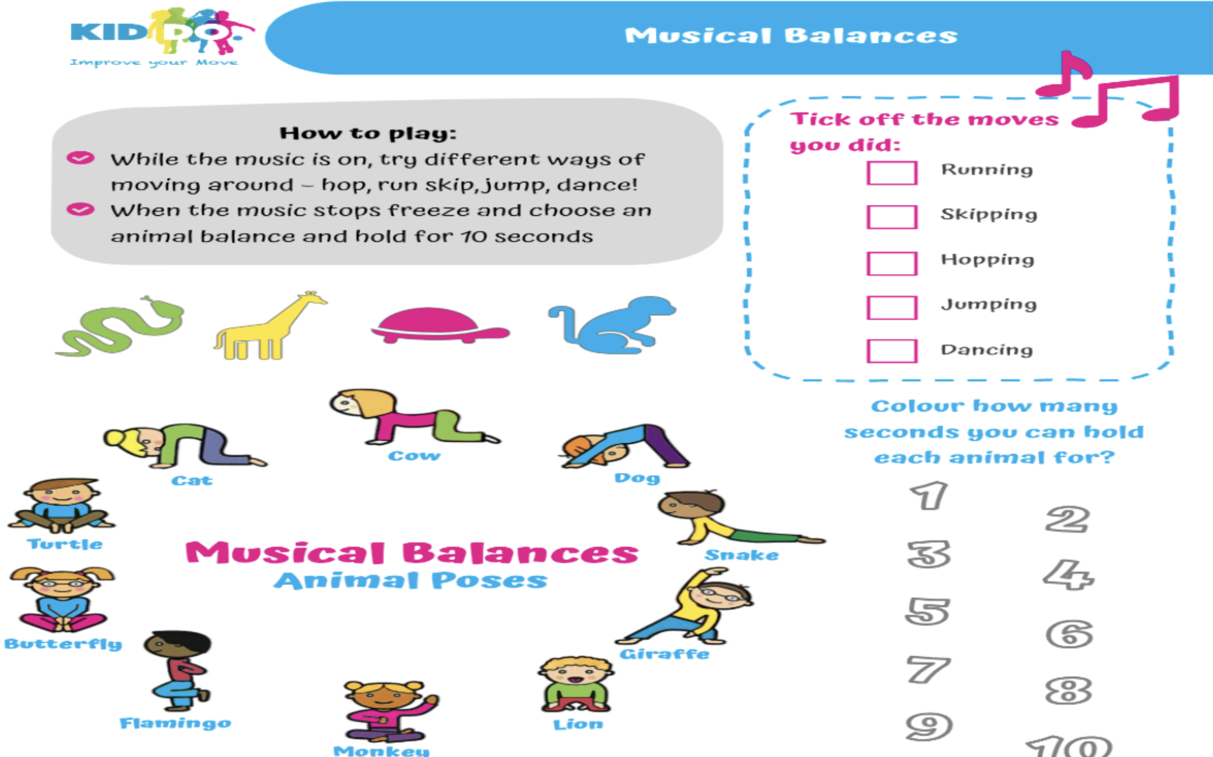
Cool-down: Animal Poses
Our final Animal themed cool down follows on from the previous two weeks. In this one try different ways of moving to music then when the music stops try holding one of the animal poses, or one of your own you created in the last two weeks and hold it for 10 seconds. Try and do every single pose!

Slide 10

Activities to Keep You Moving This Half-term
Remember there are lots of other ways you can keep active this half term. These next few activities are ones you can complete week by week during lockdown. All the activities from previous weeks are there in case you haven’t had chance to start them yet. Some have been updated with a few bonus challenges as well so look out for them.
This week I’ve added another resource you can use this term at home. The NHS Change 4 life website has loads of “10 minute shake-ups” that are all Disney themed games based around your favourite characters that are really easy to do at home with minimal equipment and are really fun.

Slide 11

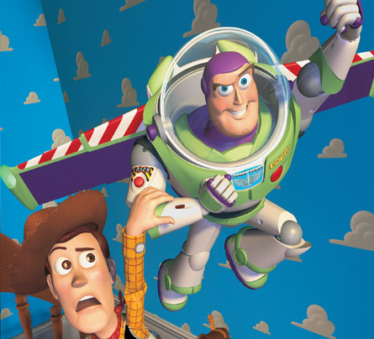
10 Minute Shake Up
Change4Life and Disney have teamed up to bring you play-along games inspired by your favourite Disney and Pixar characters. These 10-minute bursts of fun will really get kids moving and count towards the 60 active minutes they need every day!
There are 10 minute games for absolutely everyone. So if you want to play on your own or with a brother and sister or someone else at home you can. If you want to play a ball based game or a game with no equipment they’ve got them all. So if your favourite character is Elsa or your more a Buzz Lightyear fan that’s fine go and have a look what game your most loved character recommends.

Slide 12
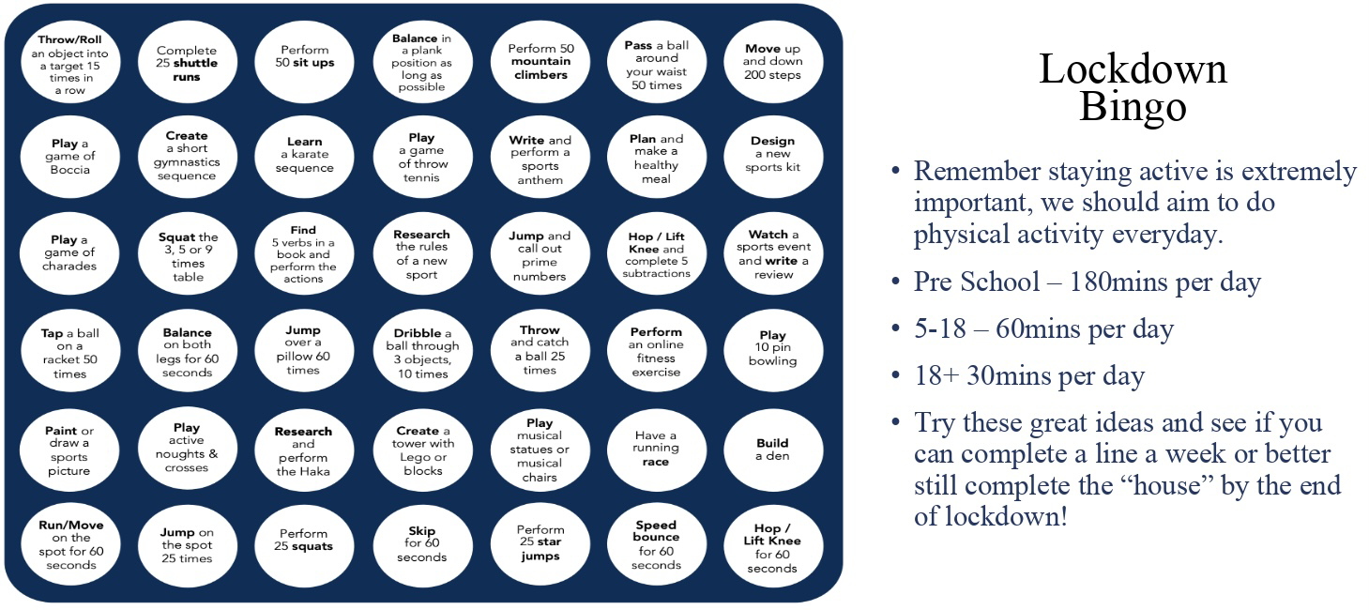
Lockdown Bingo!
Staying active is extremely important, we should aim to do physical activity everyday for 60 minutes if you are aged between 5-18.
Try these great ideas on our bingo sheet and see if you can complete a line a week or better yet complete the entire sheet by the end of lockdown and celebrate getting BINGO!!!
Has anyone got a line yet? Or even bingo?!

Slide 13

Mountain Climbers
Let’s climb a mountain! Using your stairs or just walking around the rooms in your house.
Every day this year we’ve been doing our daily mile and we don’t want to stop now just because of lockdown. So here’s a simple and challenging idea to keep it going. You climb the height of your chosen mountain by taking steps up your staircase. The current record for vertical height climbed by going up stairs is 18585m in 24 hours. We will be impressed if anyone beats that!
Your challenge is to pick a mountain you want to climb this lockdown find some facts about the mountain and work out how many steps you need to do to climb that mountain. Here’s a few already worked out for you:
Scarfell Pike: 6,180 steps
Snowdon: 7,120 steps
Ben Nevis: 8,810 steps
Whereas Mount Everest will take 58,070 steps!!!
*BONUS* Before lockdown I climbed Helvelyn in the Lake District. It is around 3500 steps to get from the bottom to the top on the route I took. Can anyone beat my time of 2 hours 30 minutes to get from the bottom to the top.
Don’t forget if you complete one you could always climb another there are plenty of mountains to climb.

Slide 14

Scavenger Hunt
Indoor scavenger hunt is the perfect challenge for being stuck inside.
Find some small items that you could hide around the house.
Get someone at home to hide them - you could start with just one room, or one item in each room.
Time how long it takes to collect them all.
Try it again and try and beat your time.
Ways to make it more challenging;
Add more items and try and make them smaller and smaller so they’re harder to spot.
Add more rooms to the hunt so you have got a bigger area to search in.
Try to do complete the scavenger hunt moving in different ways. Have to move on all fours, only allowed to hop on one leg etc.

Slide 15
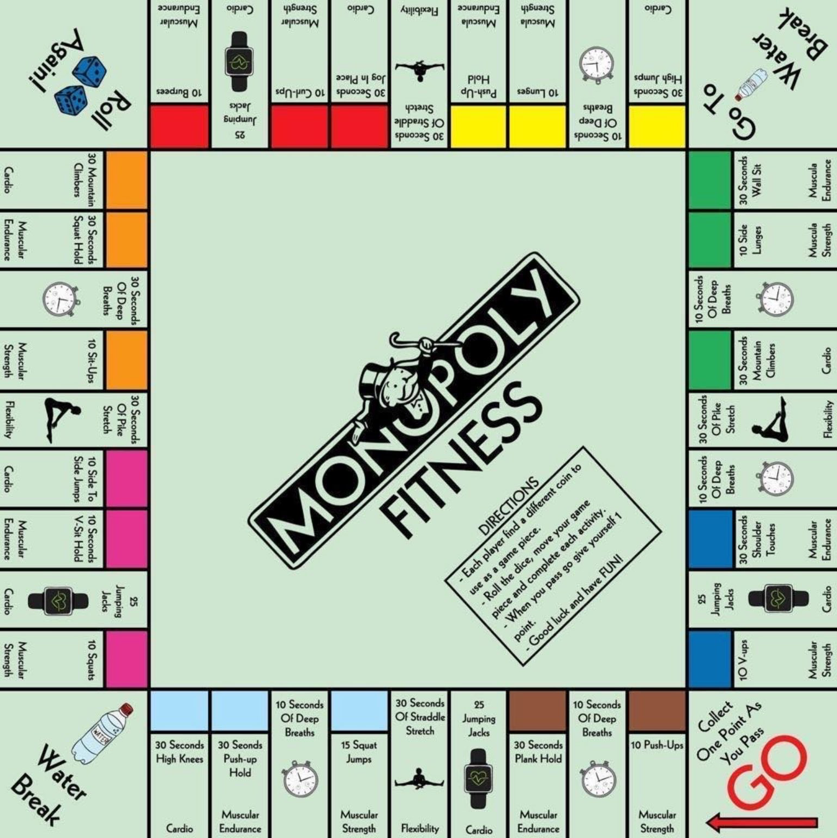
Monopoly Fitness
A fitness twist on the classic game. If you can, print off this slide and grab some coins as game pieces and some dice.
Roll the dice, move your game piece and complete each activity.
When you pass go give yourself one point. You could say first to 5 or 10 points is the winner. For a longer workout you could even do first to 20 points.
Good luck and have FUN!

Slide 16
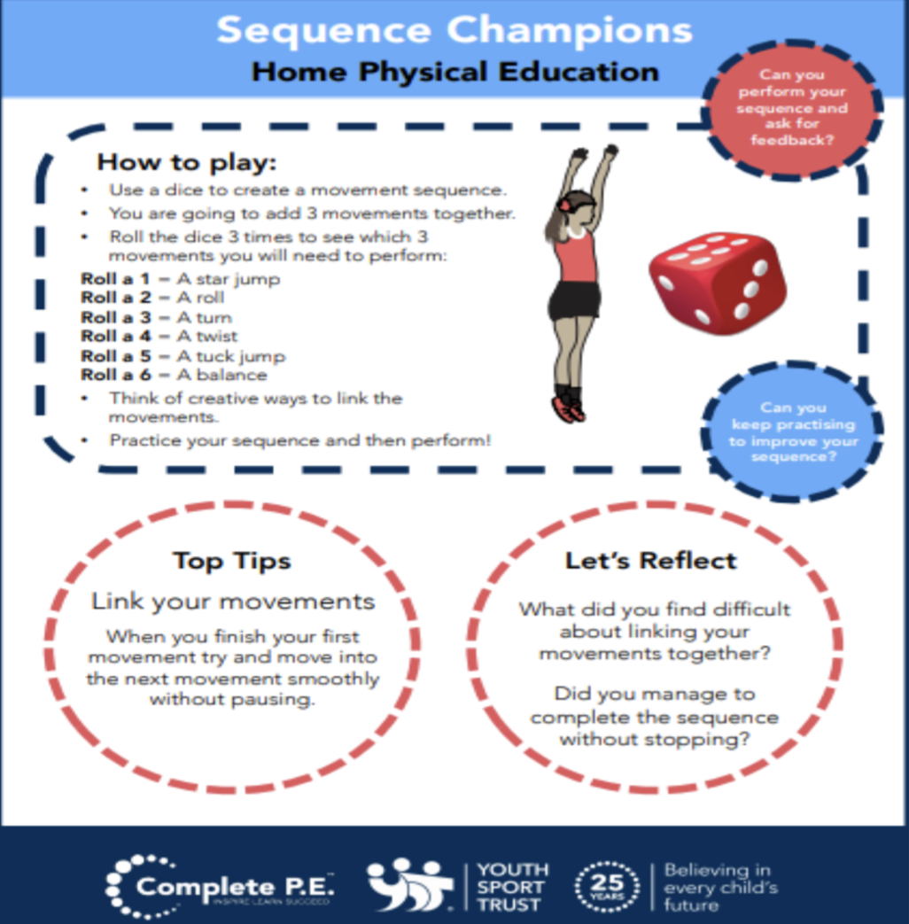
Create your own workout
Following on from everyone enjoying creating their own workouts in the first week. I’ve added it to the half term activities so that you can carry on perfecting your work out routines. Keep working at them and hopefully when we are all back in school and we can use them as a warmups.
Try these extension tasks if your really enjoying this one:
Create your own list of movements to try.
Add some music to your routine and perform it for someone.
Choose 3 different balances and link each balance with a movement from your list e.g. a twist, a jump, a roll. Try and hold each balance for 3-5 seconds.

Slide 17
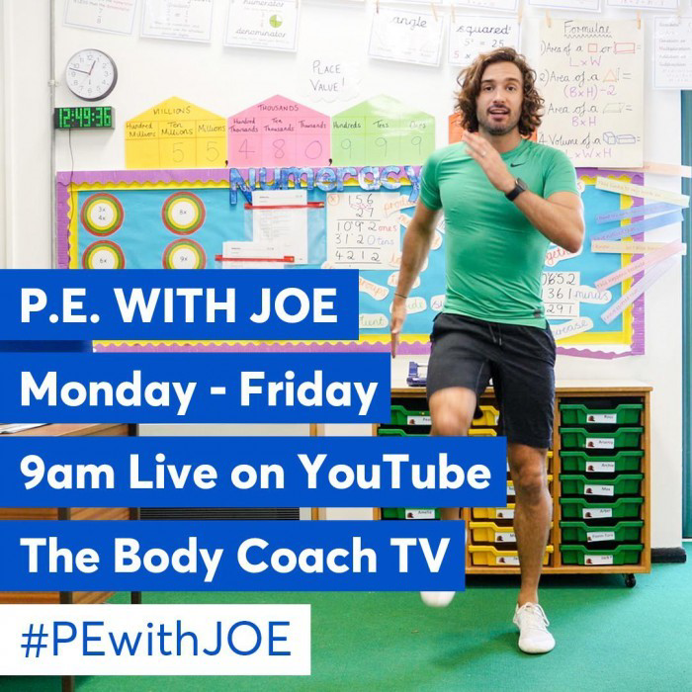
Joe Wicks: P.E at home
If you are still looking for more workout-based activities, Joe Wicks’ weekly workouts are great for kids of all ages.
They are three times a week: Monday, Wednesday and Friday live streamed from 9am.
YouTube channel link: https://www.youtube.com/channel/UCAxW1XT0iEJo0TYlRfn6rYQ
These videos are an excellent tool to use both at school and at home that many schools just like ours are taking advantage off and thankful for.

Slide 18

BBC Supermovers for KS1 and KS2
BBC Supermovers if a fun filled resource for all primary school ages both KS1 and KS2. It is packed with loads of ways to keep young people moving and active but at the same time learning and practicing other key subjects like Maths, English and Science.
The webpage link is: https://www.bbc.co.uk/teach/supermovers
There are up to a 100 different videos to choose from so go have a look and find some fun new ways to learn and be active at the same time.

Slide 19
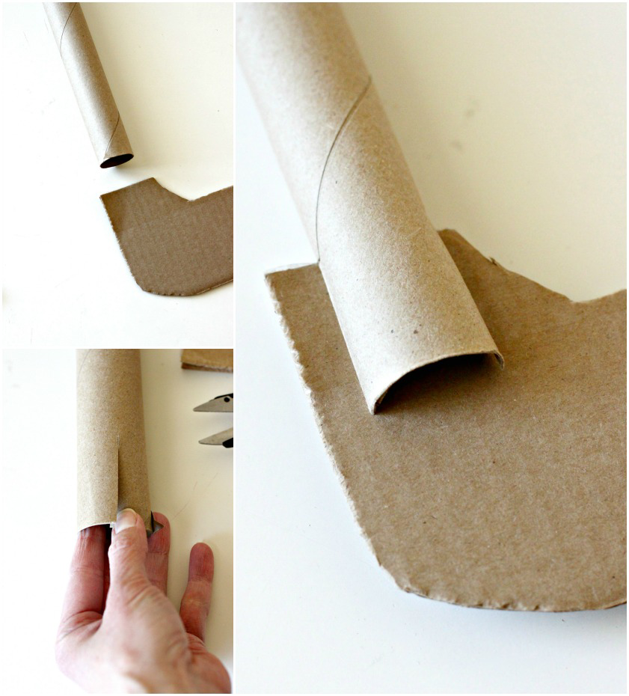
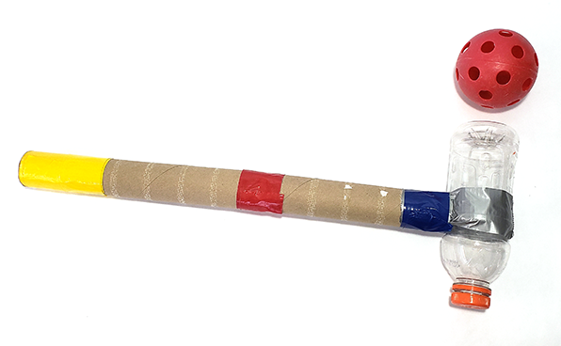
Bonus Challenge
If you haven’t already get creating your own hockey stick!
In anticipation of coming back to school you could be practicing your hockey skills. But to do this you’ll need a hockey stick. As a challenge over the next few weeks try and create one yourself and decorate it how you like. Here’s a few examples for you. Submit a picture of yours to your class dojo so we can see your creations.
On the next slide I have updated the hockey videos so if you’ve already made yours check them out and see if you can give some of them a go. If not just give them a watch to help with your Hockey development and learning.

Slide 20
Extra videos for inspiration for HOCKEY
If you have created your own Hockey stick you could try following these videos for practice or just watch to help understand how we play the sport.
Hockey Core Skills: Grips - Double V Grip:
https://www.youtube.com/watch?v=2GePCYSF6nY
Hockey Core Skills: Passing Skills - Hit:
https://www.youtube.com/watch?v=93xlxmH3_3U
Hockey Core Skills: Passing Skills - Forehand Sweep:
https://www.youtube.com/watch?v=hD49MCZAcV0

