Slide 1



P.E from Home Reception

Slide 2
Introduction
Physical activity can be lots of things. It can mean all bodily movements that use energy. It includes all types of physical exercise, sports and dance activities. But it also includes indoor and outdoor play, work-related activity, outdoor and adventurous activities, active travel (walking, cycling, scooting) and even something as simple as using the stairs in your home.
For everyone, not just children, who are stuck at home this lockdown it’s important to maintain a physical exercise routine and where possible try and stay as active as you can be. It may even be a great time to increase how active you are if you have more available time.
The following PowerPoint has a few ways in which your child can stay active across this half term and will also be updated weekly with a lesson based format with different weekly challenge activities to keep them busy, active and help improve sporting skills. Hope you all enjoy! Thanks Elliott

Slide 3

Warm-up: Cosmic Yoga
It’s always important to stretch and warm up before doing any sport to get us ready for our activities.
Today we are going to do a Minecraft themed cosmic yoga for our warm up. Click the link below to begin.
https://www.youtube.com/watch?v=02E1468SdHg&list=PL8snGkhBF7nhEquR7wXbzIXjFrlXsze_H&index=1

Slide 4
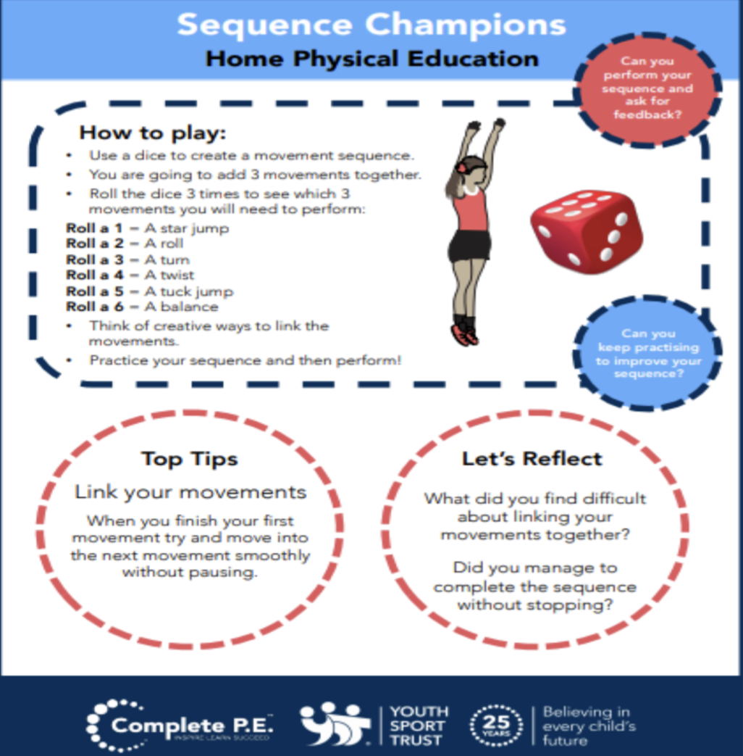
Activity 1: Create your own workout
Can you create your own workout! Using this guide and a dice, roll it to come up with your own hard work out.
Practice it yourself and then you could get someone at home to give it a go.
Try these extension tasks if your really enjoying this one:
Create your own list of movements to try.
Add some music to your routine and perform it for someone.
Choose 3 different balances and link each balance with a movement from your list e.g. a twist, a jump, a roll. Try and hold each balance for 3-5 seconds.

Slide 5
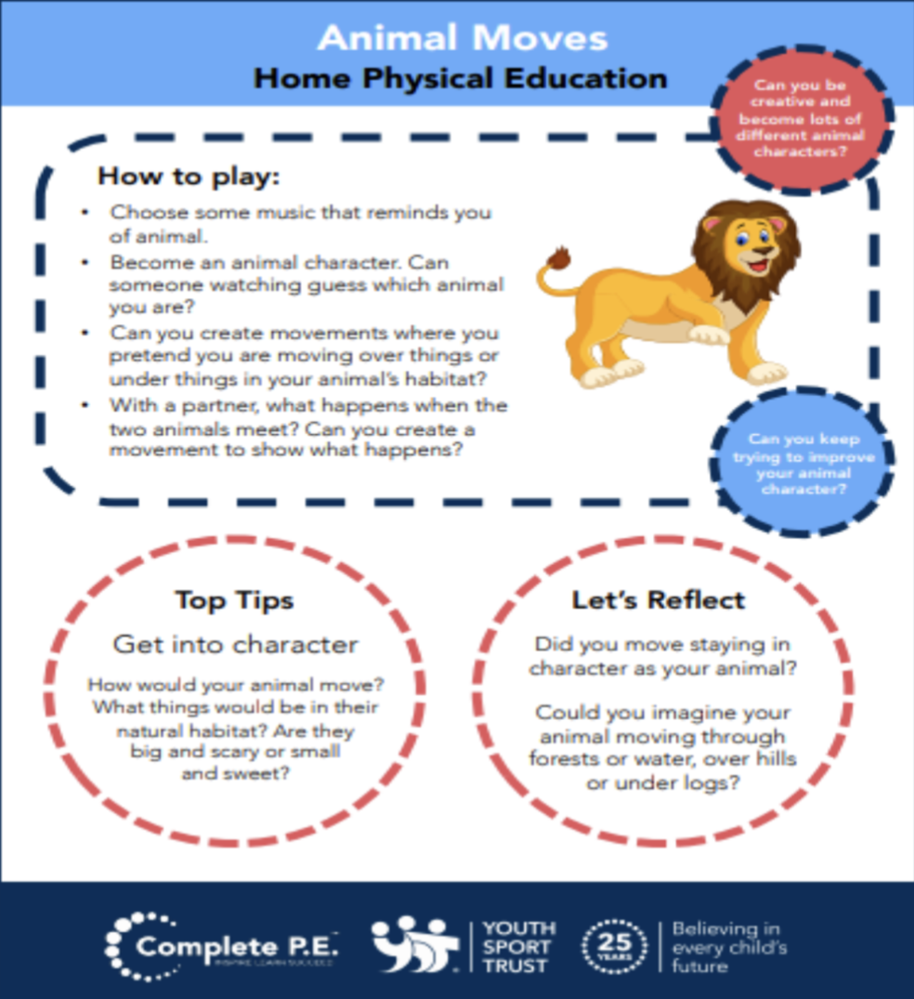
Cool-down: Animal movers
Using the guide here you can warm down and finish our P.E. lesson with a fun animal based game where someone at home needs to guess what animal you are from how you move and act. You can be any animal you choose.

Slide 6

Activities to keep you moving this half term
The following activities are things you can do through the week to keep you moving and active this half term! Complete the challenges and keep us updated of how your getting on weekly.

Slide 7
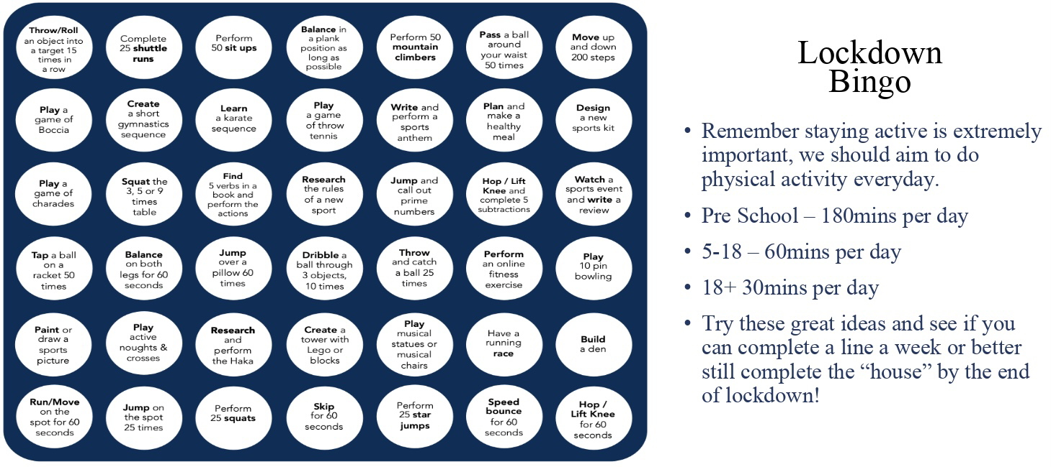
Lockdown Bingo!
Staying active is extremely important, we should aim to do physical activity everyday for 60 minutes if you are aged between 5-18.
Try these great ideas on our bingo sheet and see if you can complete a line a week or better yet complete the entire sheet by the end of lockdown and celebrate getting BINGO!!!

Slide 8

Scavenger Hunt
Indoor scavenger hunt is the perfect challenge for being stuck inside.
Find some small items that you could hide around the house.
Get someone at home to hide them - you could start with just one room, or one item in each room.
Time how long it takes to collect them all.
Try it again and try and beat your time.
Ways to make it more challenging;
Add more items and try and make them smaller and smaller so they’re harder to spot.
Add more rooms to the hunt so you have got an bigger area to search in.
Try to do complete the scavenger hunt moving in different ways. Have to move on all fours, only allowed to hop on one leg etc.

Slide 9
Joe Wicks: P.E at home
If you are still looking for more workout-based activities, Joe Wicks’ weekly workouts are great for kids of all ages.
They are three times a week: Monday, Wednesday and Friday live streamed from 9am.
YouTube channel link: https://www.youtube.com/channel/UCAxW1XT0iEJo0TYlRfn6rYQ
These videos are an excellent tool to use both at school and at home that many schools just like ours are taking advantage off and thankful for.

Slide 10
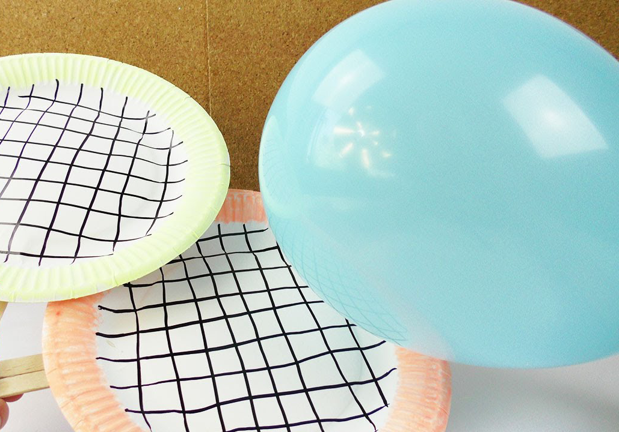
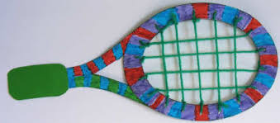
Bonus Challenge
Create your own tennis racket!
Following on from your first online activity set by Miss Puttick that everyone seemed to really enjoy (PE session 1) we thought a way we could make this even more fun is over the next few weeks try and create your own Tennis racket/bat and decorate it how you like.
Here’s a few examples for you. Submit a picture or video of yours to your class dojo so we can see your creations. Elliott, Miss Puttick and Mrs Barber will choose our favourites.

