Slide 1

Activities to Keep You Moving This Half-term
Remember there are lots of other ways you can keep active this half term. These next few activities are ones you can complete week by week during lockdown. All the activities from previous weeks are there in case you haven’t had chance to start them yet. Some have been updated with a few bonus challenges as well so look out for them.
This week I’ve added two new ones. Monopoly fitness and create your own workout from week 1 has been added so that you can carry on being creative and improving them so that we could use them for our warmups once we are all back in school.

Slide 2
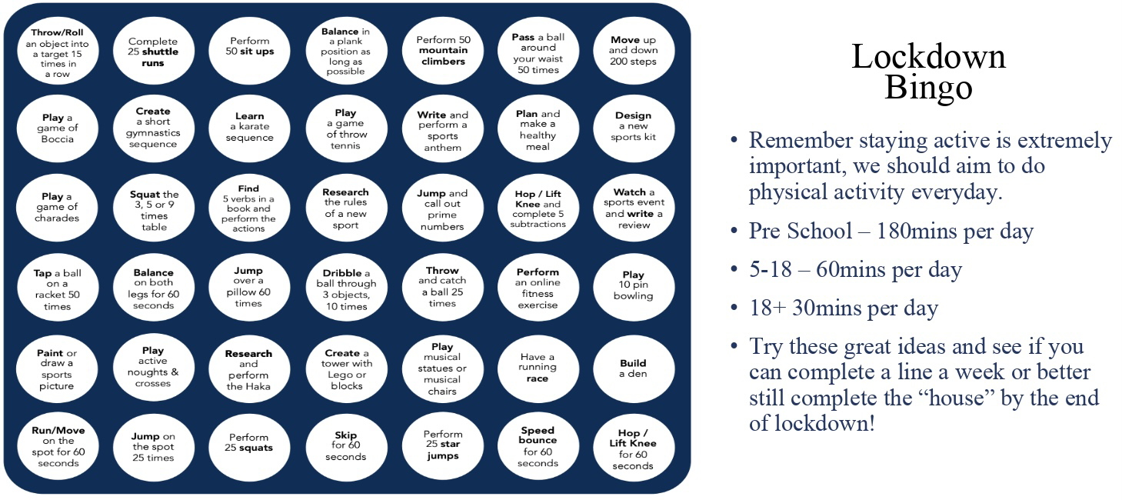
Lockdown Bingo!
Staying active is extremely important, we should aim to do physical activity everyday for 60 minutes if you are aged between 5-18.
Try these great ideas on our bingo sheet and see if you can complete a line a week or better yet complete the entire sheet by the end of lockdown and celebrate getting BINGO!!!
Has anyone got a line yet? Or even bingo?!

Slide 3

Mountain Climbers
Let’s climb a mountain! Using your stairs or just walking around the rooms in your house.
Every day this year we’ve been doing our daily mile and we don’t want to stop now just because of lockdown. So here’s a simple and challenging idea to keep it going. You climb the height of your chosen mountain by taking steps up your staircase. The current record for vertical height climbed by going up stairs is 18585m in 24 hours. We will be impressed if anyone beats that!
Your challenge is to pick a mountain you want to climb this lockdown find some facts about the mountain and work out how many steps you need to do to climb that mountain. Here’s a few already worked out for you:
Scarfell Pike: 6,180 steps
Snowdon: 7,120 steps
Ben Nevis: 8,810 steps
Whereas Mount Everest will take 58,070 steps!!!
*BONUS* Before lockdown I climbed Helvelyn in the Lake District. It is around 3500 steps to get from the bottom to the top on the route I took. Can anyone beat my time of 2 hours 30 minutes to get from the bottom to the top.
Don’t forget if you complete one you could always climb another there are plenty of mountains to climb.

Slide 4
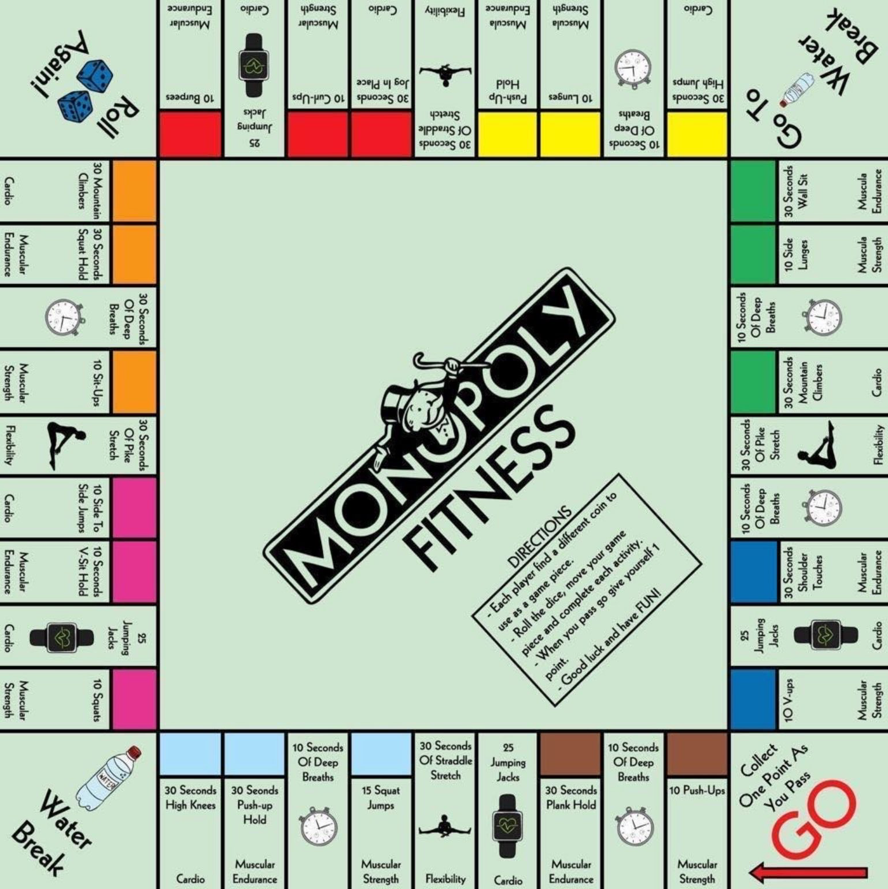
Monopoly Fitness
A fitness twist on the classic game. If you can, print off this slide and grab some coins as game pieces and some dice.
Roll the dice, move your game piece and complete each activity.
When you pass go give yourself one point. You could say first to 5 or 10 points is the winner. For a longer workout you could even do first to 20 points.
Good luck and have FUN!

Slide 5
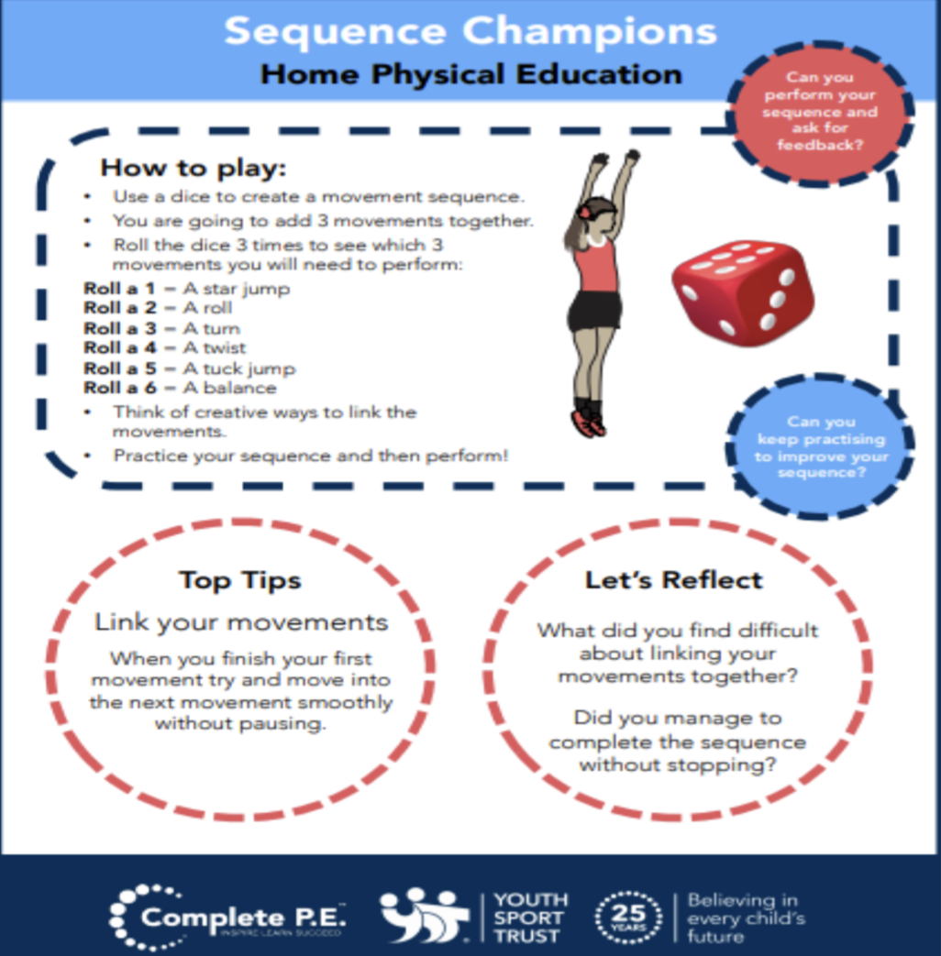
Create your own workout
Following on from everyone enjoying creating their own workouts in the first week. I’ve added it to the half term activities so that you can carry on perfecting your work out routines. Keep working at them and hopefully when we are all back in school and we can use them as a warmups.
Try these extension tasks if your really enjoying this one:
Create your own list of movements to try.
Add some music to your routine and perform it for someone.
Choose 3 different balances and link each balance with a movement from your list e.g. a twist, a jump, a roll. Try and hold each balance for 3-5 seconds.

Slide 6
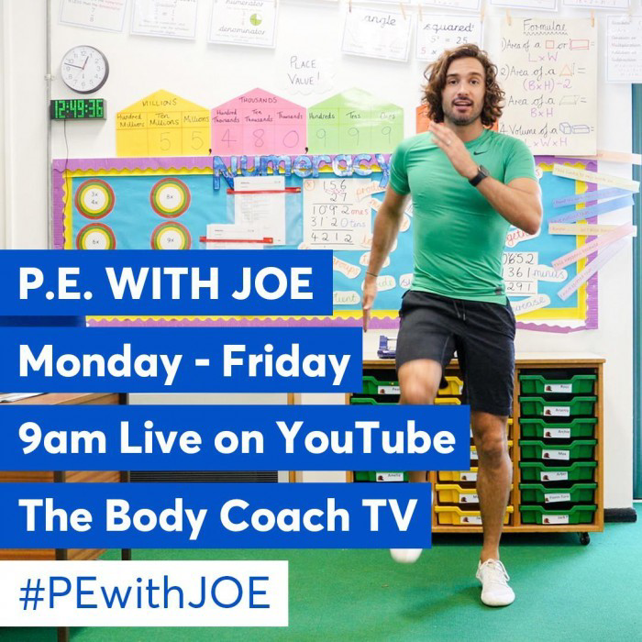
Joe Wicks: P.E at home
If you are still looking for more workout-based activities, Joe Wicks’ weekly workouts are great for kids of all ages.
They are three times a week: Monday, Wednesday and Friday live streamed from 9am.
YouTube channel link: https://www.youtube.com/channel/UCAxW1XT0iEJo0TYlRfn6rYQ
These videos are an excellent tool to use both at school and at home that many schools just like ours are taking advantage off and thankful for.

Slide 7

BBC Supermovers for KS1 and KS2
BBC Supermovers if a fun filled resource for all primary school ages both KS1 and KS2. It is packed with loads of ways to keep young people moving and active but at the same time learning and practicing other key subjects like Maths, English and Science.
The webpage link is: https://www.bbc.co.uk/teach/supermovers
There are up to a 100 different videos to choose from so go have a look and find some fun new ways to learn and be active at the same time.

Slide 8
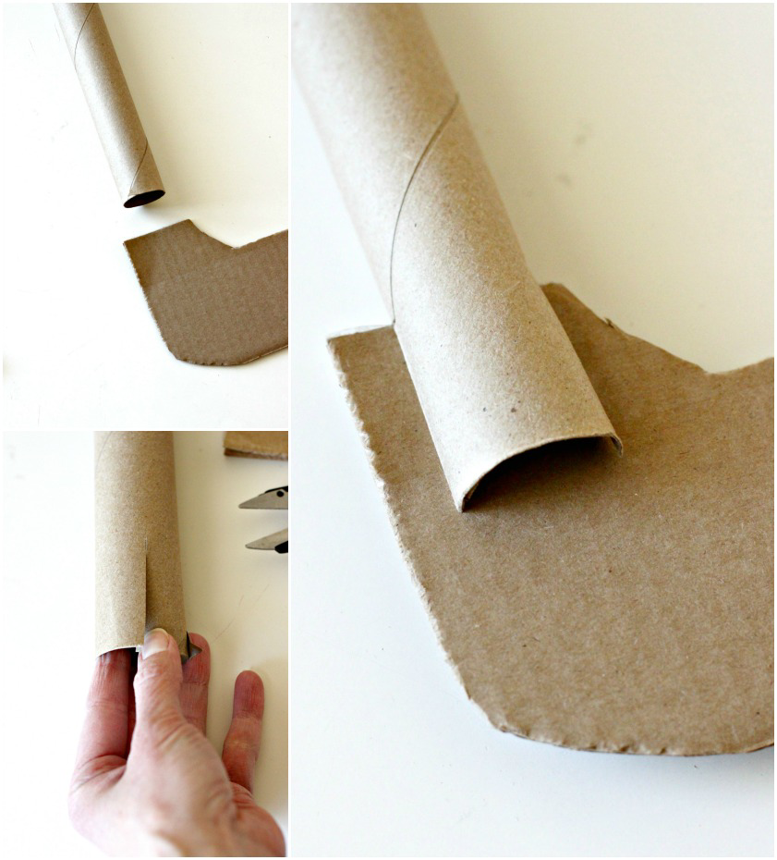
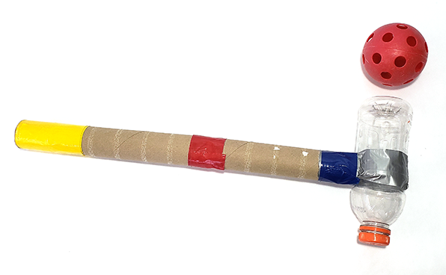
Bonus Challenge
If you haven’t already get creating your own hockey stick!
In anticipation of coming back to school you could be practicing your hockey skills. But to do this you’ll need a hockey stick. As a challenge over the next few weeks try and create one yourself and decorate it how you like. Here’s a few examples for you. Submit a picture of yours to your class dojo so we can see your creations.
On the next slide I have updated the hockey videos so if you’ve already made yours check them out and see if you can give some of them a go. If not just give them a watch to help with your Hockey development and learning.

Slide 9
Extra videos for inspiration for HOCKEY
If you have created your own Hockey stick you could try following these videos for practice or just watch to help understand how we play the sport.
Hockey Core Skills: Ball Control - Pulls Drags:
https://www.youtube.com/watch?v=WRAkfHEj5wM
Hockey Core Skills: Passing Skills - Push on the Move Side & Frontal:
https://www.youtube.com/watch?v=I7rSCdpRLrI
Hockey Core Skills: Basic Forehand Receiving:
https://www.youtube.com/watch?v=JnIMreaOwWk

