Slide 1



P.E from Home Year 5&6

Slide 2
Introduction
Physical activity can be lots of things. It can mean all bodily movements that use energy. It includes all types of physical exercise, sports and dance activities. But it also includes indoor and outdoor play, work-related activity, outdoor and adventurous activities, active travel (walking, cycling, scooting) and even something as simple as using the stairs in your home.
For everyone, not just children, who are stuck at home this lockdown it’s important to maintain a physical exercise routine and where possible try and stay as active as you can be. It may even be a great time to increase how active you are if you have more available time. Staying active is extremely important, we should aim to do physical activity everyday for 60 minutes if you are aged between 5-18.
This is our fourth instalment for P.E. At home. The following PowerPoint has some new ways in which your child can stay active this week as well as those challenges for across this half term. Hopefully you are making a start at those longer activities for this half term. Remember if there is one activity you really enjoyed from a previous week there is no reason you can’t go back to that PowerPoint and play it again. These PowerPoints are all about giving you ideas for things to do at home, but that doesn’t mean you can’t be creative yourself and change some of these games to make them more fun for you!
Thanks Elliott

Slide 3
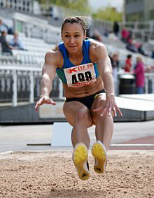

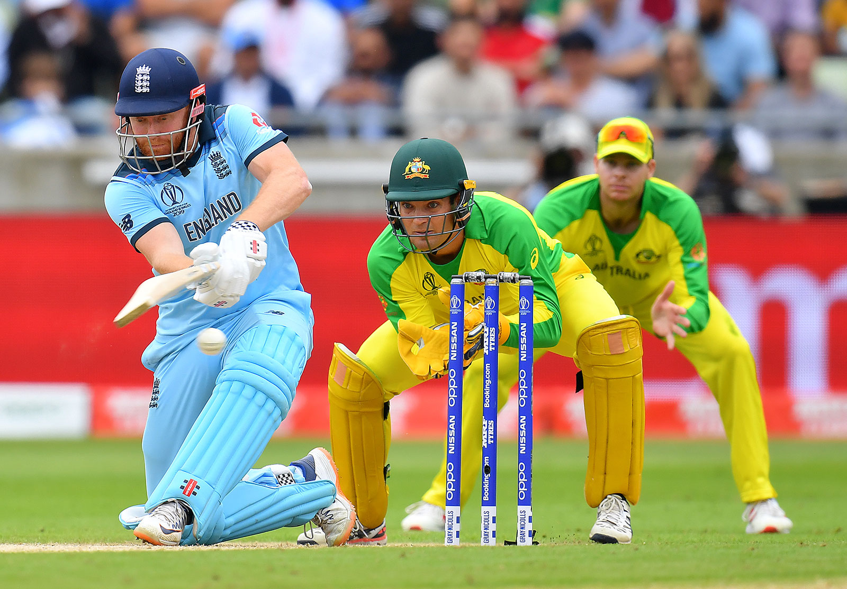
This Weeks Activities
Remember you don’t have to do all of these activities in one go! Spread them across the week if you want to keep you busy!
This week our activities are working on a variety of skills that are applicable and needed in almost any sport. The first is building on our footwork patterns from previous weeks but in the form of jumping this time. This is a skill needed in everyday life but especially in sports such as athletics. The second skill is agility, this applies the first activity and previous footwork activities into different games that will get us moving to avoid both static and moving objects testing out footwork coordination to be as fast as possible; this links to several sports such as football, rugby and cricket. This week I’ve added a third main activity to give you more choice and keep you busy. That means this week we’ve got more chances than ever to win those Gold medals with three activities as well as the 60 second challenges! This weeks third activity is a great one that we’ve done in school before as a team game but is just as fun working on your own. King of the cones activity is a variety of 3 games with aim of beating a partner through throwing or rolling accuracy to steal all of there cones. It can be adapted as well so you can create your own way to play. Remember just because you don’t have cones doesn’t mean you can’t play, it can be done with any household object.

Slide 4

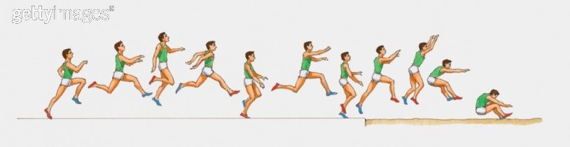
Warm-up & Activity 1: Jumping Combinations
Our next activity will build on the work we did on footwork patterns a few weeks ago by applying those skills to jumping combinations. The video link below shows you how to set-up and what we are going to practice for our warm up. For our warm-up challenge try and set up some courses that look like the ones in the video to play the three versions of the games. Try completing as many as you can getting faster and faster each time.
https://www.youtube.com/watch?v=cRjO1IGwbLo
Courtesy of Yorkshire Sport Foundation
For our main challenge put what you’ve practised in the warm up into trying to perfect the Triple Jump. We did the triple jump in athletics at the start of the school year so we should all remember the basics to it. Remember it’s called the triple jump because it’s a hop-skip-jump; doing all three back to back as one continuous movement.
Use the image below to help-workout which foot to land on and push off and watch this video below for some inspiration for your jump.
Men’s Triple Jump RIO 2016: https://www.youtube.com/watch?v=xfxvPFYB4VE
Try and get
Do the following to earn those medals;
Gold: Complete 20 jumping combination circuits & master the triple jump setting as long a jump as you can!
Silver: Complete 15 jumping combination circuits & master the triple jump setting as long a jump as you can!
Bronze: Complete 10 jumping combination circuits & master the triple jump setting as long a jump as you can!
Submit your high scores to class dojo!

Slide 5
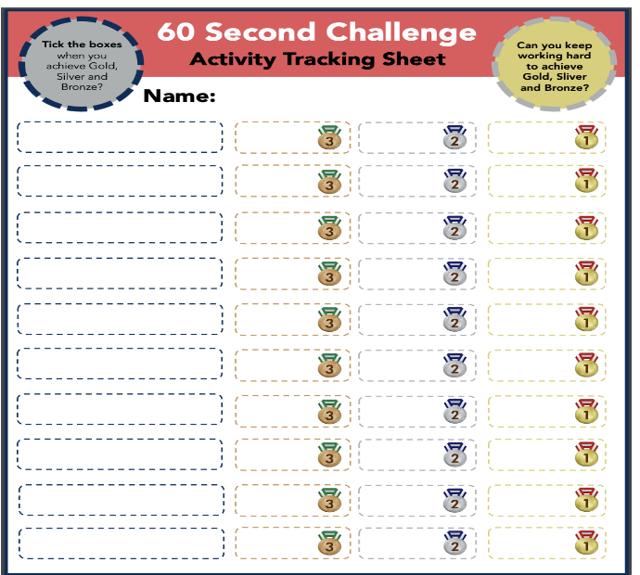
Activity 2: Agility
Our next activity will test our agility; how we change direction, how we move our feet, how fast we do it. These games build on activity one as well as our previous footwork patterns. The second game in this video is like our get past the goalkeeper one from previous weeks. The video link below shows you how to play and what we are going to practice.
https://www.youtube.com/watch?v=cUy-nGjLWQM
Courtesy of Yorkshire Sport Foundation
For our medal challenge play the obstacle game at the end of the video with the balls that you need to dodge. Try playing for 60 second games and then try again and beat your scores from the previous go. Avoid the obstacles on the floor and them balls to get these medals!
Do the following to earn those medals;
Gold: Don’t touch any obstacles and avoid getting hit with the ball in 3 games.
Silver: Touch less than 3 obstacles and avoid getting hit more than 3 times in 3 games.
Bronze: Touch less than 5 obstacles and avoid getting hit more than 5 times in 3 games.
Submit your high scores to class dojo!

Slide 6
Activity 3: King of the Cones
Our next activity will build on on and test our hand-eye coordination skills that we worked on previously through striking the cone (or other object) to beat our partner at the games in the video link below. It’s also a great fitness booster game as it will need to be moving sharp to beat your partner. The video link below shows you how to play and what we are going to practice.
https://www.youtube.com/watch?v=GXN9cYj6eX8
Courtesy of Yorkshire Sport Foundation
For our medal challenge try any of the three versions of the games in the video and try and beat your partner.
Do the following to earn those medals;
Gold: Play your partner at all three games and manage to hit there cones 50 times all together and win 5 times at any of the games.
Silver: Play your partner at all three games and manage to there cones 30 times all together and win 3 times at any of the games.
Bronze: Play your partner at all three games and manage to hit there cones 10 times all together and win 1 times at any of the games.
Submit your high scores to class dojo!

Slide 7
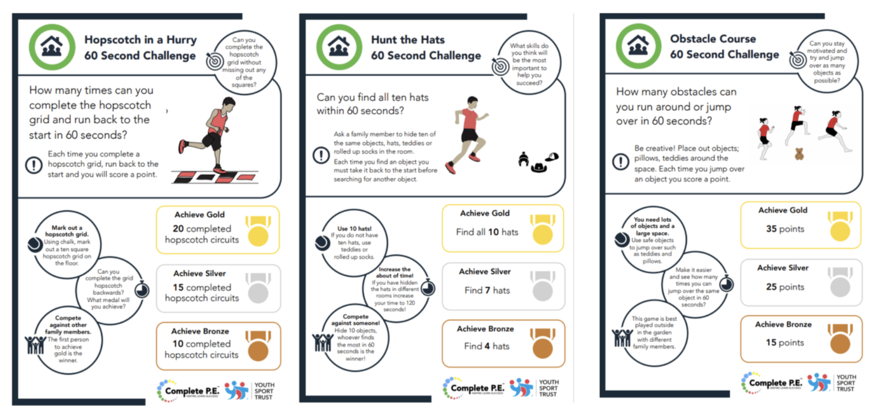
Activity 4: 60 second skill challenge *bonus*
Here are a few more 60 second challenges you can do to earn even more medals. Remember don’t worry if you don’t get Gold straightaway keep practicing to work your way up from Bronze, to Silver, to Gold. Remember to record your scores on the score sheet from the previous slide.

Slide 8
Activity 5: Workout Challenge
The below are a few links to videos from the wonderful YouTube channel of Joe Wicks who has been keeping the entire nation moving across all three of these lockdowns. They are some short exercise blasts that can be done in one go as a longer exercise workout or as a daily top up.
Active 8 Minute Workout 4 | The Body Coach TV
https://www.youtube.com/watch?v=E5cmJpSFZB8&list=PLyCLoPd4VxBvPHOpzoEk5onAEbq40g2-k&index=18
Froggy Coach Active 8 Minute Workout | The Body Coach TV
https://www.youtube.com/watch?v=16FIVgWUklY&list=PLyCLoPd4VxBvPHOpzoEk5onAEbq40g2-k&index=21

Slide 9
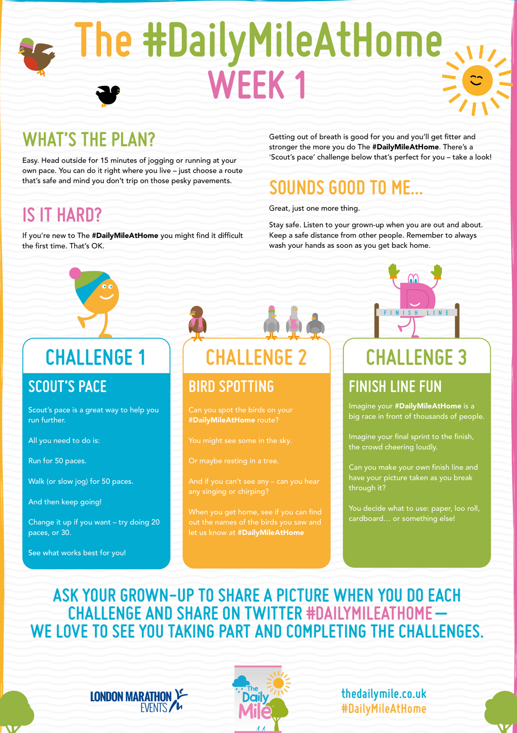
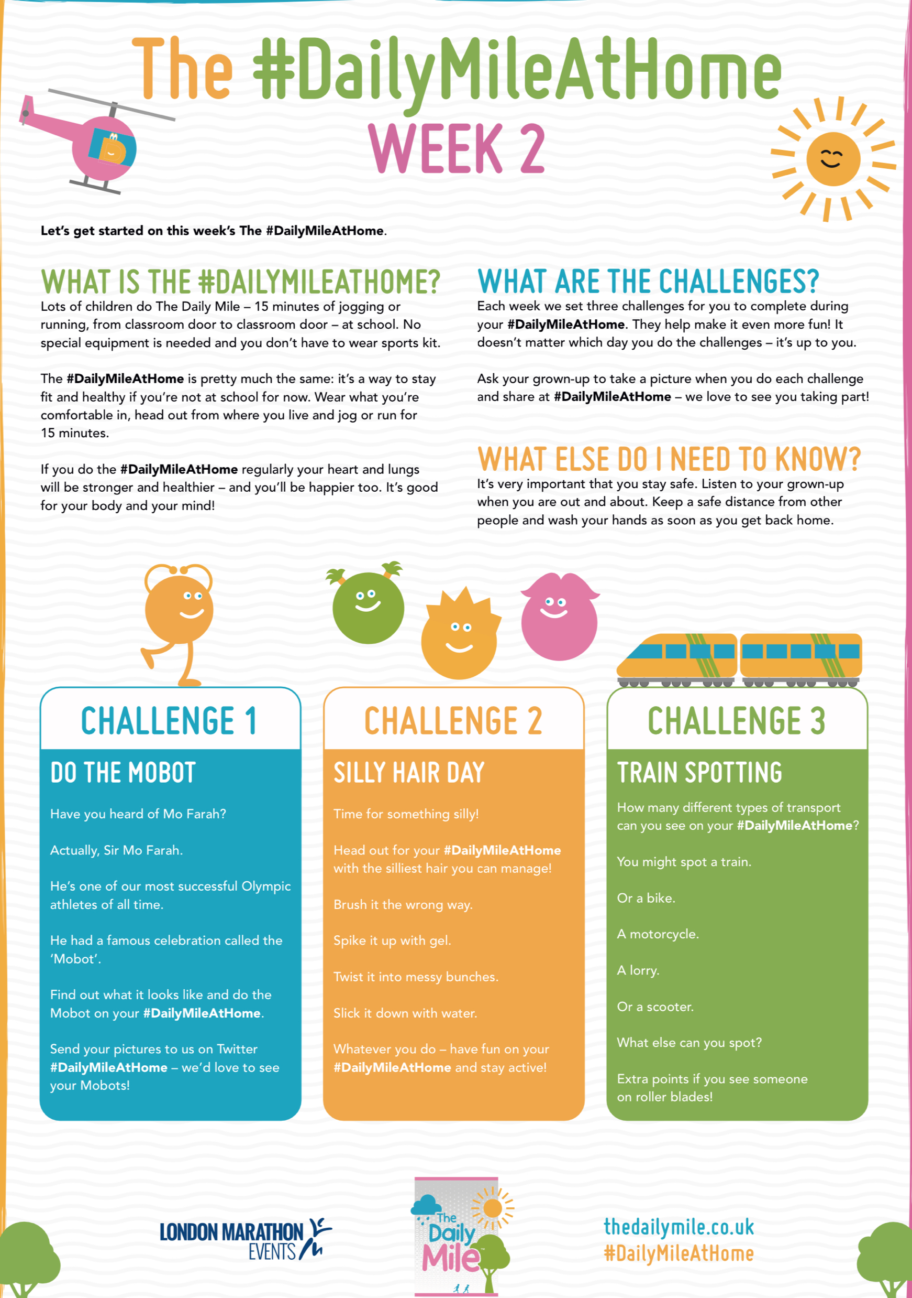
Cool-down: Daily Mile Challenge
In School this year and last summer we’ve had a big focus on completing our “Daily Mile” challenge everyday. These two worksheets are this weeks and last weeks daily mile challenges. They give you fun and creative ways to do your daily mile at home both indoors and outside. Doing a daily mile is a good way to cool down after an intense day of workouts or sporting activities.

Slide 10

Activities to Keep You Moving This Half-term
Remember there are lots of other ways you can keep active this half term. These next few activities are ones you can complete week by week during lockdown. All the activities from previous weeks are there in case you haven’t had chance to start them yet. Some have been updated with a few bonus challenges as well so look out for them.
This week I’ve added a table that gives an overview of online free streamed sports and P.E. Sessions that I will try and add more and more too when I find others. There is Joe Wicks P.E. Sessions on there that we have already talked about but there is after school club sessions as well as sports specific sessions for rugby and cricket. These are suitable for those who might already play as well as those wanting to try something new.

Slide 11
Online Weekly Sessions Timetable
The table below gives you an overview of what online classes are available that you can do at home for free and when they are streamed live on YouTube. All sessions are available on the providers channel after the stream so don’t worry if you miss them or can’t tune in at that time they can always be done later.
Monday | Tuesday | Wednesday | Thursday | Friday | Saturday | Sunday
Am | Am | Am | Am | Am | Am | Am
9am till 10am Joe Wicks P.E. At Home https://www.youtube.com/playlist?list=PLyCLoPd4VxBuS4UeyHMccVAjpWaNbGomt | 10:30am till 11am YST Healthy Movers (EYFS & Year 1) https://www.youtube.com/channel/UCJerWssJeAsbd1kY79oRm7g | 9am till 10am Joe Wicks P.E. At Home https://www.youtube.com/playlist?list=PLyCLoPd4VxBuS4UeyHMccVAjpWaNbGomt | 10:30am till 11am YST Healthy Movers (EYFS & Year 1) https://www.youtube.com/channel/UCJerWssJeAsbd1kY79oRm7g | 9am till 10am Joe Wicks P.E. At Home https://www.youtube.com/playlist?list=PLyCLoPd4VxBuS4UeyHMccVAjpWaNbGomt |  | England Rugby Weekly Rugby Skill & Fitness Sessions Mini & Juniors Age 7-17 https://www.youtube.com/playlist?list=PLcSP18b0KfWMlWu1fevzCT0yM5I8CQ5Yp
Pm | Pm | Pm | Pm | Pm | Pm | Pm
 | 5pm YST After School Sport Clubs https://www.youtube.com/user/YouthSportTrust/videos | 2pm till 2:45pm Chance to Shine Cricket Coaching https://www.youtube.com/results?search_query=chance+to+shine+live | 5pm YST After School Sport Clubs https://www.youtube.com/user/YouthSportTrust/videos

Slide 12


10 Minute Shake Up
Change4Life and Disney have teamed up to bring you play-along games inspired by your favourite Disney and Pixar characters. These 10-minute bursts of fun will really get kids moving and count towards the 60 active minutes they need every day!
There are 10 minute games for absolutely everyone. So if you want to play on your own or with a brother and sister or someone else at home you can. If you want to play a ball based game or a game with no equipment they’ve got them all. So if your favourite character is Elsa or your more a Buzz Lightyear fan that’s fine go and have a look what game your most loved character recommends.

Slide 13
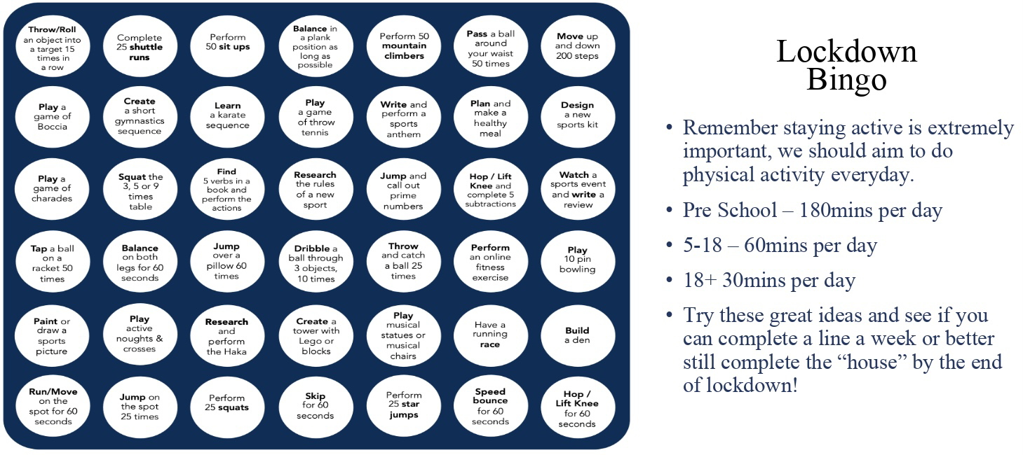
Lockdown Bingo!
Staying active is extremely important, we should aim to do physical activity everyday for 60 minutes if you are aged between 5-18.
Try these great ideas on our bingo sheet and see if you can complete a line a week or better yet complete the entire sheet by the end of lockdown and celebrate getting BINGO!!!
Has anyone got a line yet? Or even bingo?!

Slide 14

Mountain Climbers
Let’s climb a mountain! Using your stairs or just walking around the rooms in your house.
Every day this year we’ve been doing our daily mile and we don’t want to stop now just because of lockdown. So here’s a simple and challenging idea to keep it going. You climb the height of your chosen mountain by taking steps up your staircase. The current record for vertical height climbed by going up stairs is 18585m in 24 hours. We will be impressed if anyone beats that!
Your challenge is to pick a mountain you want to climb this lockdown find some facts about the mountain and work out how many steps you need to do to climb that mountain. Here’s a few already worked out for you:
Scarfell Pike: 6,180 steps
Snowdon: 7,120 steps
Ben Nevis: 8,810 steps
Whereas Mount Everest will take 58,070 steps!!!
*BONUS* Before lockdown I climbed Helvelyn in the Lake District. It is around 3500 steps to get from the bottom to the top on the route I took. Can anyone beat my time of 2 hours 30 minutes to get from the bottom to the top.
Don’t forget if you complete one you could always climb another there are plenty of mountains to climb.

Slide 15

Scavenger Hunt
Indoor scavenger hunt is the perfect challenge for being stuck inside.
Find some small items that you could hide around the house.
Get someone at home to hide them - you could start with just one room, or one item in each room.
Time how long it takes to collect them all.
Try it again and try and beat your time.
Ways to make it more challenging;
Add more items and try and make them smaller and smaller so they’re harder to spot.
Add more rooms to the hunt so you have got a bigger area to search in.
Try to do complete the scavenger hunt moving in different ways. Have to move on all fours, only allowed to hop on one leg etc.

Slide 16
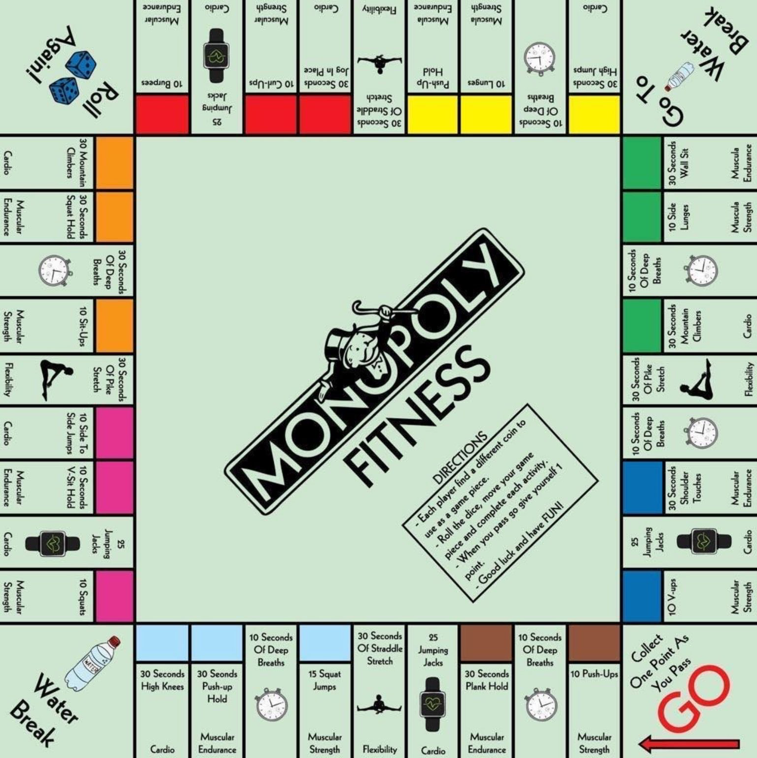
Monopoly Fitness
A fitness twist on the classic game. If you can, print off this slide and grab some coins as game pieces and some dice.
Roll the dice, move your game piece and complete each activity.
When you pass go give yourself one point. You could say first to 5 or 10 points is the winner. For a longer workout you could even do first to 20 points.
Good luck and have FUN!

Slide 17
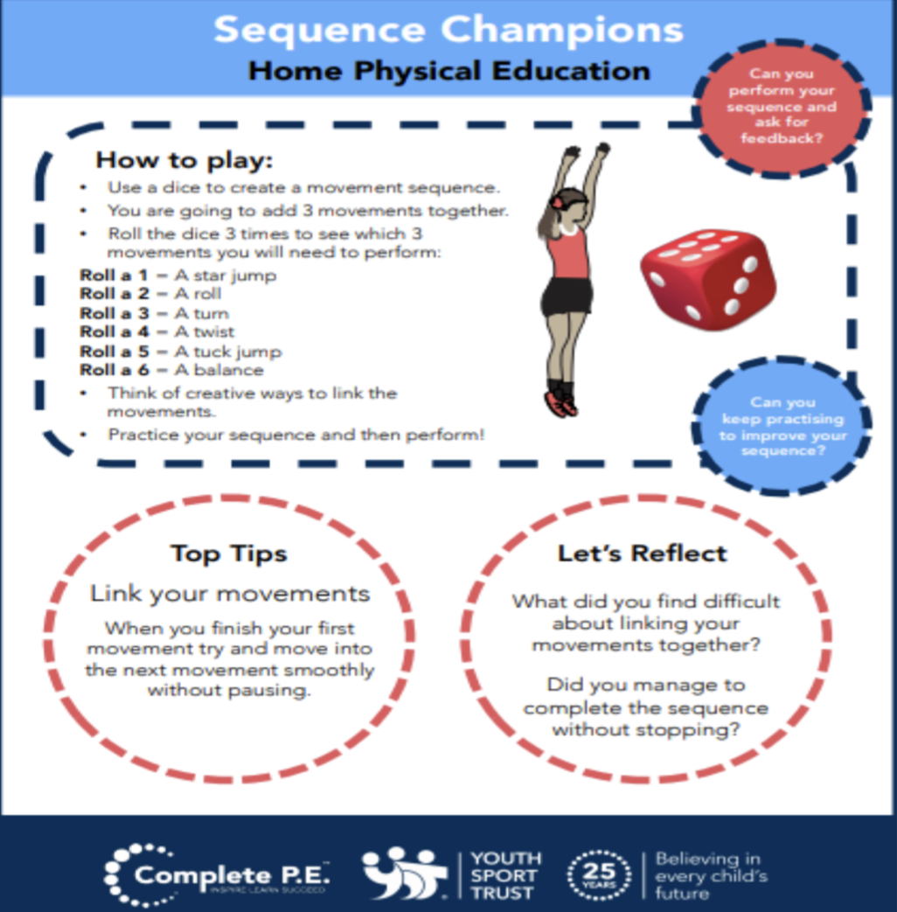
Create your own workout
Following on from everyone enjoying creating their own workouts in the first week. I’ve added it to the half term activities so that you can carry on perfecting your work out routines. Keep working at them and hopefully when we are all back in school and we can use them as a warmups.
Try these extension tasks if your really enjoying this one:
Create your own list of movements to try.
Add some music to your routine and perform it for someone.
Choose 3 different balances and link each balance with a movement from your list e.g. a twist, a jump, a roll. Try and hold each balance for 3-5 seconds.

Slide 18

Joe Wicks: P.E at home
If you are still looking for more workout-based activities, Joe Wicks’ weekly workouts are great for kids of all ages.
They are three times a week: Monday, Wednesday and Friday live streamed from 9am.
YouTube channel link: https://www.youtube.com/channel/UCAxW1XT0iEJo0TYlRfn6rYQ
These videos are an excellent tool to use both at school and at home that many schools just like ours are taking advantage off and thankful for.

Slide 19

BBC Supermovers for KS1 and KS2
BBC Supermovers if a fun filled resource for all primary school ages both KS1 and KS2. It is packed with loads of ways to keep young people moving and active but at the same time learning and practicing other key subjects like Maths, English and Science.
The webpage link is: https://www.bbc.co.uk/teach/supermovers
There are up to a 100 different videos to choose from so go have a look and find some fun new ways to learn and be active at the same time.

Slide 20
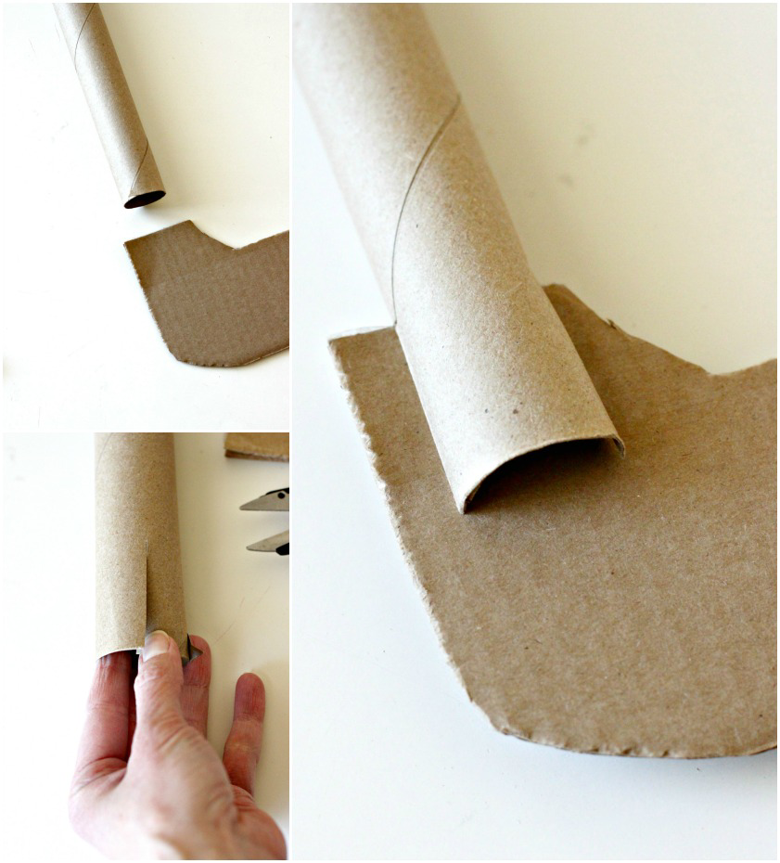
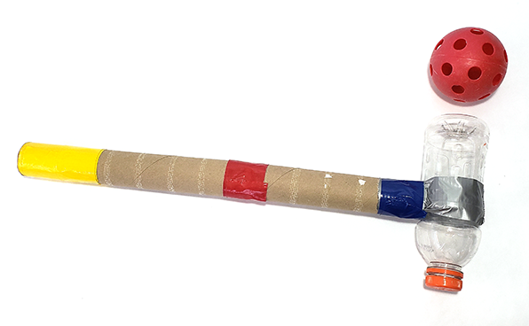
Bonus Challenge
**Those that have made there own Hockey Sticks please submit some pictures or videos to class dojo so we can put some of your wonderful creations in next weeks PowerPoint **
In anticipation of coming back to school you could be practicing your hockey skills. But to do this you’ll need a hockey stick. As a challenge over the next few weeks try and create one yourself and decorate it how you like. Here’s a few examples for you. Submit a picture of yours to your class dojo so we can see your creations.
On the next slide I have updated the hockey videos so if you’ve already made yours check them out and see if you can give some of them a go. If not just give them a watch to help with your Hockey development and learning.

Slide 21
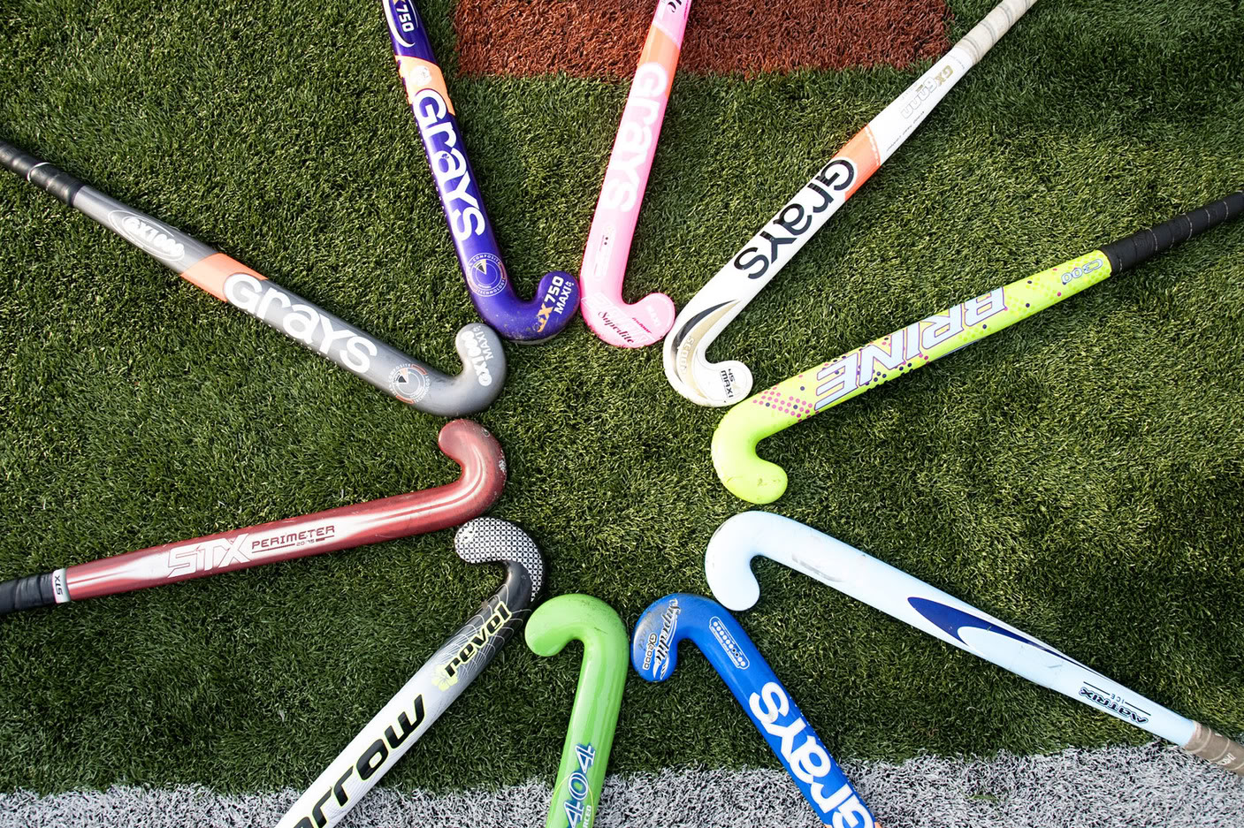
Extra videos for inspiration for HOCKEY
If you have created your own Hockey stick you could try following these videos for practice or just watch to help understand how we play the sport.
Hockey Core Skills: Basic Backhand Receiving:
https://www.youtube.com/watch?v=Ov7csaEDQ1M
Hockey Core Skills: Passing Skills – Backhand Sweep or Slide:
https://www.youtube.com/watch?v=kGPpnDV008Q
Hockey Core Skills: Ball Control – 3D Skills
https://www.youtube.com/watch?v=_Mx1v3tnuc8
Hockey Core Skills: Indian Dribble – Yard Pulls
https://www.youtube.com/watch?v=EL9kcaAkHJ4

