Slide 1



P.E from Home Year 6

Slide 2
Introduction
Physical activity can be lots of things. It can mean all bodily movements that use energy. It includes all types of physical exercise, sports and dance activities. But it also includes indoor and outdoor play, work-related activity, outdoor and adventurous activities, active travel (walking, cycling, scooting) and even something as simple as using the stairs in your home.
For everyone, not just children, who are stuck at home this lockdown it’s important to maintain a physical exercise routine and where possible try and stay as active as you can be. It may even be a great time to increase how active you are if you have more available time.
The following PowerPoint has a few ways in which your child can stay active across this half term and will also be updated weekly with a lesson based format with different weekly challenge activities to keep them busy, active and help improve sporting skills. Hope you all enjoy! Thanks Elliott

Slide 3
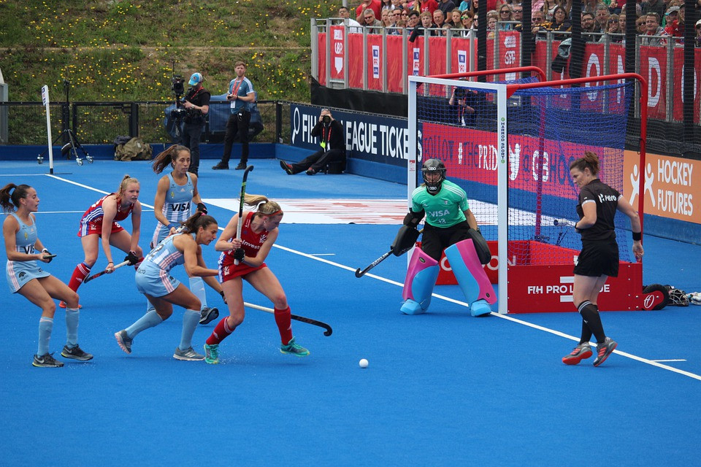
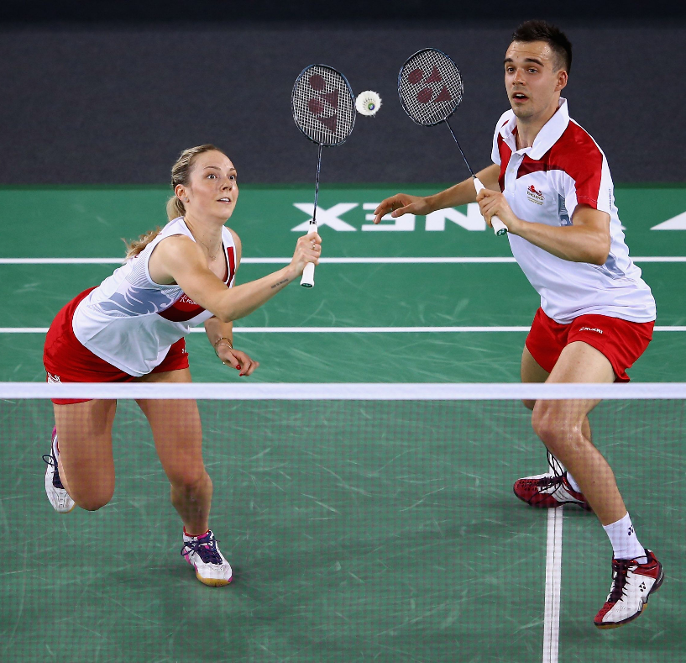
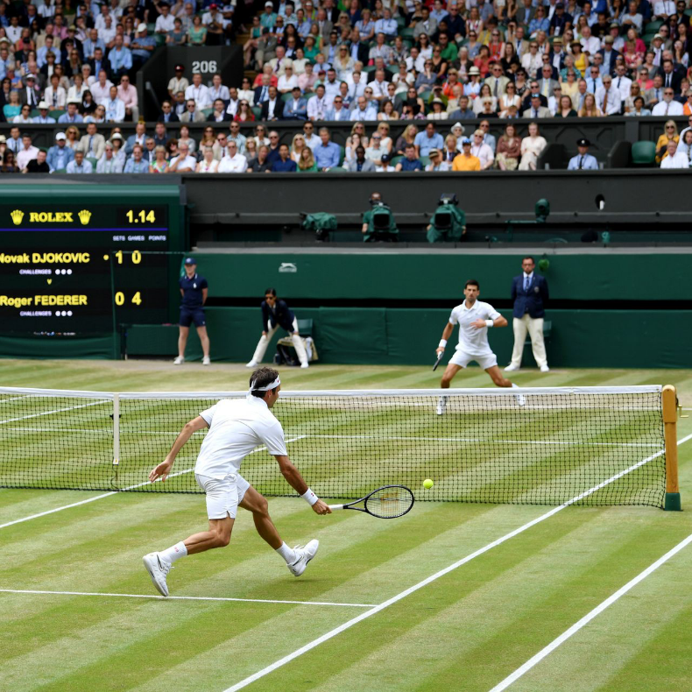
This Weeks Activities
One of our focuses is going to be coordination and ball skills. This term our sporting focus is Hockey followed by Tennis and Badminton after half term.
All these sports use a type of ball and a stick/racket that you hold in your hands and use to hit the ball.

Slide 4
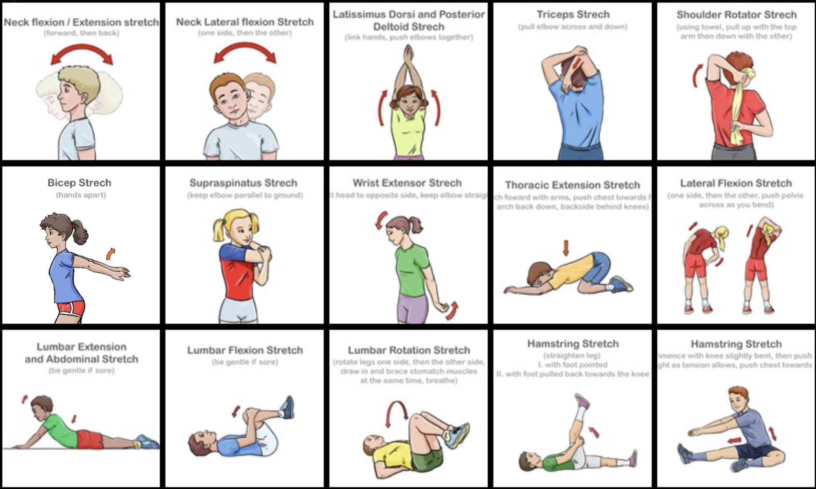
Warm up and Cool down: Stretch it off
After any sport or workout it’s always important to stretch off before and afterwards to help your muscles from getting injuries.
Here is a few stretches you can do both before and after your exercise to help get your body ready and help it recover.
As a bonus can you think of any more stretches that are not on these cards that you could add to your stretching routine.

Slide 5
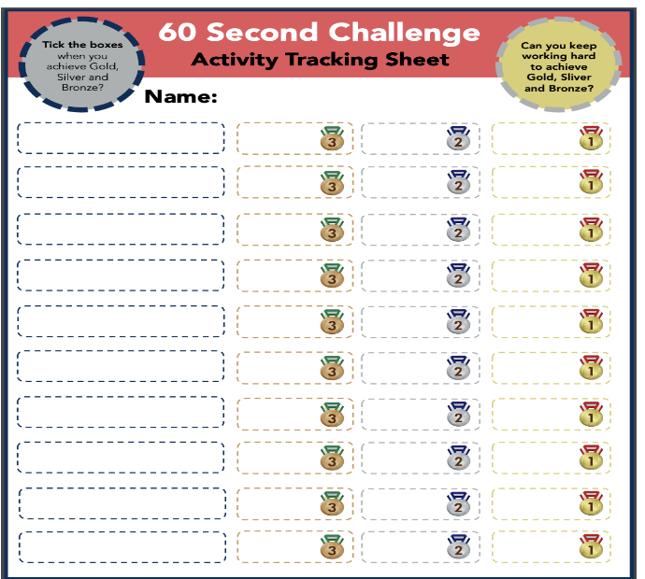
Activity 1: Coordination
Our first activity will test the key skills needed in Hockey, Tennis and Badminton; hand eye coordination and being able to control a ball with a bat/racket/stick. The video link below shows you how to play and what we are going to practice.
https://www.youtube.com/watch?v=IvySZYSZFNY
Courtesy of Yorkshire Sport Foundation
Gold: Don’t drop the ball for 90 seconds and get a rally of 40
Silver: Don’t drop the ball for 60 seconds and get a rally of 30
Bronze: Don’t drop the ball for 30 seconds and get a rally of 20
Submit your high score for keep ups and rallies to class dojo!

Slide 6
Activity 2: Workout Challenge
The below are a few links to videos from the wonderful YouTube channel of Joe Wicks who has been keeping the entire nation moving across all three of these lockdowns. They are some short exercise blasts that can be done in one go as a longer exercise workout or as a daily top up.
Active 8 Minute Workout Featuring Izzy | The Body Coach TV
https://www.youtube.com/watch?v=YIB2SJnBHBQ&list=PLyCLoPd4VxBvPHOpzoEk5onAEbq40g2-k&index=3
Active 8 Minute Workout 1 | The Body Coach TV
https://www.youtube.com/watch?v=uqLNxJe4L2I&list=PLyCLoPd4VxBvPHOpzoEk5onAEbq40g2-k&index=6
Remember to go to Joe Wicks YouTube channel Monday, Wednesday and Friday where he streams live at 9 am loads of fun P.E. sessions. (More on this on slide 12).

Slide 7
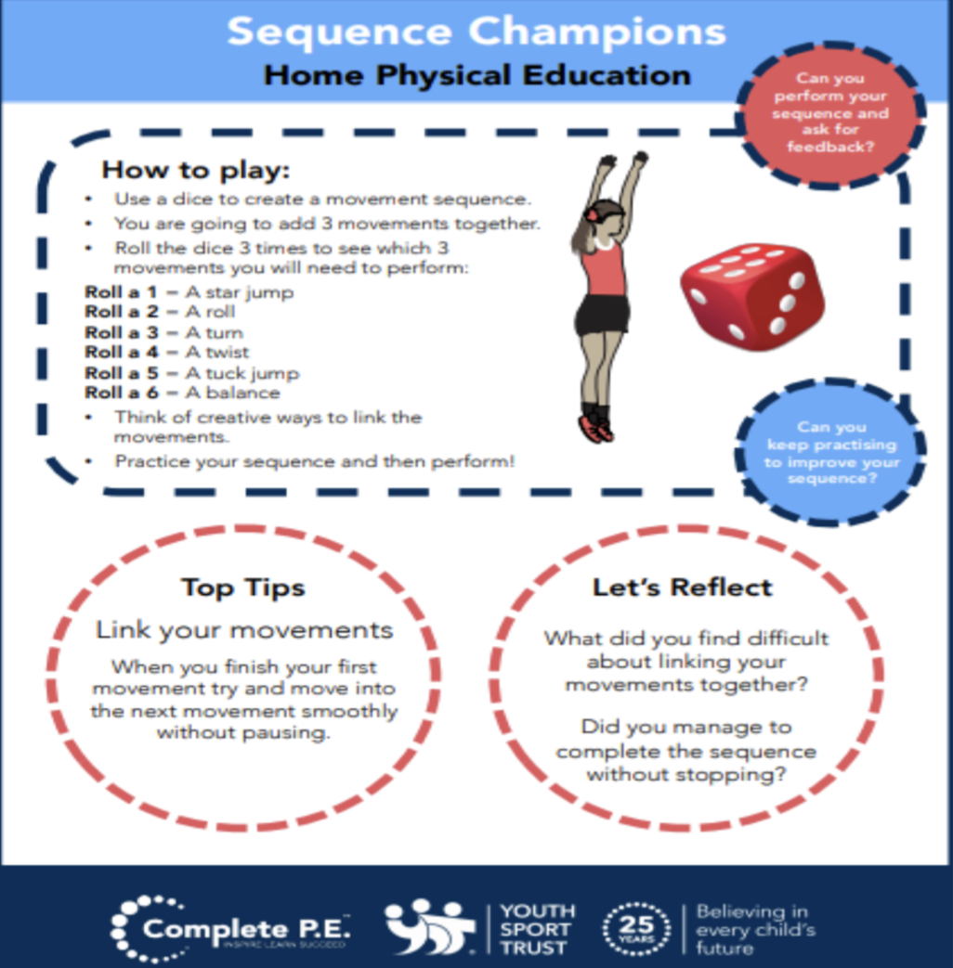
Activity 3: Create your own workout
Can you create your own workout! Using this guide and a dice, roll it to come up with your own hard work out. Practice it yourself and then you could get someone at home to give it a go.
Try these extension tasks if your really enjoying this one:
Create your own list of movements to try.
Add some music to your workout.
Try doing more than 1 of each. You could do 5 then you might increase to 10 or even 15 to make your workouts harder for yourself and others. E.g. 5 star jumps then 5 sit-ups then 5 squats.

Slide 8

Activities to keep you moving this half term
The following activities are things you can do through the week to keep you moving and active this half term! Complete the challenges and keep us updated of how you are getting on weekly.

Slide 9
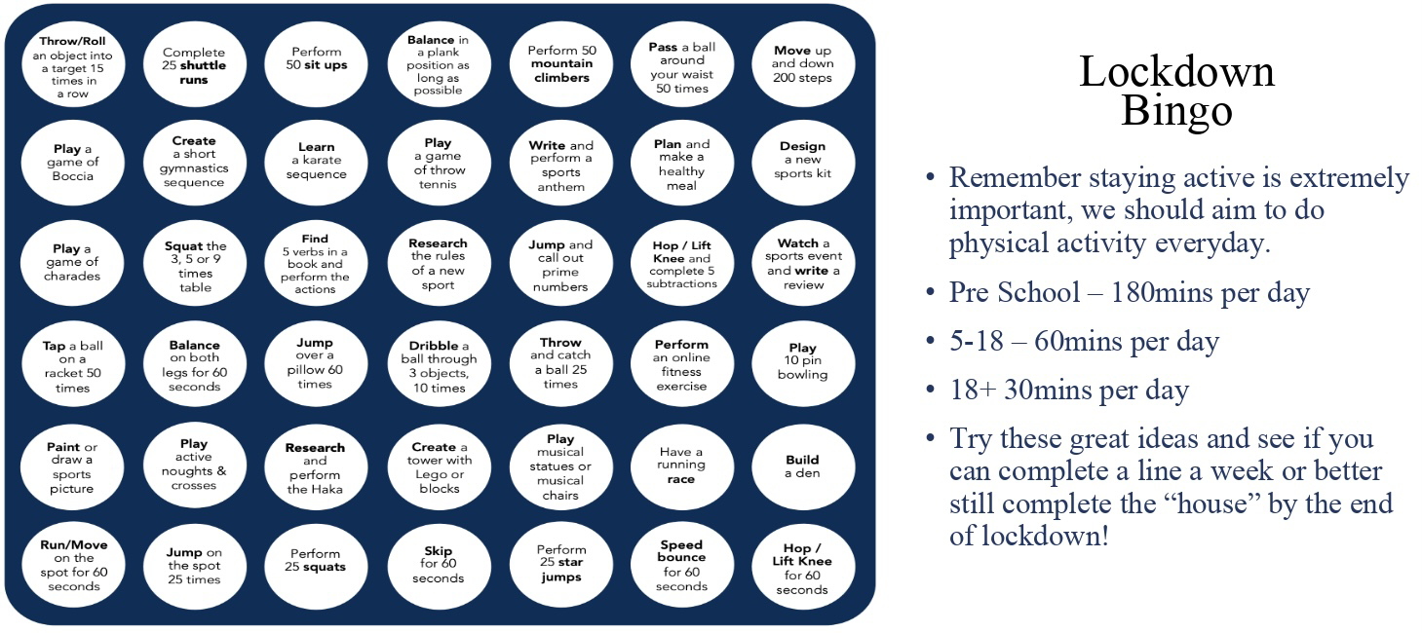
Lockdown Bingo!
Staying active is extremely important, we should aim to do physical activity everyday for 60 minutes if you are aged between 5-18.
Try these great ideas on our bingo sheet and see if you can complete a line a week or better yet complete the entire sheet by the end of lockdown and celebrate getting BINGO!!!

Slide 10

Mountain Climbers
Let’s climb a mountain! Using your stairs or just walking around the rooms in your house.
Every day this year we’ve been doing our daily mile and we don’t want to stop now just because of lockdown. So here’s a simple and challenging idea to keep it going. You climb the height of your chosen mountain by taking steps up your staircase. The current record for vertical height climbed by going up stairs is 18585m in 24 hours. We will be impressed if anyone beats that!
Your challenge is to pick a mountain you want to climb this lockdown find some facts about the mountain and work out how many steps you need to do to climb that mountain. Here’s a few already worked out for you:
Scarfell Pike: 6,180 steps
Snowdon: 7,120 steps
Ben Nevis: 8,810 steps
Whereas Mount Everest will take 58,070 steps!!!
Don’t forget if you complete one you could always climb another there are plenty of mountains to climb.

Slide 11
Joe Wicks: P.E at home
If you are still looking for more workout-based activities, Joe Wicks’ weekly workouts are great for kids of all ages.
They are three times a week: Monday, Wednesday and Friday live streamed from 9am.
YouTube channel link: https://www.youtube.com/channel/UCAxW1XT0iEJo0TYlRfn6rYQ
These videos are an excellent tool to use both at school and at home that many schools just like ours are taking advantage off and thankful for.
Try and complete all three each week to get as super fit as you can during this lockdown! Let us know how many you’ve done each week on class dojo and let’s so who can do the most.

Slide 12
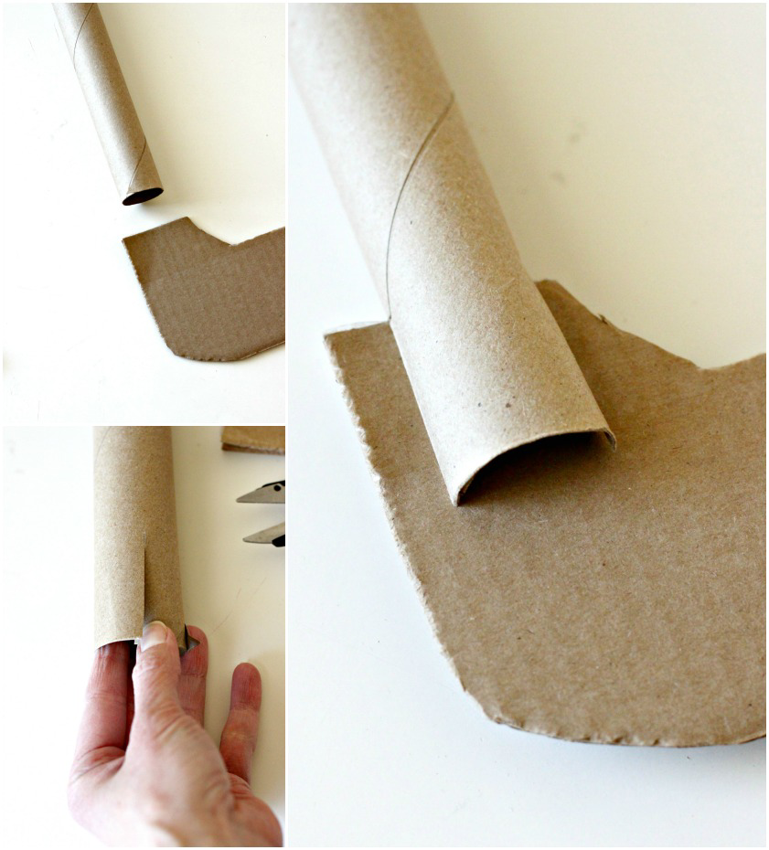
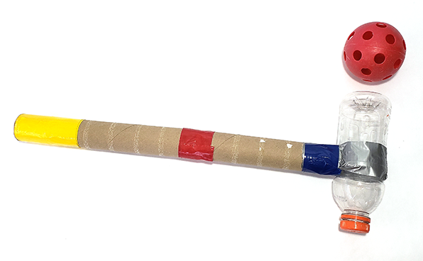
Bonus Challenge
Create your own hockey stick!
In anticipation of coming back to school you could be practicing your hockey skills. But to do this you’ll need a hockey stick. As a challenge over the next few weeks try and create one yourself and decorate it how you like. Here’s a few examples for you. Submit a picture of yours to your class dojo so we can see your creations.

Slide 13
Extra videos for inspiration for HOCKEY
If you have created your own Hockey stick you could try following these videos for practice or just watch to help understand how we play the sport.
Hockey beginners guide:
https://www.youtube.com/watch?v=NPnrKxFwInc&list=PLuyGVxpiODzy-YmiPfS7CBkSh-eG4f3h0&index=12
Holding the hockey stick and how to dribble:
https://www.youtube.com/watch?v=p5CKIgh8AhU
Hockey how to push pass:
https://www.youtube.com/watch?v=STuNCtp4tJc

