Slide 1



P.E from Home Year 6

Slide 2
Introduction
Physical activity can be lots of things. It can mean all bodily movements that use energy. It includes all types of physical exercise, sports and dance activities. But it also includes indoor and outdoor play, work-related activity, outdoor and adventurous activities, active travel (walking, cycling, scooting) and even something as simple as using the stairs in your home.
For everyone, not just children, who are stuck at home this lockdown it’s important to maintain a physical exercise routine and where possible try and stay as active as you can be. It may even be a great time to increase how active you are if you have more available time. Staying active is extremely important, we should aim to do physical activity everyday for 60 minutes if you are aged between 5-18.
The following PowerPoint is our third instalment for P.E. at home and has some new ways in which your child can stay active this week as well as those challenges for across this half term. Hopefully you are making a start at those longer activities for this half term. Maybe some of you have already climbed many mountains or even got Bingo? Remember if you have let us know on class dojo.
Thanks Elliott

Slide 3
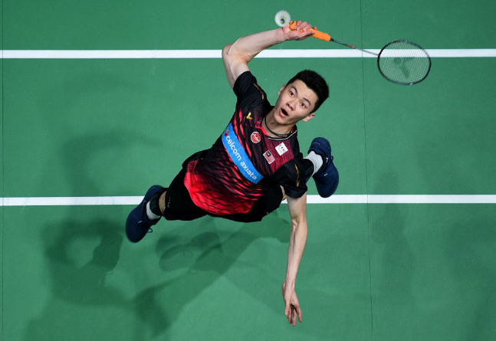
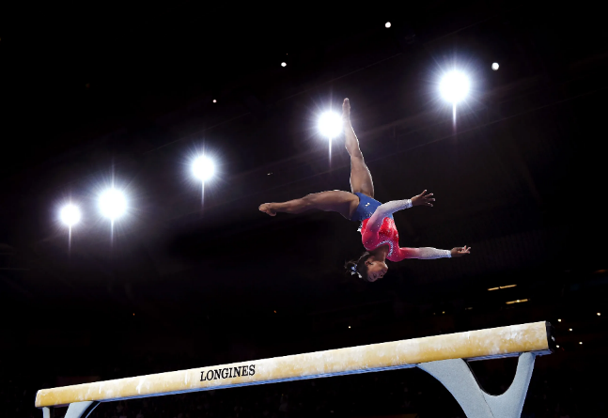
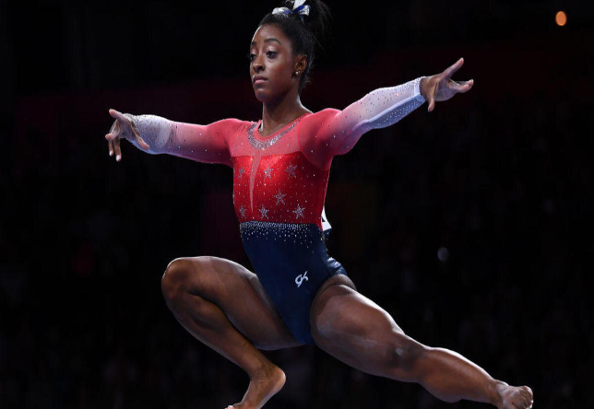
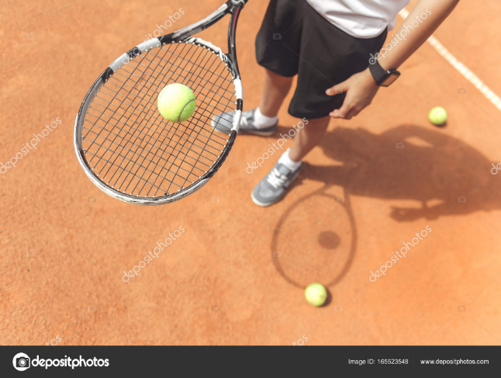
This Weeks Activities
This week one of our focuses is going to be on strength and balance through gymnastics. We will also focus on hand-eye coordination and reactions. Core strength and good balance are essential in any young child’s life and are required in the basic movements and activities they will do daily. Hand-eye coordination and reactions are just as important in daily life but apply to this half-terms sporting focus of Hockey, but are even more essential in our upcoming next half-term sports of Badminton and Tennis.

Slide 4
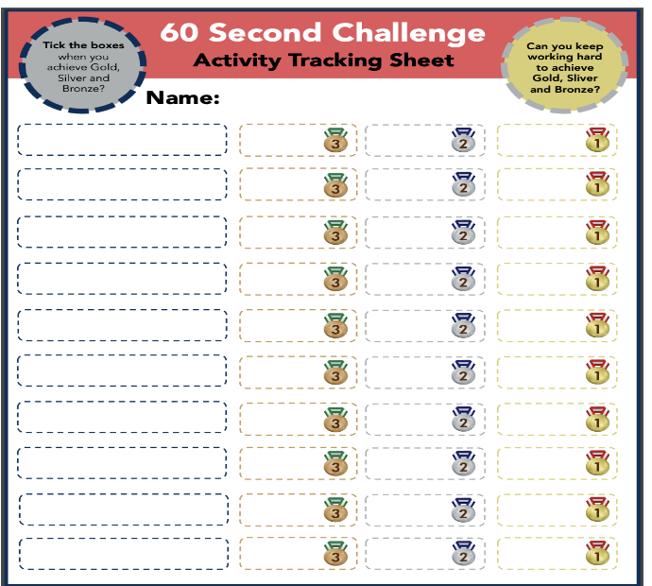
Warm-Up & Activity 1: Rock & Roll Gymnastics
Our next activity will work on some gymnastic moves to help increase strength and balance. All of these moves are very basic but are great for improving leg and core strength and despite the children in the video making it look easy for some of us whose legs may not be as strong or struggle with our balance you may find these challenging. Even get parents at home to give them a go I’m sure some of them would be surprised at how hard the last roll to one leg move might be for them. The video link below shows you how to play and what we are going to practice.
https://www.youtube.com/watch?v=DcGFteFryoA
Courtesy of Yorkshire Sport Foundation
Do the following to earn those medals;
Gold: Rock back and forward to stand on one leg 5 times in a row on each leg.
Silver: Rock back and forward to stand on two legs 15 times in a row.
Bronze: Rock back and forward to sit up 20 times in a row.
Submit your high score for keep ups and rallies to class dojo!

Slide 5
Activity 2: Balloon Blasting
Our next activity will test our hand-eye coordination through striking the balloon to keep it up and return it to a partner. The video is more aimed towards key stage 1 but illustrates the basic is of what we are going to practice.
https://www.youtube.com/watch?v=08AIvWfmJlo
Courtesy of Yorkshire Sport Foundation
Now for our challenge what I would like you to do is with a partner if possible try and keep the balloon up for as long as possible. But to make it harder set up a circle or square on the floor; you must always have one foot inside this created area at all times. This will mean you need to be more accurate with your hits to keep the rally going.
For the second challenge on your own can you try and keep two balloons up for as long as possible. Use both hands and you may have to swap between right and left for each balloon to keep it up.
Gold: Get a rally of 90 seconds and keep two balloons up on your own for 45 hits.
Silver: Get a rally of 60 seconds and keep two balloons up on your own for 30 hits.
Bronze: Get a rally of 30 seconds and keep two balloons up on your own for 15 hits.
Submit your high score for keep ups and rallies to class dojo!

Slide 6
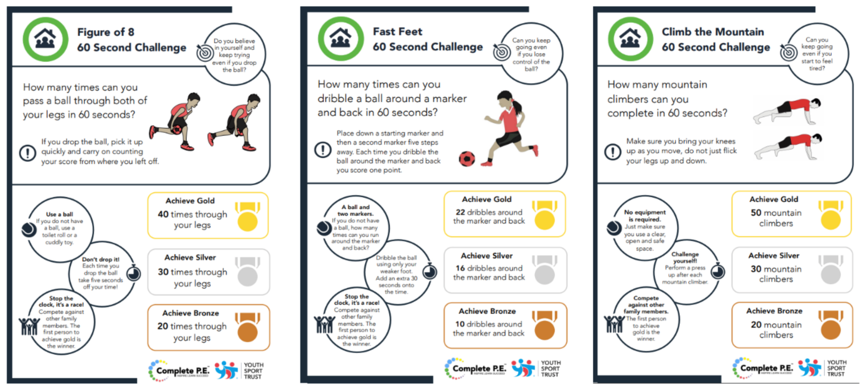
Activity 3: 60 second skill challenge *bonus*
Here are a few more 60 second challenges you can do to earn even more medals. Remember don’t worry if you don’t get Gold straightaway keep practicing to work your way up from Bronze, to Silver, to Gold. Remember to record your scores on the score sheet from the previous slide.

Slide 7
Activity 4: Workout Challenge
The below are a few links to videos from the wonderful YouTube channel of Joe Wicks who has been keeping the entire nation moving across all three of these lockdowns. They are some short exercise blasts that can be done in one go as a longer exercise workout or as a daily top up.
Active 8 Minute Workout Featuring Eloise and Charlie | The Body Coach TV
https://www.youtube.com/watch?v=pLuM18p9zbM&list=PLyCLoPd4VxBvPHOpzoEk5onAEbq40g2-k&index=14
Active 8 Minute Workout 3 | The Body Coach TV
https://www.youtube.com/watch?v=9uw9ug_g-gM&list=PLyCLoPd4VxBvPHOpzoEk5onAEbq40g2-k&index=18
Remember to go to Joe Wicks YouTube channel Monday, Wednesday and Friday where he streams live at 9 am loads of fun P.E. sessions. (More on this on slide 16).

Slide 8
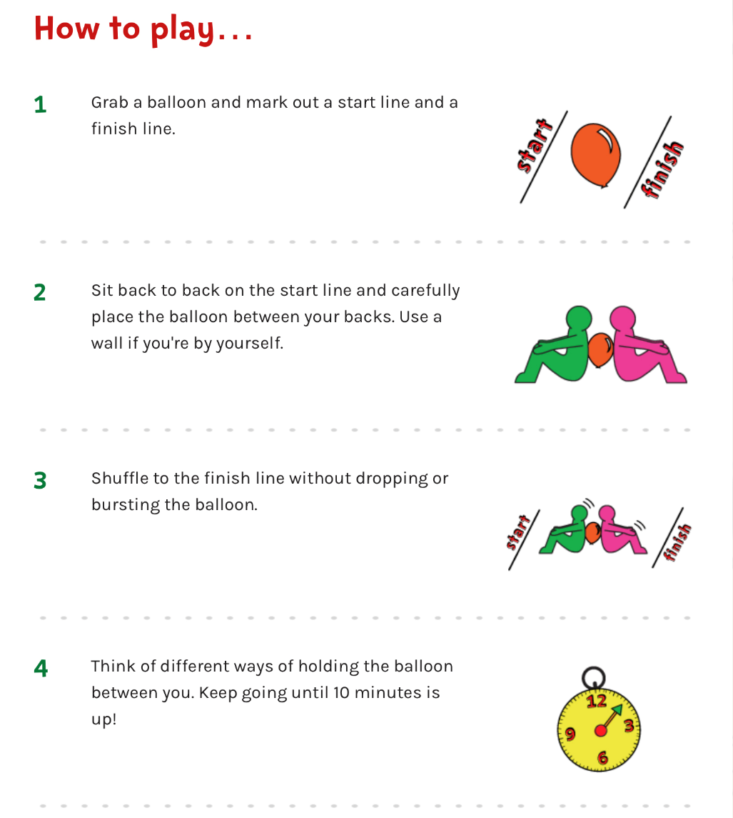
Cool-down: Balloon Dash
As we already have the balloons from our previous challenge we are going to use them for our cool down today. It is a 10 minute shake up challenge from change for life’s page (see slide 10).
For the challenge your aim is to work together with a partner to move the balloon from one point to another with the balloon between your backs without letting it touch the floor.

Slide 9

Activities to Keep You Moving This Half-term
Remember there are lots of other ways you can keep active this half term. These next few activities are ones you can complete week by week during lockdown. All the activities from previous weeks are there in case you haven’t had chance to start them yet. Some have been updated with a few bonus challenges as well so look out for them.
This week I’ve added another resource you can use this term at home. The NHS Change 4 life website has loads of “10-minute shake-ups” that are all Disney themed games based around your favourite characters that are easy to do at home with minimal equipment and are fun. For older children change for life has a lot of resources for all sports and has suggestions for new sports you may never have considered playing before. So, head on over and look you might find a new sport that you want to give ago after lockdown!

Slide 10
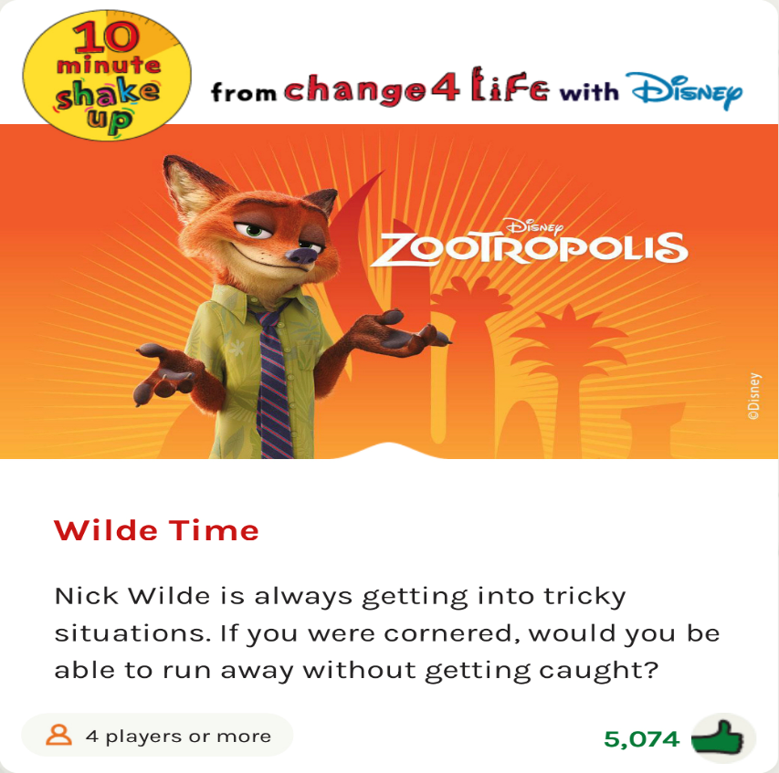

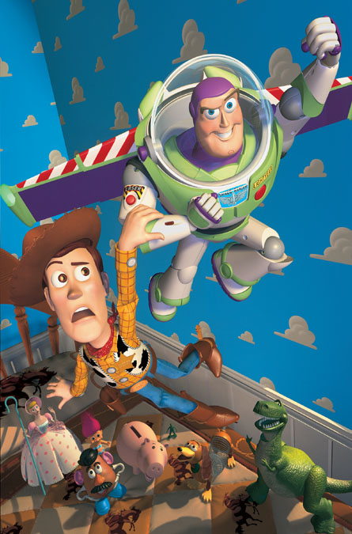

10 Minute Shake Up
Change4Life and Disney have teamed up to bring you play-along games inspired by your favourite Disney and Pixar characters. These 10-minute bursts of fun will really get kids moving and count towards the 60 active minutes they need every day!
Now Year 5 & 6 don’t be put off just because it’s Disney! The games themselves are great and our cool-down today was one of them! So if you enjoyed that go take a look.
There are 10 minute games for absolutely everyone. So if you want to play on your own or with a brother and sister or someone else at home you can. If you want to play a ball based game or a game with no equipment they’ve got them all.
Change4Life also has info and resources for a lot of other sports, even ones that you may have done in P.E. And wanted to try so go have a look.

Slide 11
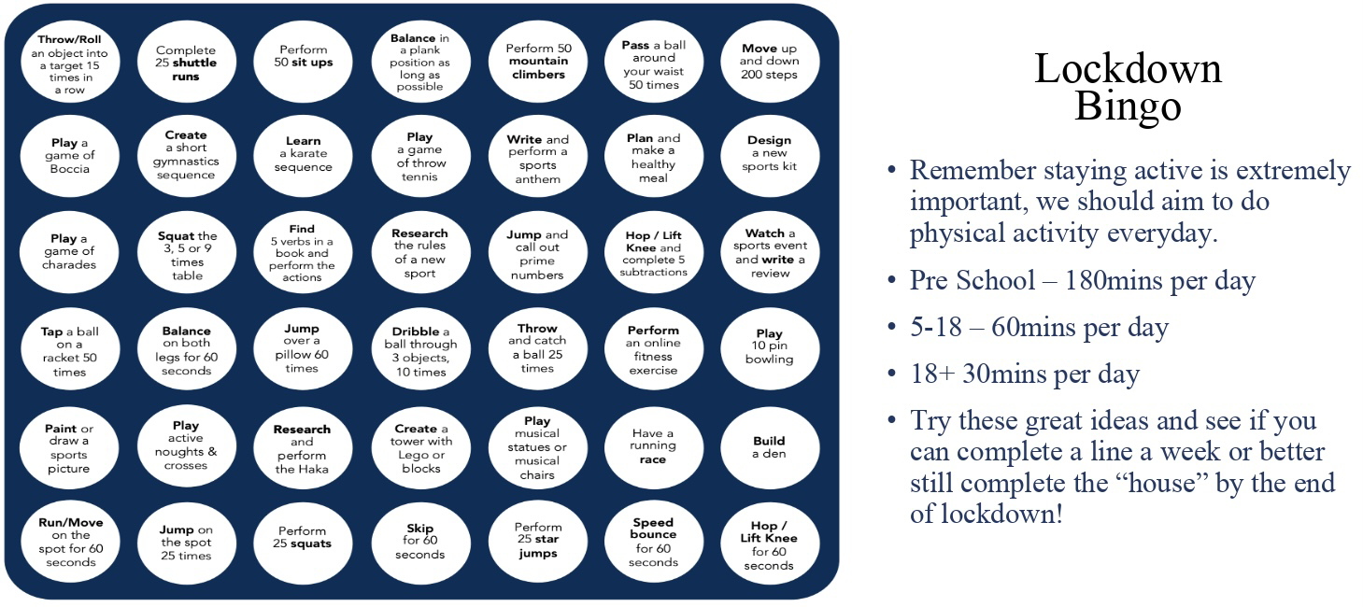
Lockdown Bingo!
Staying active is extremely important, we should aim to do physical activity everyday for 60 minutes if you are aged between 5-18.
Try these great ideas on our bingo sheet and see if you can complete a line a week or better yet complete the entire sheet by the end of lockdown and celebrate getting BINGO!!!
Has anyone got a line yet? Or even bingo?!

