Slide 1
Activity 5: Workout Challenge
The below are a few links to videos from the wonderful YouTube channel of Joe Wicks who has been keeping the entire nation moving across all three of these lockdowns. They are some short exercise blasts that can be done in one go as a longer exercise workout or as a daily top up.
Active 8 Minute featuring Harry | The Body Coach TV
https://www.youtube.com/watch?v=TUp2_VAHIrI&list=PLyCLoPd4VxBvPHOpzoEk5onAEbq40g2-k&index=12
5 Minute Move featuring Zara | The Body Coach TV
https://www.youtube.com/watch?v=N7CX0_7sLTA&list=PLyCLoPd4VxBvPHOpzoEk5onAEbq40g2-k&index=16
5 Minute Move featuring Francesca | The Body Coach TV
https://www.youtube.com/watch?v=hvJXQT4gowg&list=PLyCLoPd4VxBvPHOpzoEk5onAEbq40g2-k&index=22

Slide 2
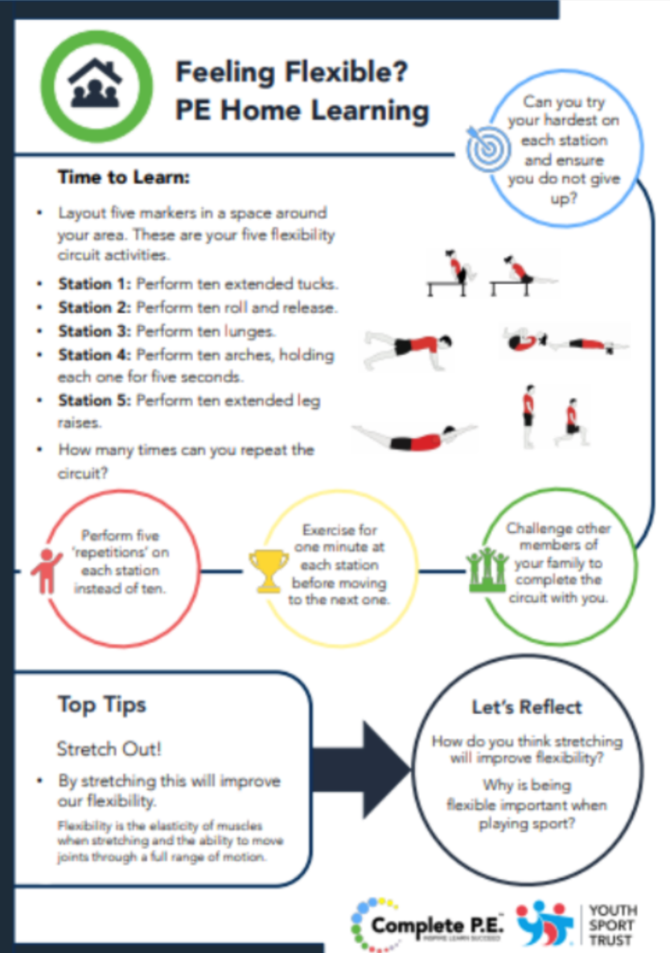
Cool-down: That’s not so Cool-down
This week we have ditched the easier cool-down and we are going to finish with a fun flexible fitness circuit. After 5 weeks of P.E. at home we should all be extra fit with all the activities and resources we have had to be getting on with, so we are not going to cool-down with an easier challenge instead we are finishing by putting all that hard work to the test!
The worksheet takes you through five moves that will make us stronger and flexible. You could do them once through each or do it in sets so work through all five 2 or 3 times, this would be a good idea for KS2. For KS1 and reception these moves can be simplified if one is proving more difficult than others. For example try doing less reps so only 5 instead of 10, or make the move simpler so for lunges don’t go as low.

Slide 3
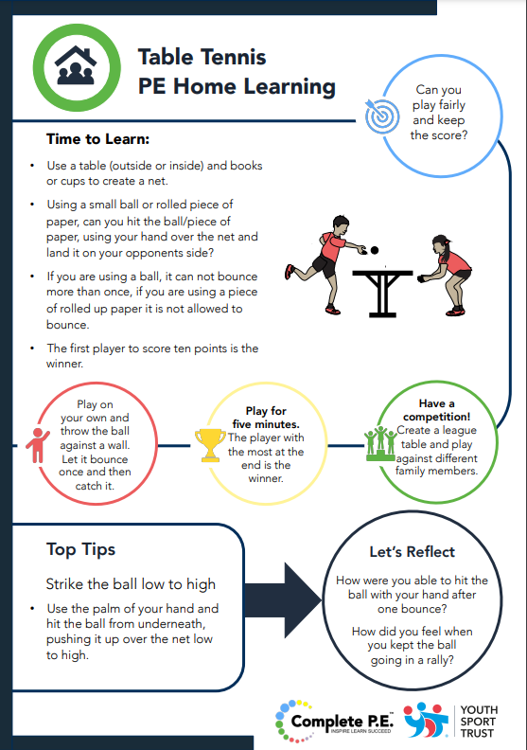
Next Sporting Focus Intro: Badminton & Tennis
With our sporting focus moving from Hockey to Badminton and Tennis, I thought it appropriate to add in this Table Tennis at home game. Over the last few weeks we have done many Tennis based games as they are great for testing a range of skills, loads of fun and easy to do at home.
Give this game a go with someone at home to get you into the swing of this half terms topics and on your way to becoming a Tennis pro. You might even be able to show us those skills you have mastered when everyone can return to school.

Slide 4

Activities to Keep You Moving This Half-term
Remember there are lots of other ways you can keep active this half term. These next few activities are ones you can complete week by week during lockdown. All the activities from previous weeks are there in case you haven’t had chance to start them yet. Some have been updated with a few bonus challenges as well so look out for them.
This week I’ve added a new version of our lockdown Bingo; Daily Mile Bingo. As we said last week in our cool-down, The Daily Mile has been a big part of our school life both this and last school year trying to stay as healthy as we can in these times where we can’t play as much sport or get outside and exercise as much as we would like. With this Bingo it gives us fun incentives to keep going with our Daily Mile and compete it at home. We have also got a new version of our Monopoly Fitness; Sportopoly. Again, this resource like others we have used in these presentations comes from the excellent youth sport trust. So, if you have already played our first version give his one a go with people at home for some great fun.

Slide 5
Online Weekly Sessions Timetable
The table below gives you an overview of what online classes are available that you can do at home for free and when they are streamed live on YouTube. All sessions are available on the providers channel after the stream so don’t worry if you miss them or can’t tune in at that time they can always be done later.
Monday | Tuesday | Wednesday | Thursday | Friday | Saturday | Sunday
Am | Am | Am | Am | Am | Am | Am
9am till 10am Joe Wicks P.E. At Home https://www.youtube.com/playlist?list=PLyCLoPd4VxBuS4UeyHMccVAjpWaNbGomt | 10:30am till 11am YST Healthy Movers (EYFS & Year 1) https://www.youtube.com/channel/UCJerWssJeAsbd1kY79oRm7g | 9am till 10am Joe Wicks P.E. At Home https://www.youtube.com/playlist?list=PLyCLoPd4VxBuS4UeyHMccVAjpWaNbGomt | 10:30am till 11am YST Healthy Movers (EYFS & Year 1) https://www.youtube.com/channel/UCJerWssJeAsbd1kY79oRm7g | 9am till 10am Joe Wicks P.E. At Home https://www.youtube.com/playlist?list=PLyCLoPd4VxBuS4UeyHMccVAjpWaNbGomt |  | England Rugby Weekly Rugby Skill & Fitness Sessions Mini & Juniors Age 7-17 https://www.youtube.com/playlist?list=PLcSP18b0KfWMlWu1fevzCT0yM5I8CQ5Yp
Pm | Pm | Pm | Pm | Pm | Pm | Pm
 | 5pm YST After School Sport Clubs https://www.youtube.com/user/YouthSportTrust/videos | 2pm till 2:45pm Chance to Shine Cricket Coaching https://www.youtube.com/results?search_query=chance+to+shine+live | 5pm YST After School Sport Clubs https://www.youtube.com/user/YouthSportTrust/videos

Slide 6


10 Minute Shake Up
Change4Life and Disney have teamed up to bring you play-along games inspired by your favourite Disney and Pixar characters. These 10-minute bursts of fun will really get kids moving and count towards the 60 active minutes they need every day!
There are 10 minute games for absolutely everyone. So if you want to play on your own or with a brother and sister or someone else at home you can. If you want to play a ball based game or a game with no equipment they’ve got them all. So if your favourite character is Elsa or your more a Buzz Lightyear fan that’s fine go and have a look what game your most loved character recommends.

Slide 7

Daily Mile Bingo
Keep doing those daily miles at home but now you can win while you run, walk, hop, skip, jump, or however else you want to your mile?!
Our daily mile cool-down last week was a little reminder that we have done it for so long in school and everyone has got so good at it, doing it quicker and quicker each week, don’t stop doing it now in lockdown. Keep trying where you can to get it done and this daily mile bingo sheet should help with that.
Try doing your daily mile following these challenges and complete the whole card to earn your certificate. Go to this link to print off your daily mile certificate once completed:
https://thedailymile.co.uk/wp-content/uploads/2021/01/Daily-Mile_NY-Bingo-Certificate-2.pdf

Slide 8
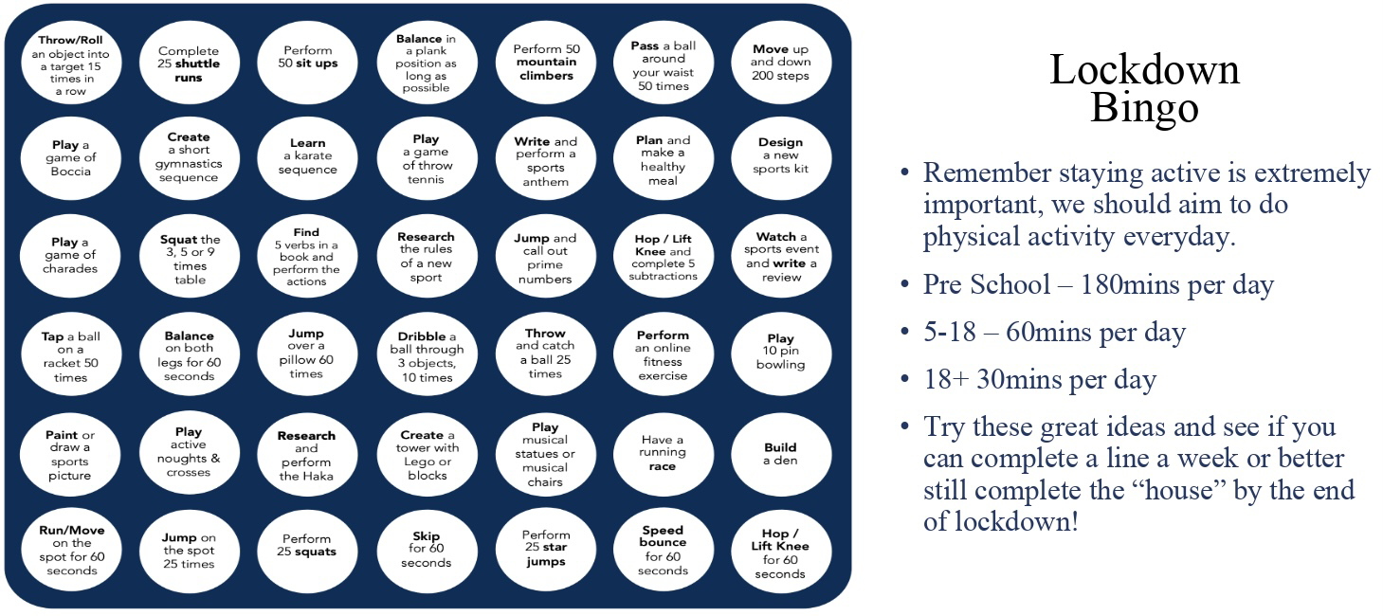
Lockdown Bingo!
Staying active is extremely important, we should aim to do physical activity everyday for 60 minutes if you are aged between 5-18.
Try these great ideas on our bingo sheet and see if you can complete a line a week or better yet complete the entire sheet by the end of lockdown and celebrate getting BINGO!!!
Has anyone got a line yet? Or even bingo?!

Slide 9

Mountain Climbers
Let’s climb a mountain! Using your stairs or just walking around the rooms in your house.
Every day this year we’ve been doing our daily mile and we don’t want to stop now just because of lockdown. So here’s a simple and challenging idea to keep it going. You climb the height of your chosen mountain by taking steps up your staircase. The current record for vertical height climbed by going up stairs is 18585m in 24 hours. We will be impressed if anyone beats that!
Your challenge is to pick a mountain you want to climb this lockdown find some facts about the mountain and work out how many steps you need to do to climb that mountain. Here’s a few already worked out for you:
Scarfell Pike: 6,180 steps
Snowdon: 7,120 steps
Ben Nevis: 8,810 steps
Whereas Mount Everest will take 58,070 steps!!!
*BONUS* Before lockdown I climbed Helvelyn in the Lake District. It is around 3500 steps to get from the bottom to the top on the route I took. Can anyone beat my time of 2 hours 30 minutes to get from the bottom to the top.
Don’t forget if you complete one you could always climb another there are plenty of mountains to climb.

