Slide 1
Phonics
Friday 15th January 2021

Slide 2
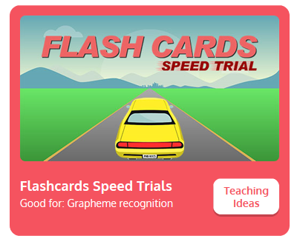
Practise your sounds using Flashcards Speed Trial on Phonics Play
Pick individual graphemes – all set 2 + j, v, w and x
Username: jan21
Password: home
https://www.phonicsplay.co.uk/resources/phase/2/flashcards-speed-trials

Slide 3

Practise reading your keywords using Tricky Word Trucks on Phonics Play
Choose Phase 2 Tricky Words
Username: jan21
Password: home
https://www.phonicsplay.co.uk/resources/phase/2/tricky-word-trucks

Slide 4
Can you join in with the alphabet song? Remember that we say the letter names and not their sounds.
https://www.youtube.com/results?sp=mAEB&search_query=mr+vox+alphabet+song+zed

Slide 5
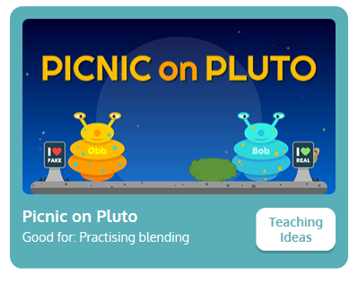
Play Picnic on Pluto on Phonics Play.
Blend the sounds to read the words
Phase 3 – focus on this weeks sounds: j, v, w and x
Username: jan21
Password: home
https://www.phonicsplay.co.uk/resources/phase/3/picnic-on-pluto

