Slide 1
Phonics
Thursday 14th January 2021

Slide 2
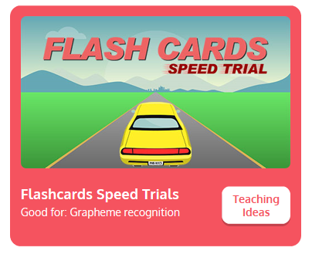
Practise your sounds using Flashcards Speed Trial on Phonics Play
Pick individual graphemes – all set 2 + j, v and w
Username: jan21
Password: home
https://www.phonicsplay.co.uk/resources/phase/2/flashcards-speed-trials

Slide 3

Practise reading your keywords using Tricky Word Trucks on Phonics Play
Choose Phase 2 Tricky Words
Username: jan21
Password: home
https://www.phonicsplay.co.uk/resources/phase/2/tricky-word-trucks

Slide 4
Today we are looking at the sound x
https://www.youtube.com/watch?v=pSadirablKc
Can you draw the letter in the air?

Slide 5
Can you find the words that begin with the x sound?
https://www.bbc.co.uk/bitesize/topics/zvq9bdm/articles/z7p3pg8
Watch the video of Geraldine the Giraffe looking at the x sound:
https://www.youtube.com/watch?v=WjOCuGIme9Q

Slide 6

Can you write the words to match the pictures?

Slide 7

Can you write the words to match the pictures?

Slide 8

Can you write the words to match the pictures?

Slide 9

Can you write the words to match the pictures?

Slide 10

Can you write the words to match the pictures?

