Slide 1
Phonics
Tuesday 19th January 2021

Slide 2
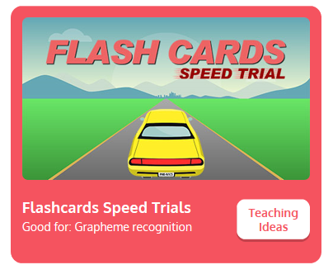
Practise your sounds using Flashcards Speed Trial on Phonics Play
Pick individual graphemes – Set 1-6 + y
Username: jan21
Password: home
https://www.phonicsplay.co.uk/resources/phase/2/flashcards-speed-trials

Slide 3

Practise reading your keywords using Tricky Word Trucks on Phonics Play
Choose Phase 2 Tricky Words
Username: jan21
Password: home
https://www.phonicsplay.co.uk/resources/phase/2/tricky-word-trucks

Slide 4
Today we are looking at the sound z which can be represented as
z or zz
https://www.youtube.com/watch?v=YiSDOn3vWMo
Can you draw the letter in the air?

Slide 5
Watch the video and find the words that use the z sound?
https://www.bbc.co.uk/bitesize/topics/zvq9bdm/articles/zrj6jhv
Watch the video of Geraldine the Giraffe looking at the z sound:
https://www.youtube.com/watch?v=t9dOmDQsXiw

Slide 6

Can you write a word to match the picture? Write your words down in a list.

Slide 7

Can you write a word to match the picture? Write your words down in a list.

Slide 8
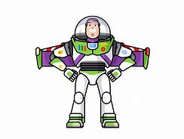
Can you write a word to match the picture? Write your words down in a list.

Slide 9

Can you write a word to match the picture? Write your words down in a list.

