Slide 1
Phonics
Wednesday 13th January 2021

Slide 2
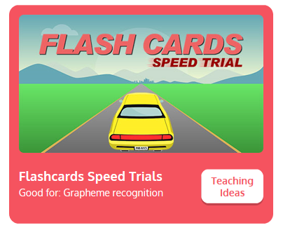
Practise your sounds using Flashcards Speed Trial on Phonics Play
Pick individual graphemes – all set 2 + j and v
Username: jan21
Password: home
https://www.phonicsplay.co.uk/resources/phase/2/flashcards-speed-trials

Slide 3

Practise reading your keywords using Tricky Word Trucks on Phonics Play
Choose Phase 2 Tricky Words
Username: jan21
Password: home
https://www.phonicsplay.co.uk/resources/phase/2/tricky-word-trucks

Slide 4
Today we are looking at the sound w
https://www.youtube.com/watch?v=PlDPegyV6XI
Can you draw the letter in the air?

Slide 5
Can you find the words that begin with the w sound?
https://www.bbc.co.uk/bitesize/topics/zvq9bdm/articles/zmnbnrd
Watch the video of Geraldine the Giraffe looking at the v sound:
https://www.youtube.com/watch?v=IWZLTI4zTtQ

Slide 6
Can you blend the sounds in the words to read and answer the yes and no questions?
Can men jog to get fit?

Slide 7
Can you blend the sounds in the words to read and answer the yes and no questions?
Has a pot of jam got a lid?

Slide 8
Can you blend the sounds in the words to read and answer the yes and no questions?
Can a van go up a hill?

Slide 9
Can you blend the sounds in the words to read and answer the yes and no questions?
Has a cat got a web?

