Slide 1






Slide 2

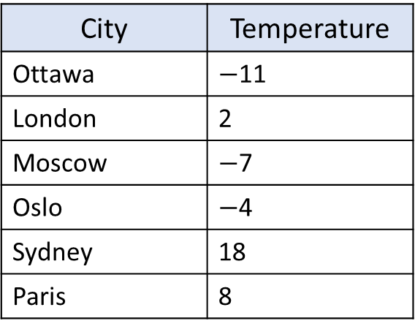
The table shows the temperature in different cities in December.
Use the information to complete the table.
Have a think
The temperature in London is 13 degrees warmer than Ottawa.
City | Temperature
Ottawa | $−$11
London | 2
Moscow | $−$7
Oslo | $−$4
Sydney | 18
Paris | 8
The temperature in Sydney is 9 times warmer than in London.
The temperature in Oslo is 4 degrees colder than freezing point.
The temperature in Ottawa is 19 degrees colder than in Paris.
The temperature in Moscow is 3 degrees less than in Oslo.

Slide 3
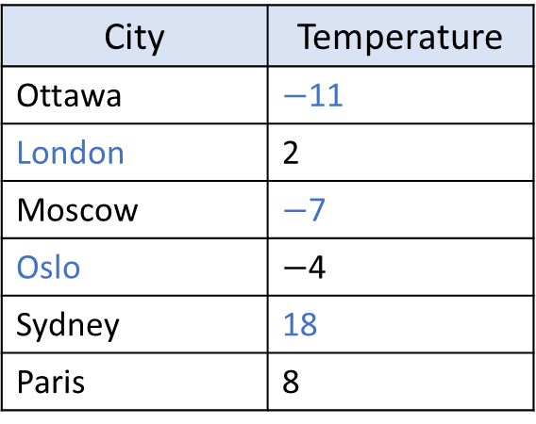
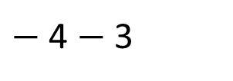
The table shows the temperature in different cities in December.
Use the information to complete the table.
The temperature in London is 13 degrees warmer than Ottawa.
City | Temperature
Ottawa | $−$11
London | 2
Moscow | $−$7
Oslo | $−$4
Sydney | 18
Paris | 8
The temperature in Sydney is 9 times warmer than in London.
The temperature in Oslo is 4 degrees colder than freezing point.
The temperature in Ottawa is 19 degrees colder than in Paris.
The temperature in Moscow is 3 degrees less than in Oslo.
$−$ 4 $−$ 3

Slide 4
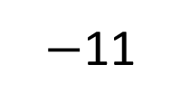
The table shows the temperature in different cities in December.
Use the information to complete the table.
The temperature in London is 13 degrees warmer than Ottawa.
City | Temperature
Ottawa | $−$11
London | 2
Moscow | $−$7
Oslo | $−$4
Sydney | 18
Paris | 8
The temperature in Sydney is 9 times warmer than in London.
11
8
$−$11
?
0
8
The temperature in Ottawa is 19 degrees colder than in Paris.

Slide 5
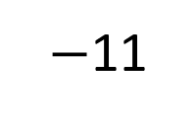
The table shows the temperature in different cities in December.
Use the information to complete the table.
The temperature in London is 13 degrees warmer than Ottawa.
Which city is the hottest?
Which is the coldest?
City | Temperature
Ottawa | $−$11
London | 2
Moscow | $−$7
Oslo | $−$4
Sydney | 18
Paris | 8
The temperature in Sydney is 9 times warmer than in London.
What’s the difference between the hottest and coldest cities?
11
2
$−$11
0
2
?
Investigate the temperature of different cities. Can you create a similar challenge for your friend?

Slide 6



Stamps are very popular this time of year as lots of people are
sending cards to their friends and family.
Eva and Ron have run out of stamps!
I have plenty, you can have some of mine!
Teddy gives $\frac{\text{2}}{\text{5}}$ of his stamps to Ron.
He then gives half of the remaining stamps to Eva.
Have a think
He has 24 stamps left.
How many stamps did Teddy have to begin with?

Slide 7


Teddy gives $\frac{\text{2}}{\text{5}}$ of his stamps to Ron.
He then gives half of the remaining stamps to Eva.
He has 24 stamps left.
How many stamps did Teddy have to begin with?
48
?

Slide 8
Teddy gives $\frac{\text{2}}{\text{5}}$ of his stamps to Ron.
He then gives half of the remaining stamps to Eva.
He has 24 stamps left.
How many stamps did Teddy have to begin with?
?
80
16
16
16
16
16
Ron
48

Slide 9

Rosie is posting 10 greetings cards.
She writes the house number on the front of each envelope.
Here are the house numbers.
1
2
3
4
5
6
8
9
12
48
Have a think
Rosie posts 2 cards every day for 5 days.
The product of the house numbers on each day is shown in the table.
Mon | Tue | Wed | Thu | Fri
18 | 24 | 48 | 40 | 36
Which cards did Rosie post on which day?

Slide 10
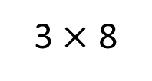
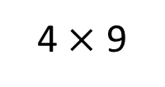
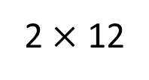
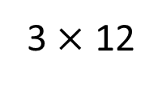
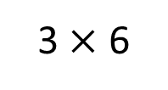
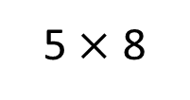
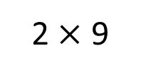
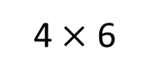
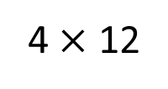
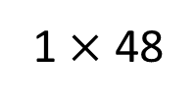
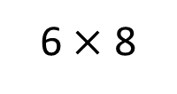
1
2
3
4
5
6
8
9
12
48
Mon 18 | Tue 24 | Wed 48 | Thu 40 | Fri 36
2 $×$ 9
2 $×$ 12
1 $×$ 48
5 $×$ 8
3 $×$ 12
3 $×$ 6
3 $×$ 8
4 $×$ 12
4 $×$ 9
4 $×$ 6
6 $×$ 8

Slide 11
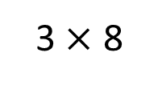
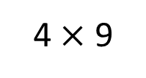
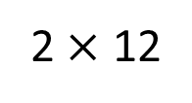
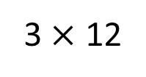
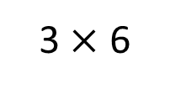
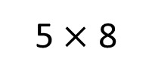
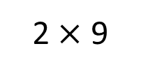
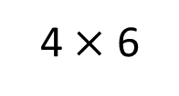
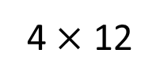
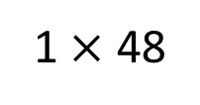
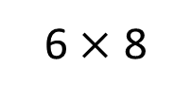
1
2
3
4
5
6
8
9
12
48
Mon 18 | Tue 24 | Wed 48 | Thu 40 | Fri 36
2 $×$ 9
2 $×$ 12
1 $×$ 48
5 $×$ 8
3 $×$ 12
3 $×$ 6
3 $×$ 8
4 $×$ 12
4 $×$ 9
4 $×$ 6
6 $×$ 8

Slide 12
Rosie is posting 10 greetings cards.
She writes the house number on the front of each envelope.
Here are the house numbers.
1
4
5
9
10
13
32
35
38
39
Rosie posts 2 cards every day for 5 days.
The sum of the house numbers on each day is shown in the table.
Mon | Tue | Wed | Thu | Fri
45 | 14 | 48 | 39 | 40
Which cards did Rosie post on which day?

