Slide 1



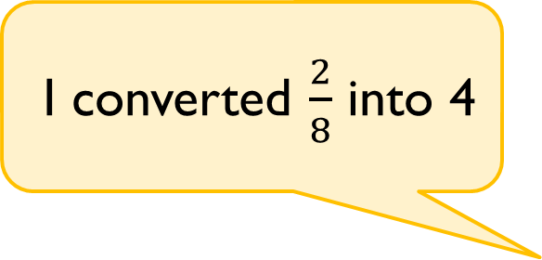
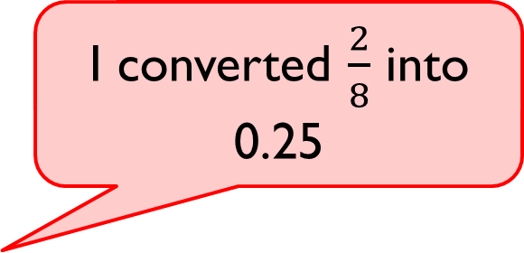
Rosie and Tommy have both attempted to convert $\frac{2}{8}$ into a decimal.
Who is correct?
Prove it.
I converted $\frac{2}{8}$ into 0.25
I converted $\frac{2}{8}$ into 4

Slide 2
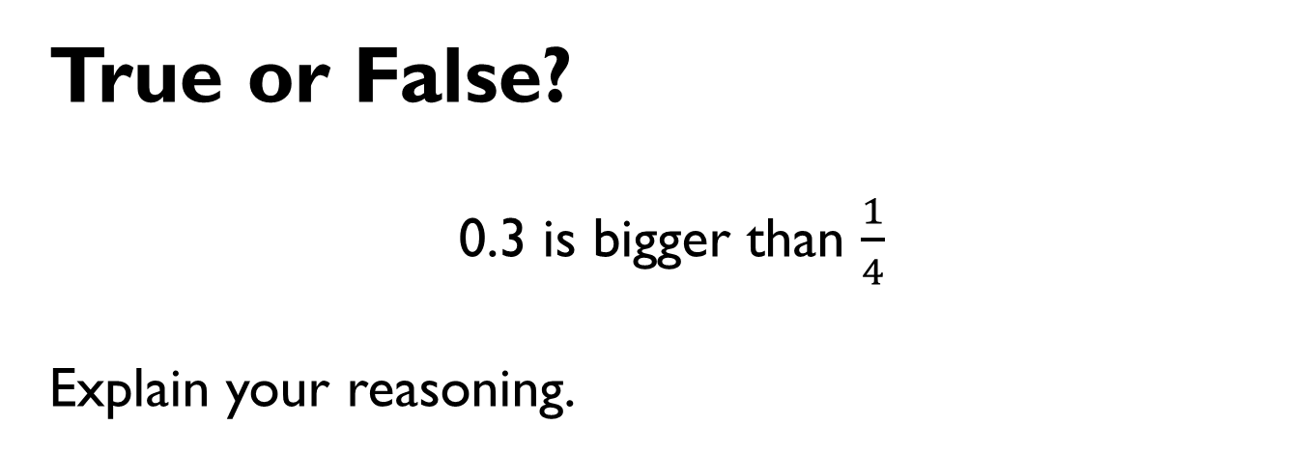
True or False?
0.3 is bigger than $\frac{1}{4}$
Explain your reasoning.

