Slide 1
Friday
WB 8.2.21

Slide 2
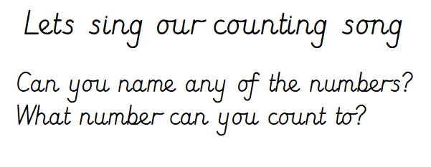
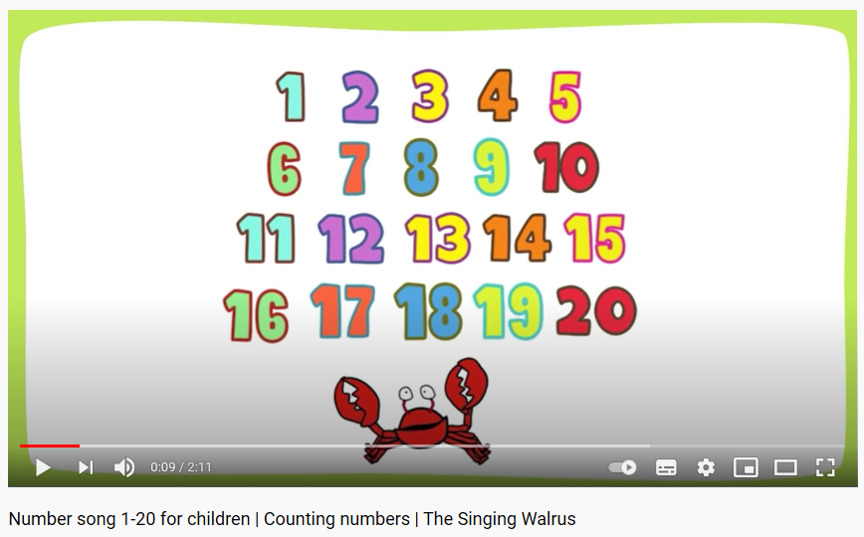
Starter-
https://www.youtube.com/watch?v=D0Ajq682yrA

Slide 3
This week is ‘Games Week’ and we are going to be revising our number work across the week during the main inputs.

Slide 4
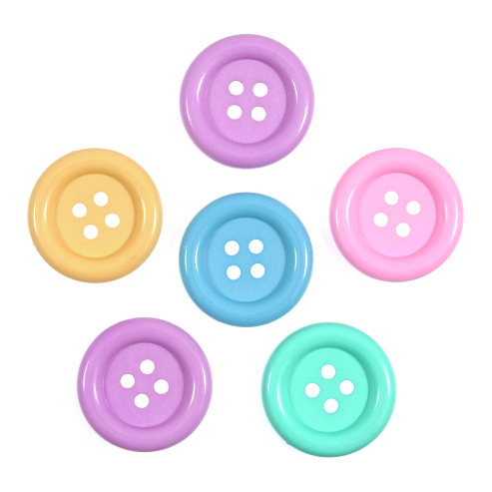
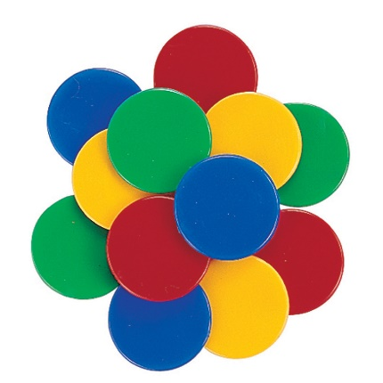
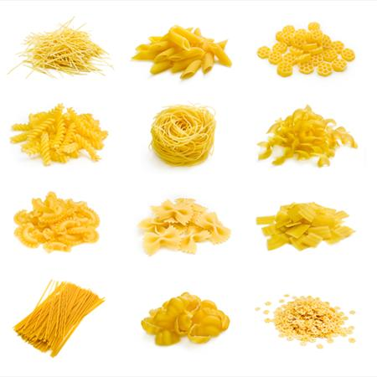
Main Input -Choose a number card and count out the correct amount of objects
Can you make your own number cards from 1-20?
Cut up card into small squares and write them number in the centre.
Place them all number down on a surface – choose a number – use your practical resource to count out that many e.g. I choose the number 7 card … Now I will count out 7 buttons.

Slide 5
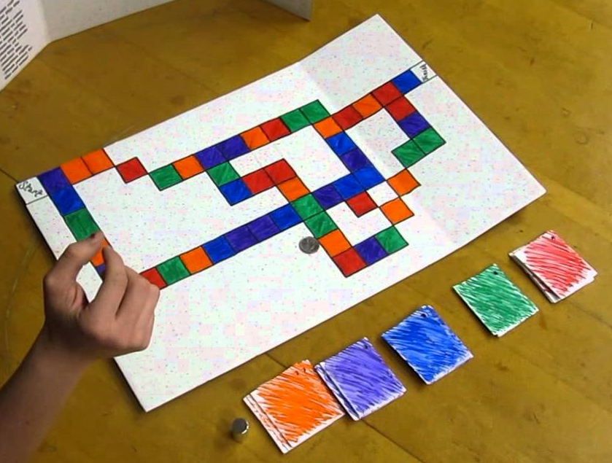
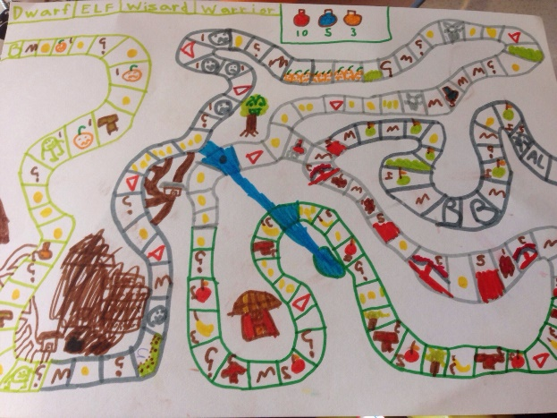
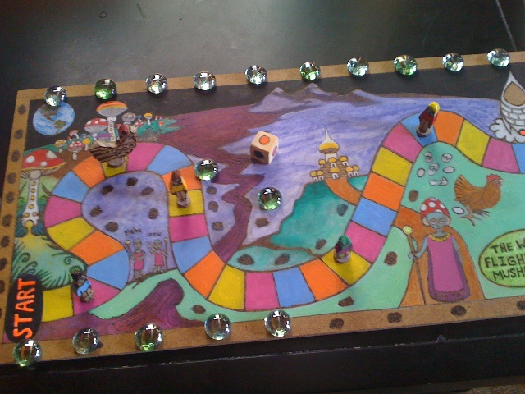
Main Activity –
Today you will design your own board game. Use the games you have played throughout the week to help you create your very own.
Play it with a partner!
Did it work?
What went well with your game?
What could you improve upon next time?

