Slide 1
Monday
WB 8.2.21

Slide 2
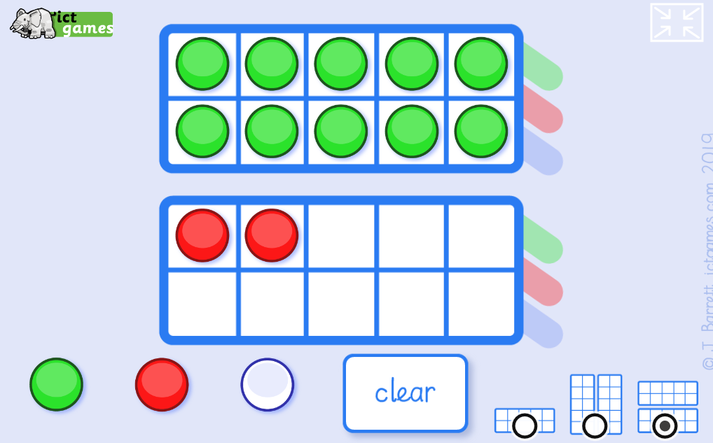
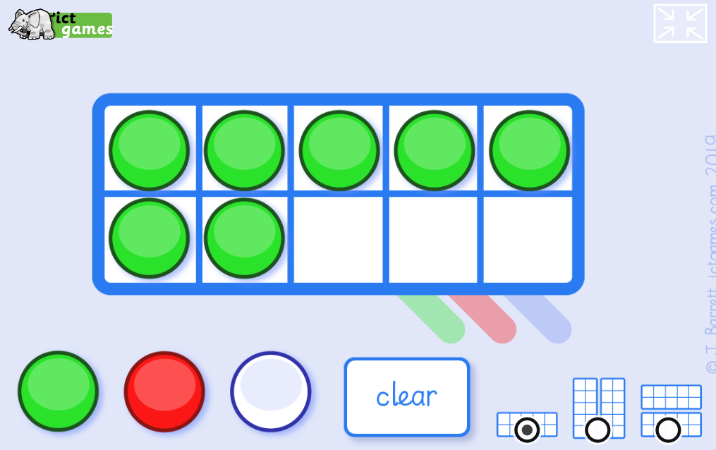
Starter:
Choose a number 1-10. Can you make that number using the tens frame?
Challenge yourself can you make a 2 digit number?
http://www.ictgames.com/mobilePage/tenFrame/index.html
I choose the number 7.
Which teen number have I made.

Slide 3
This week is ‘Games Week’ and we are going to be revising our number work across the week during the main inputs.

Slide 4
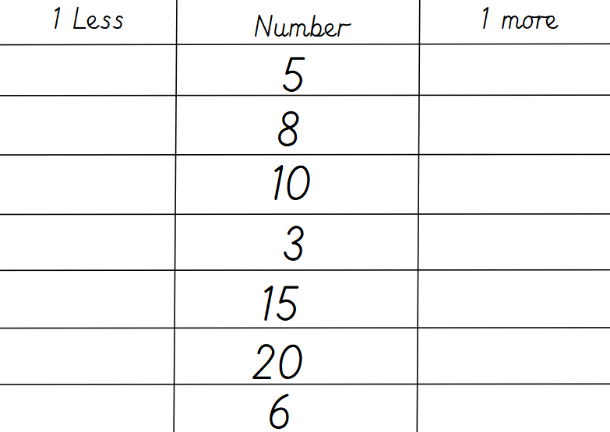
Main Input – Lets revise one more and one less than a given number

Slide 5
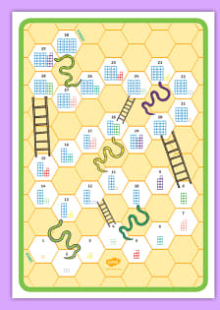
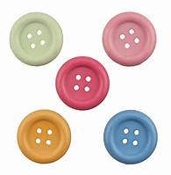
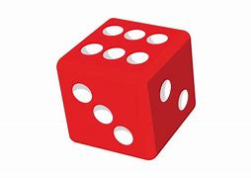
Main Activity – Find some counters from around the house you can use anything you can find – grab a dice, now find a sibling or an adult and have some fun playing Snakes and Ladders.

